Slide 1

Unsupervised Learning and
Image Search
Sung-Eui Yoon
Associate Professor
KAIST
http://sglab.kaist.ac.kr
Notes:
1

Slide 2
Key Messages
Unsupervised learning: perform learning without labels
Commonly start with features computed by unsupervised learning for higher-level supervised learning
There are many ways of performing unsupervised learning including image inpainting
Content based image search as an unsupervised learning approach

Slide 3
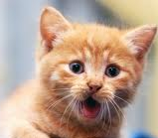
Supervised Learning
Given labeled training examples:
For instance: x^{(i)} = vector of pixel intensities.
y^{(i)} = object class ID.
Goal: find f(x) to predict y from x on training data.
  Hopefully: learned predictor works on “test” data.
255
98
93
87
…
f(x)
y = 1 (“Cat”)
Slides from Adam Coates

Slide 4
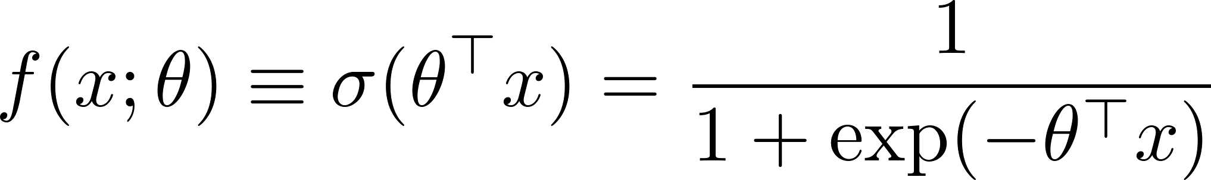

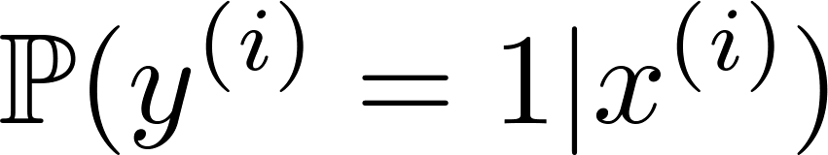
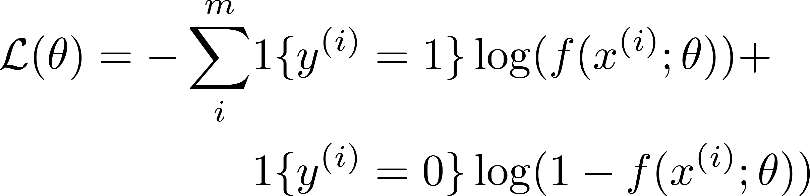
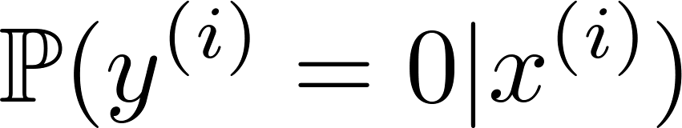
Logistic Regression
Simple binary classification algorithm
  Start with a function of the form:
  Interpretation: f(x) is probability that y = 1.
    Sigmoid “nonlinearity” squashes linear function to [0,1].
  Find choice of that minimizes objective:
1

Slide 5
UNSUPERVISED DL

Slide 6


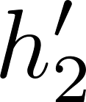
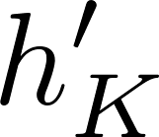
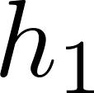
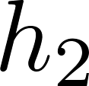
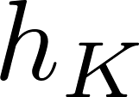



Representation Learning
In supervised learning, train “features” to accomplish top-level objective.
But what if we have too few labels to train all these parameters?

Slide 7
Representation Learning
Can we train the “representation” without using top-down supervision?
Learn a “good” representation directly?

Slide 8
Representation Learning
What makes a good representation?
  Invariant: robust to local changes of input; more abstract.
    E.g., pooled edge features: detect edge at several locations.
  Disentangling factors: put separate concepts (e.g., color, edge orientation) in separate features.
Bengio, Courville, and Vincent (2012)

Slide 9
Supervised Learning
x₂
Its goal is to learn to produce the correct output given a new input.
x
x
x
x
x
x
o
o
o
o
o
o
x₁
Data is labeled
http://mlg.eng.cam.ac.uk/zoubin/course05/lect1.pdf

Slide 10
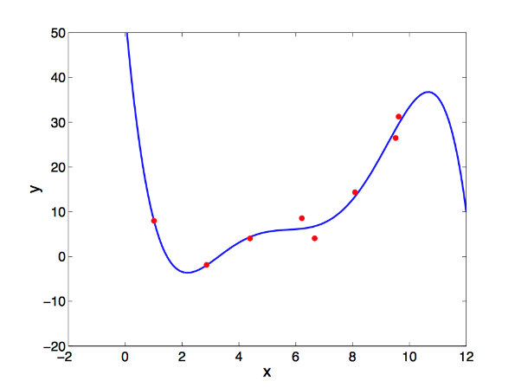
Supervised Learning
x₂
Classification
Output:
discrete class labels
Goal:
classify new inputs correctly
Regression
Output:
continuous values
Goal:
predict the output accurately for new inputs
x
x
x
x
x
x
o
o
o
o
o
o
x₁
http://mlg.eng.cam.ac.uk/zoubin/course05/lect1.pdf

Slide 11
Unsupervised Learning
x₂
Its goal is to build a model that can be used for reasoning, decision making, predicting things, communicating, etc.
For example:
finding clusters
dimensionality reduction
o
o
o
o
o
o
o
o
o
o
o
o
x₁
Data is unlabeled
http://mlg.eng.cam.ac.uk/zoubin/course05/lect1.pdf

Slide 12
Motivation and Strengths:
Unsupervised learning is not expensive and time consuming like supervised learning.
Unsupervised learning requires no human intervention.
Unlabeled data is easy to find with large quantities, unlike labeled data which is scarce.

Slide 13
Weaknesses:
More difficult than supervised learning because there is NO:
  Single objective (like test set accuracy)

Slide 14
Unsupervised Feature Learning
Train representations with unlabeled data.
  Minimize an unsupervised training loss.
    Often based on generic priors about characteristics of good features (e.g., sparsity).
    Usually train 1 layer of features at a time.
  Then, e.g., train supervised classifier on top.
  AKA “Self-taught learning” [Raina et al., ICML 2007]
W

Slide 15
Greedy layer-wise training
Train representations with unlabeled data.
  Start by training bottom layer alone.
W

Slide 16
Greedy layer-wise training
Train representations with unlabeled data.
  When complete, train a new layer on top using inputs from below as a new training set.
W
Forward pass only.

Slide 17


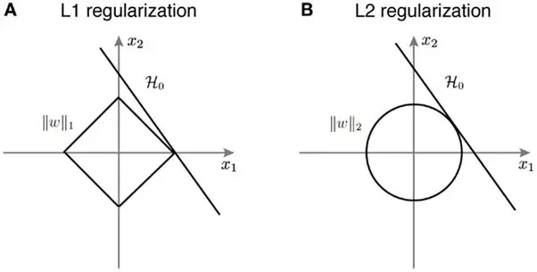
UFL Example
Simple priors for good features:
  Reconstruction: recreate input from features.
  Sparsity: explain the input with as few features as possible.
quora

Slide 18
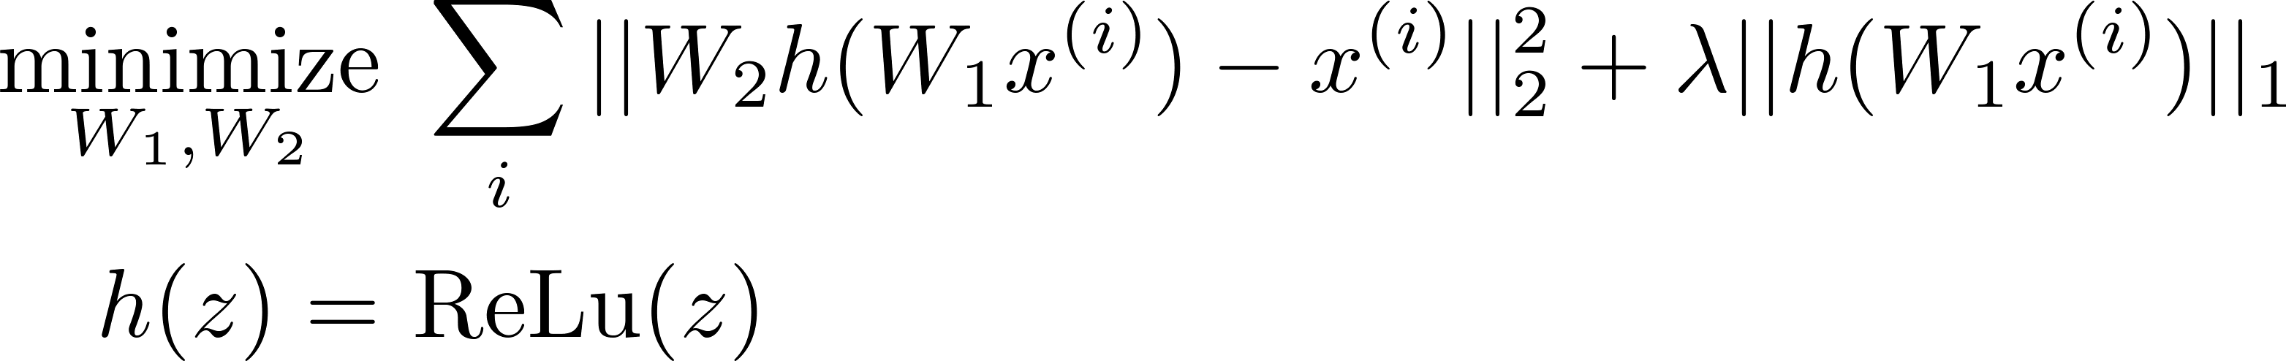
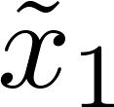
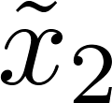
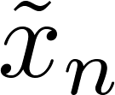
Sparse auto-encoder
Train two-layer neural network by minimizing:
Remove “decoder” and use learned features (h).
W₂
W₁
[Ranzato et al., NIPS 2006]

Slide 19
Nonlinearities
Choice of functions inside network matters.
  Sigmoid function turns out to be difficult.
  Some other choices often used:
tanh(z)
abs(z)
ReLu(z) = max{0, z}
1
1
1
-1
“Rectified Linear Unit”
→ Increasingly popular.
[Nair & Hinton, 2010]

Slide 20
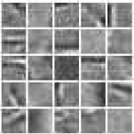
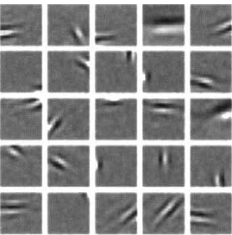


What features are learned?
Applied to image patches, well-known result:
Sparse auto-encoder
[Ranzato et al., 2007]
Sparse coding
[Olshausen & Field, 1996]
Sparse auto-encoder
K-means

Slide 21
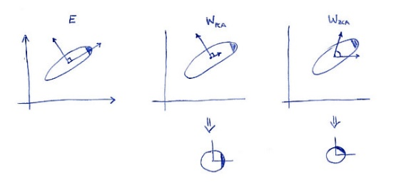

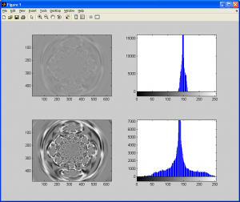
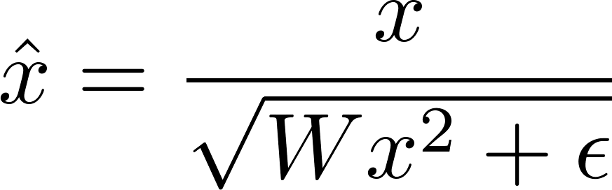
Pre-processing
Unsupervised algorithms more sensitive to pre-processing.
  Whiten your data. E.g., ZCA whitening:
    Transform less to maintain the original distribution
  Contrast normalization often useful.
  Do these before unsupervised learning at each layer.
StackEx
GIASSA.NET
[See, e.g., Coates et al., AISTATS 2011;
Code at www.stanford.edu/~acoates/]

Slide 22
High-level features?
Quite difficult to learn 2 or 3 levels of features that perform better than 1 level on supervised tasks.
  Increasingly abstract features, but unclear how much abstraction to allow or what information to leave out.

Slide 23
Unsupervised Pre-training
Use as initialization for supervised learning!
  Features may not be perfect for task, but probably a good starting point.
  AKA “supervised fine-tuning”.
Procedure:
  Train each layer of features greedily unsupervised.
  Add supervised classifier on top.
  Optimize entire network with back-propagation.
Major impetus for renewed interest in deep learning.
[Hinton et al., Neural Comp. 2006]
[Bengio et al., NIPS 2006]

Slide 24
Unsupervised Pre-training
Pre-training not always useful --- but sometimes gives better results than random initialization.
Results from [Le et al., ICML 2011]:
Image-Net Version | 9M images, 10K classes | 14M images, 22K classes
Without pre-training | 16.1% | 13.6%
With pre-training | 19.2% | 15.8%
Notes: exact classification (not top-5). Random guessing = 0.01%.
See also [Erhan et al., JMLR 2010]

Slide 25
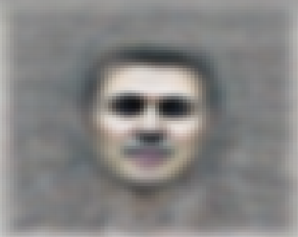
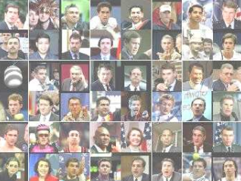
High-level features
Recent work [Le et al., 2012; Coates et al., 2012] suggests high-level features can learn non-trivial concepts with many images/computing power.
  E.g., able to find single features that respond strongly to cats, faces:
[Le et al., ICML 2012]

Slide 26
Other Unsupervised Criteria
Neural networks with other unsupervised training criteria.
  Denoising, in-painting. [Vincent et al., 2008]
  Temporal coherence [Zou et al., NIPS 2012] [Mobahi et al., ICML 2009]
    High-level features change slowly; fixation

Slide 27
Unsupervised Visual Representation Learning by Context Prediction
C. Doersch, A. Gupta, A. A. Efros
ICCV 2015
Semantic labels from humans are expensive.
Do we need semantic labels in order to learn a useful representation?
Slide: Carl Doersch

Slide 28
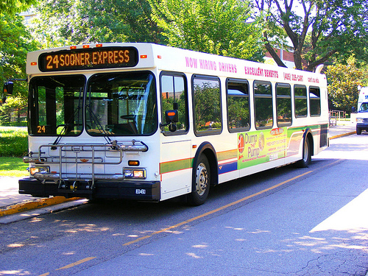
Context Prediction
Given a pair of patches from one image.
Can you say where they go relative to one another?
A
B
Slide: Carl Doersch

Slide 29
Context Prediction for Images
?
?
?
?
?
A
B
?
?
?
Slide: Carl Doersch

Slide 30
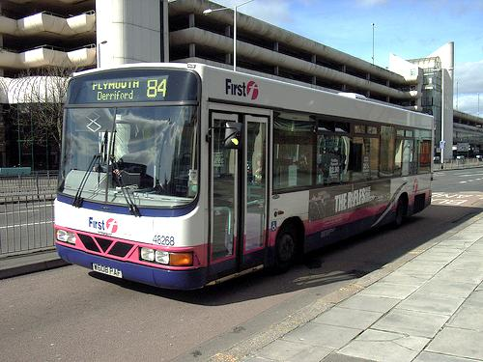
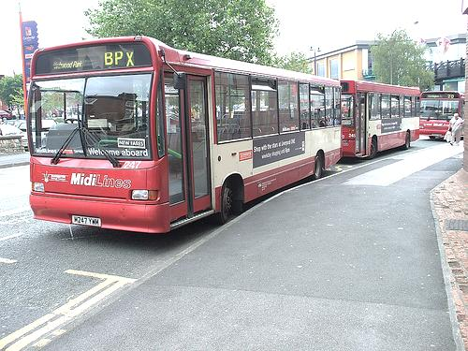
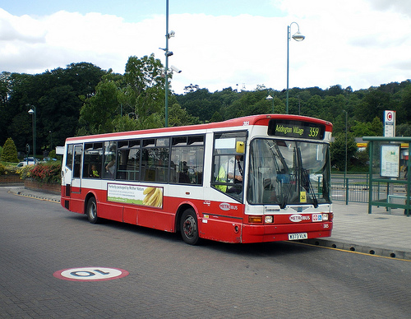
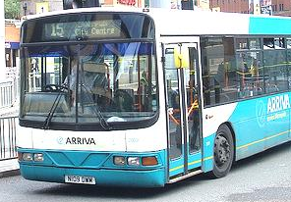
Semantics from a non-semantic task
Slide: Carl Doersch
Notes:
- This is hard if you don’t know what a bus is, but easy if you do.
- We hope that if we give this task to a machine learner, it will also solve it by recognizing semantics.

Slide 31
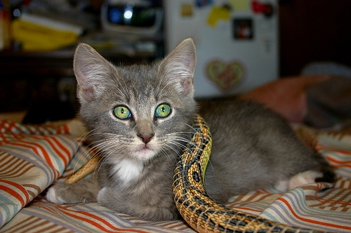
Relative Position Task
unlabeled image
Slide: Carl Doersch
Notes:
- Let’s ask a machine learner to solve this. Given an unlabeled image, we sample one patch uniformly at random, and then a second patch from one of these 8 possible locations relative to the first.
- We then pass both patches to a deep network which is trained to predict which of the 8 classes was sampled.
- Note the structure of this network: we have a relatively complex embedding that happens in parallel for both patches, followed by a relatively simple classifier that receives input from both patches. We expect that this will encourage the network to extract semantics, because that’s what makes life easier for the simple classifier.
- This embedding function can be transferred to other problems

Slide 32
Relative Position Task
8 possible locations
Classifier
CNN
CNN
Randomly Sample Patch
Sample Second Patch
Slide: Carl Doersch
Notes:
- Let’s ask a machine learner to solve this. Given an unlabeled image, we sample one patch uniformly at random, and then a second patch from one of these 8 possible locations relative to the first.
- We then pass both patches to a deep network which is trained to predict which of the 8 classes was sampled.
- Note the structure of this network: we have a relatively complex embedding that happens in parallel for both patches, followed by a relatively simple classifier that receives input from both patches. We expect that this will encourage the network to extract semantics, because that’s what makes life easier for the simple classifier.
- This embedding function can be transferred to other problems

Slide 33
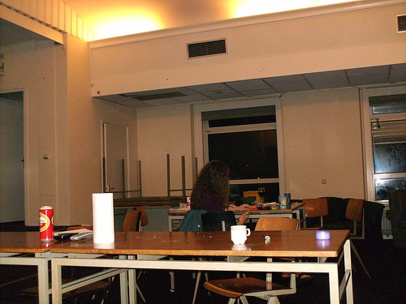
Avoiding Trivial Shortcuts
Ways that the network can solve the problem without really extracting the semantics that we’re after.
Slide: Carl Doersch
Notes:
- The way that we extract the patches is important. The problem is that there are trivial shortcuts: ways that the network can solve the problem without really extracting the semantics that we’re after, like the line in this pair of patches.
- The gap makes it less likely that low-level properties cross both patches
- The jittering makes it harder to match straight lines between two patches

Slide 34
Avoiding Trivial Shortcuts
Include a gap
makes it less likely that low-level properties cross both patches
Jitter the patch locations
makes it harder to match straight lines between two patches
Slide: Carl Doersch
Notes:
- The way that we extract the patches is important. The problem is that there are trivial shortcuts: ways that the network can solve the problem without really extracting the semantics that we’re after, like the line in this pair of patches.
- The gap makes it less likely that low-level properties cross both patches
- The jittering makes it harder to match straight lines between two patches

Slide 35





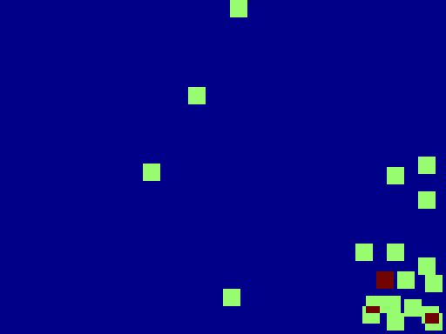

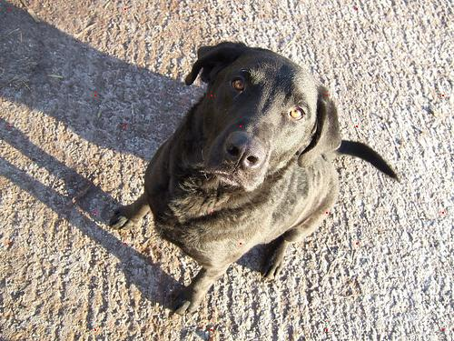

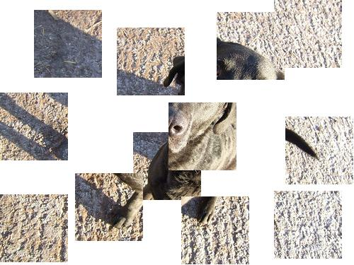


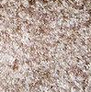




A Not-So “Trivial” Shortcut
CNN
Position in Image
Slide: Carl Doersch
Notes:
- After training for a while, another “trivial” shortcut started to take hold, which was difficult to track down. We first noticed pairs that the net could predict much better than people.
- We found its nearest neighbors were other textures with little else in common
- We then looked at the distribution of where those nearest-neighbor patches were occurring in the original image frame—turned out they were all from the same corner of the image
- Was the network figuring out where the patches were on the image frame? To find out, we trained a separate network to predict the absolute (x,y) coordinates of individual patches.
- For some images (not all), the net predicted very well, even for patches with no semantics in them.

Slide 36
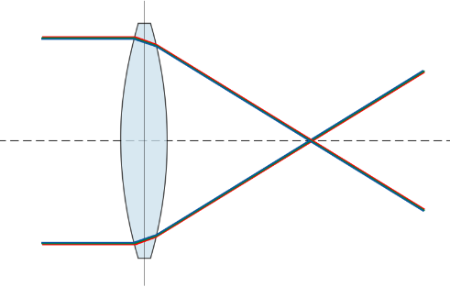


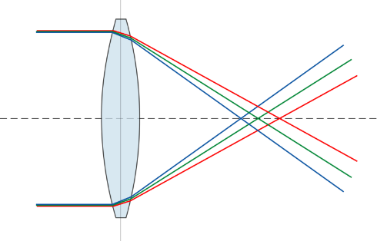
Chromatic Aberration
Chromatic aberration happens when a lens bends different wavelengths at different amount
For common lenses (specifically, the achromatic doublet), the green color channel is shrunk a little bit toward the image center relative to red and blue
Deep nets can detect this subtle shift, which tells the net where a patch is with respect to the lens, and gives away the answer to the relative-position task.
Slide: Carl Doersch
Notes:
- Turns out that the images where this worked were those affected by chromatic aberration
- Chromatic aberration happens when a lens bends different wavelengths a different amount
- For common lenses (specifically, the achromatic doublet), the green color channel is shrunk a little bit toward the image center relative to red and blue
- Deep nets can detect this subtle shift, which tells the net where a patch is with respect to the lens, and gives away the answer to the relative-position task.

Slide 37
Solution
Removing color
In this paper, 2 of the 3 color channels are randomly dropped.
Important lesson:
Deep nets are kind-of lazy. If there’s a way to solve a problem without learning semantics, they may learn to do that instead.
Slide: Carl Doersch
Notes:
There’s various ways to fix this—for example, removing color (for our experiments, we randomly dropped 2 of the 3 color channels).
But there’s a more important lesson: Deep nets are kind-of lazy. If there’s a way to solve a problem without learning semantics, they may learn to do that instead.

Slide 38
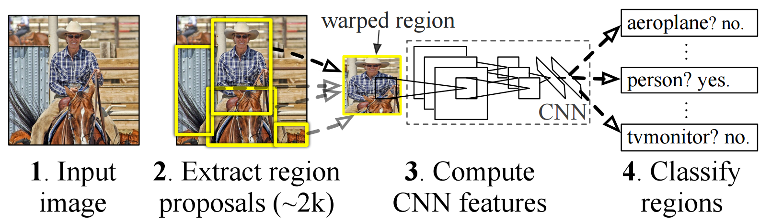
Pre-Training for R-CNN
Pre-train on relative-position task, w/o labels
[Girshick et al. 2014]
Notes:
- If we can mine objects, can we detect them? We adopt the R-CNN pipeline on VOC 2007.

Slide 39
Pascal Object Detection: VOC 2007 Performance
(pretraining for R-CNN)
54.2
% Average Precision
46.3
40.7
ImageNet Labels
Ours
No Pretraining
Slide: Carl Doersch

Slide 40
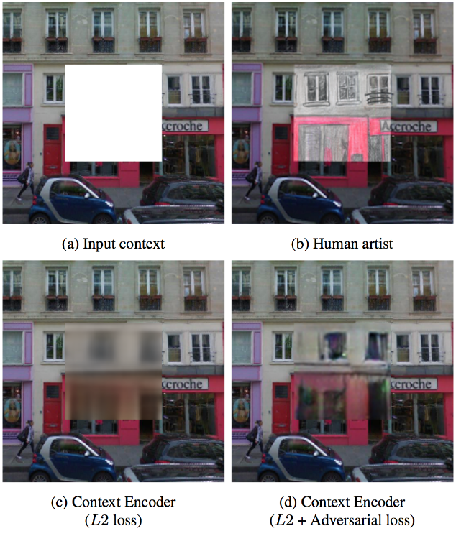
Context Encoders: Feature Learning by Inpainting
D. Pathak, P. Krähenbühl, J. Donahue, T. Darrell, A. A. Efros, CVPR 2016
Inpainting:
The art of restoring missing parts of image.

Slide 41
Context Encoders: Feature Learning by Inpainting
Classical inpainting or texture synthesis approaches are
local non-semantic methods
Hence, they cannot handle large missing region.

Slide 42
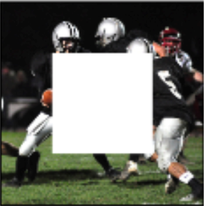
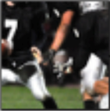
Context Encoders: Feature Learning by Inpainting
Unsupervised semantic visual feature learning
Semantic inpainting
    Input:
    an image with a missing region
    Output:
    the missing region

Slide 43
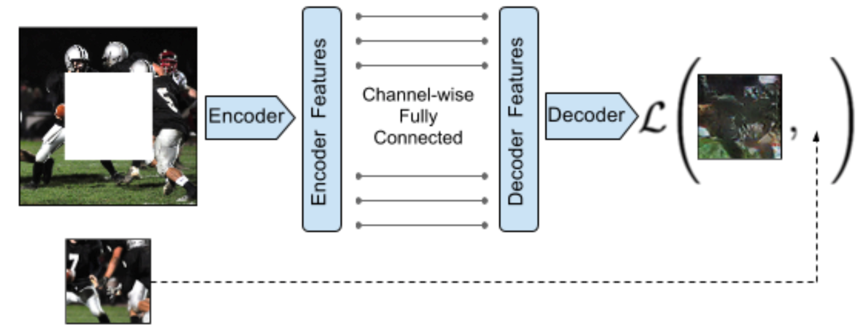
Context Encoders: Feature Learning by Inpainting
Output: a latent feature representation of that image
Input: a latent feature representation of that image
Encoder: captures the context of an image into a compact latent feature representation
Decoder: fill in realistic image content
Output: the missing image content
Input: image with the missing region
Loss function
Ground truth

Slide 44



Loss function
Input
Standard pixel-wise reconstruction loss (L2):
Tries to minimize the distance between the predicted missing region and the ground truth.
produces blurry results
Reconstruction plus an adversarial loss:
Tries to make the predicted missing region as realistic as possible.
Produces much sharper results
L2 loss
L2 + adversarial loss

Slide 45
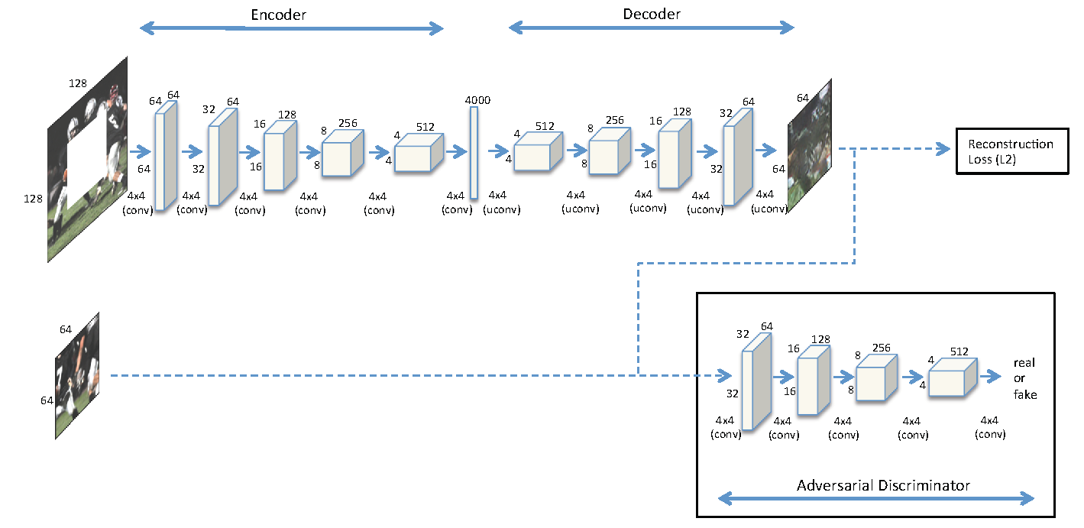
Adversarial Loss
L2 loss
  Return the average out of multiple possible candidates
  Results in blurry images
Uses the context encoder as the generator used in GAN
  GAN seems to pick a mode and make it real
  Uses the adversarial discriminator in a similar architecture of the encoder

Slide 46
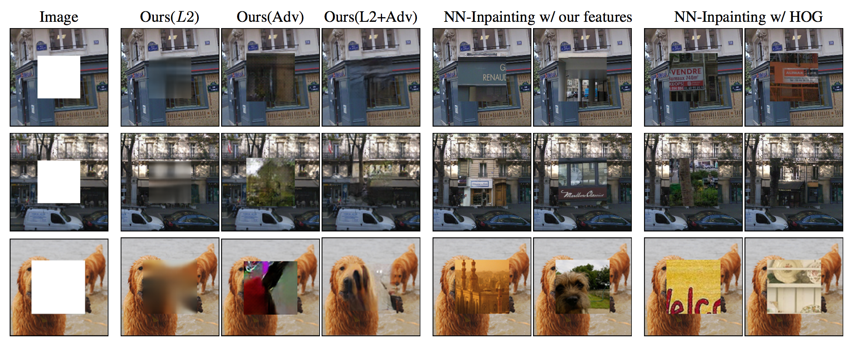
Results of Inpainting
Considers semantics of the overall image and fill the gap
Texture synthesis based approaches work better when textures can be used

Slide 47
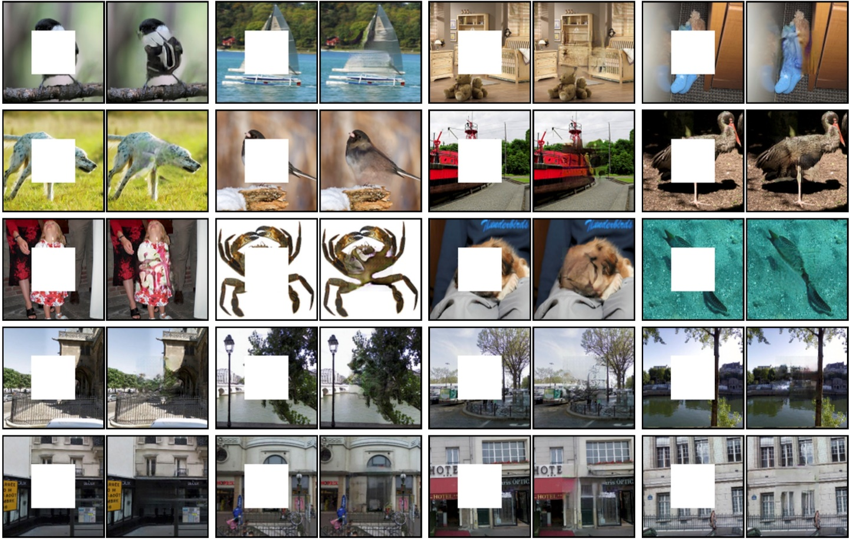
Results:

Slide 48
Feature Learning
Use the context encoder in unsupervised pre-training
Show competitive or better results over prior unsupervised approaches (e.g., autoencoder and self-supervised learning)

Slide 49
Summary
Supervised deep-learning
  Practical and highly successful in practice. A general-purpose extension to existing ML.
Unsupervised deep-learning
  Pre-training often useful in practice.
  Difficult to train many layers of features without labels.
  Some evidence that useful high-level patterns are captured by top-level features.

