Slide 1

Mid-term presentation:
Novel Learning and Sampling-based Motion Planner for High-Dimensional Robotic System
Minh-Tuan Tran - Andrea Finazzi - Shinjeong Kim
2020.11.12
Notes:
1
Hi. We are team 2 and we are Minh, Andrea and Shinjeong, and I’m Shinjeong Kim, the first presenter. We’ll talk about our novel learning and sampling-based motion planner for high-dimensional robotic system.

Slide 2
Content
I. Introduction
II. Background and Relative work
III. Problem of Current Technique
IV. Proposed Method
V. Role of Members
Notes:
Here’s the contents.

Slide 3
I. Introduction
1. Motion Planning Problem
2. Motion planning application
3. Motion Planning for High-dimensional Robotic System
Notes:
First, I’ll briefly introduce you the problem that we will deal with. For this, I’ll briefly touch what motion planning is, and their applications, and a specific subproblem of motion planning which we’ll solve.

Slide 4
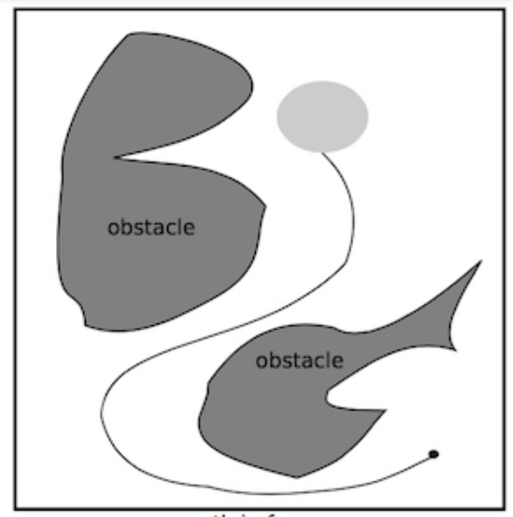




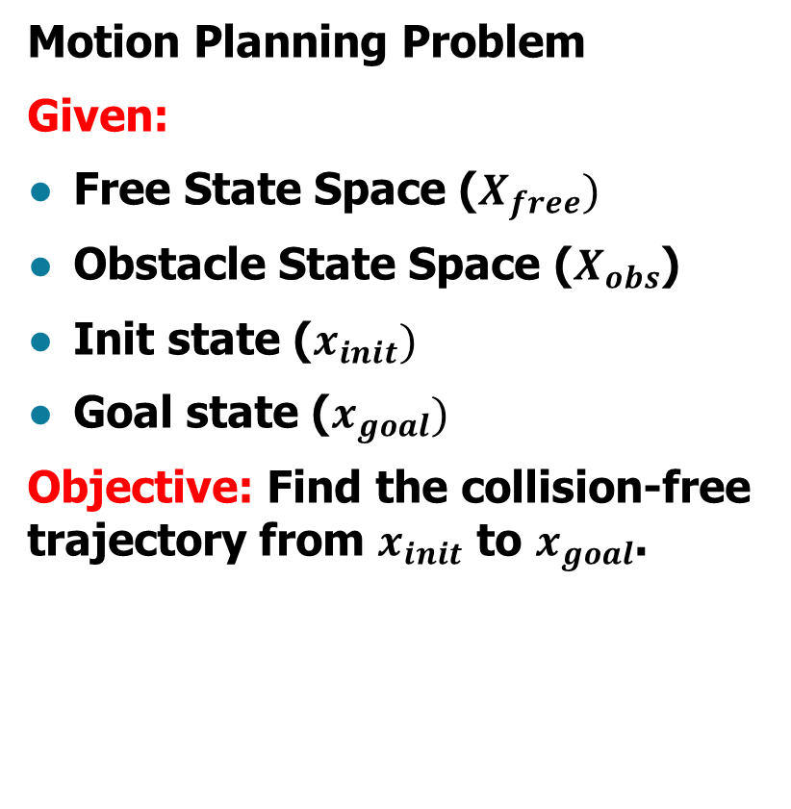
1. Motion Planning Problem
$$X_{obs}$$
$$X_{free}$$
Motion Planning Problem
Given:
Free State Space ($X_{free})$
Obstacle State Space ($X_{obs}$)
Init state ($x_{init})$
Goal state ($x_{goal})$
Objective: Find the collision-free trajectory from $x_{init}$ to $x_{goal}$.
$$x_{goal}$$
collision-free
trajectory
$$x_{init}$$
Notes:
As you know, the goal of motion planning problem is finding collision-free path from start to goal state, given the states along with the map.

Slide 5
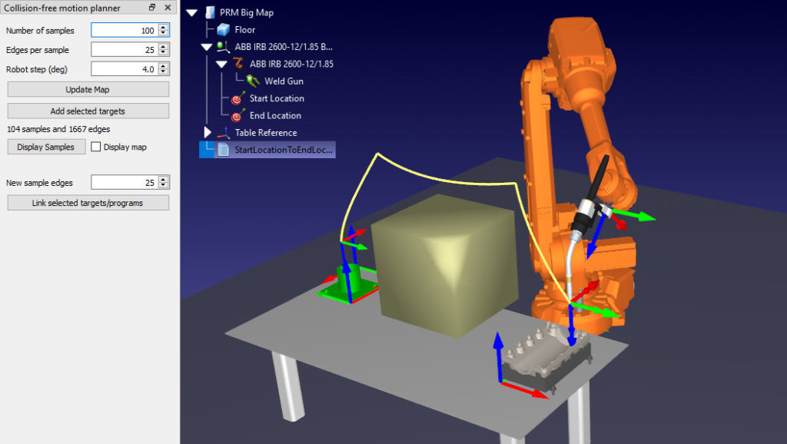
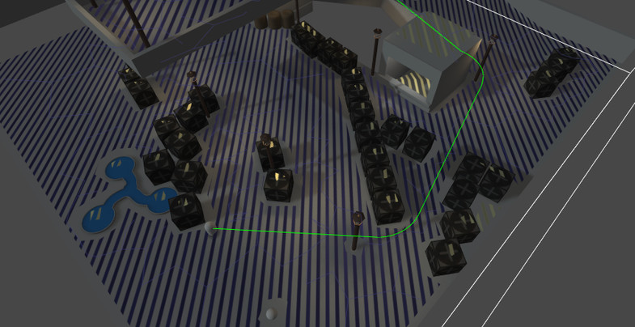
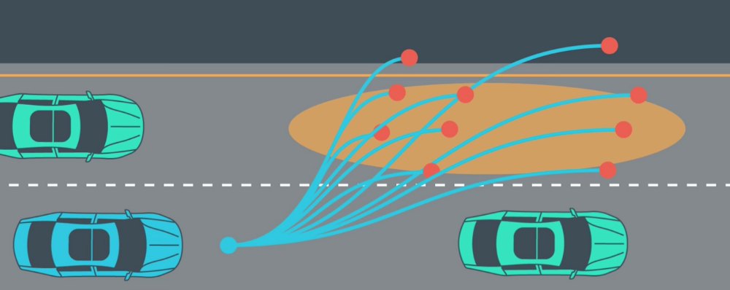
2. Motion planning application
Robot
Game NPC
Autonomous Driving
Notes:
Some of the applications of motion planning are robotics, non-player characters of games, and autonomous driving. And these make motion planning problem very important.
Left top : https://robodk.com/blog/motion-planning-trend/
Right top : https://www.google.com/url?sa=i&url=https%3A%2F%2Fassetstore.unity.com%2Fpackages%2Ftools%2Fai%2Fa-pathfinding-project-pro-87744%3Flocale%3Dko-KR&psig=AOvVaw2osRhDlqKRk0Y9-rdv_42l&ust=1605175576368000&source=images&cd=vfe&ved=0CAIQjRxqFwoTCJD9xoWg-uwCFQAAAAAdAAAAABAf
Bottom : https://medium.com/udacity/self-driving-path-planning-brought-to-you-by-udacity-students-13c07bcd4f32

Slide 6
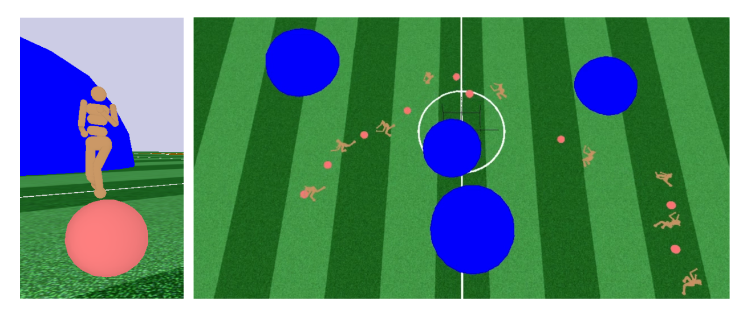
3. Motion Planning for High-dimensional Robotic System
Humanoid Robot
Humanoid Robot in OpenAI Roboschool have 50 DOF.
Notes:
Specifically, when dealing with robots, we usually have to consider very high degree of freedom. This picture is from one of our backgrounds, a paper named “Robot Motion Planning in Learned Latent Space” which dealt with 50 degree of freedom robot.

Slide 7
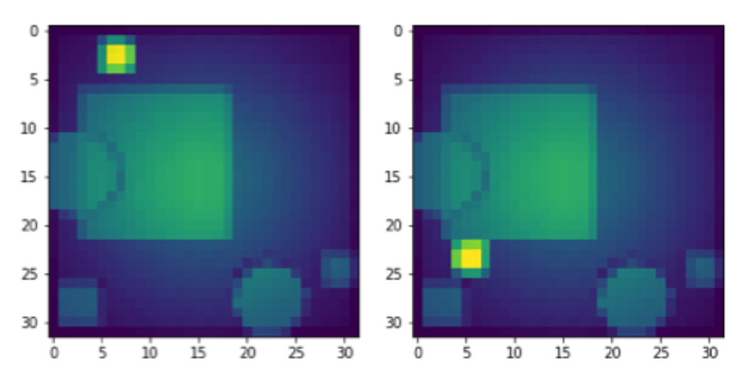
3. Motion Planning for High-dimensional Robotic System
MuJoCo Visual planning
Full state is 32x32 pixel image
Existing approaches did not succeed to manage high DOF
A high performance, novel approach for high-dimensional C-space is necessary.
Notes:
Also, these figures show two states of visual planning problem given in the same paper. This problem has 32 * 32 pixel image as a state, thus the dimension of C-space is 1024.
As far as we know, some existing methods dealt with these kinds of high dimensional C-space with very long running time. And the others dealt with lower dimensional C-space with short running time. That is, these kinds of problems are beyond the reach of existing method. Thus, a novel approach is needed, which can not only deal with high-dimensional C-space, but also has a high performance in terms of speed.

Slide 8
II. Background and Relative work
2. Deeply Informed Neural Sampling (DeepSMP)
4. Learning Sampling Distributions
5. Learning Critical Regions
6. Learned Latent Rapidly-exploring Random Trees (L2RRT)
1. RRT and RRT*
3. Motion Planning Network
Notes:
Now, I’ll talk about the backgrounds and relative works. We have not enough time to talk about everything in details, so I’ll very briefly touch the key ideas of each algorithm.

Slide 9



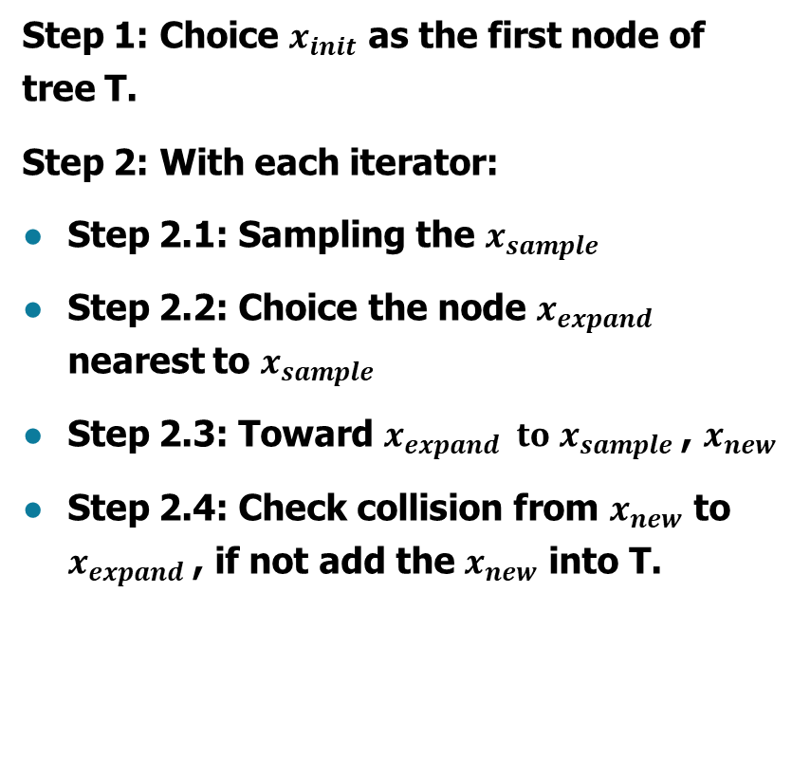



1. RRT and RRT*
a. Rapidly-exploring Random Tree (RRT)
Step 1: Choice $x_{init}$ as the first node of tree T.
Step 2: With each iterator:
Step 2.1: Sampling the $x_{sample}$
Step 2.2: Choice the node $x_{expand}$ nearest to $x_{sample}$
Step 2.3: Toward $x_{expand} to x_{sample}$, $x_{new}$
Step 2.4: Check collision from $x_{new}$ to $x_{expand}$, if not add the $x_{new}$ into T.
$$x_{goal}$$
$$x_{expand}$$
$$x_{new}$$
$$x_{sample}$$
$$x_{init}$$
Notes:
First, let me explain RRT. We start with the initial configuration as the only tree node. (다음) As you know, we first randomly sample a configuration (다음), and choose a nearest node from current tree of configuration(다음, 다음). Then we expand the tree from the nearest node to randomly sampled configuration. (다음)

Slide 10
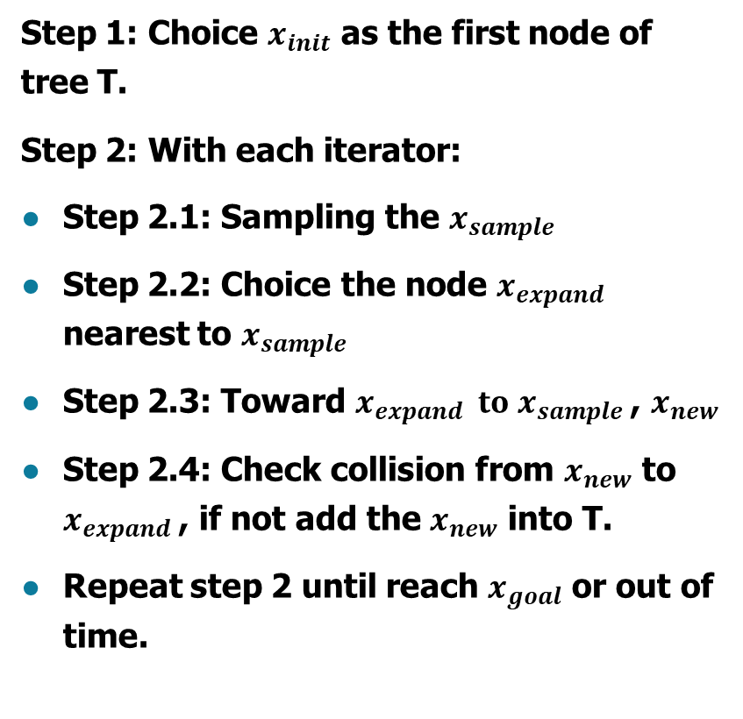

1. RRT and RRT*
a. Rapidly-exploring Random Tree (RRT)
Step 1: Choice $x_{init}$ as the first node of tree T.
Step 2: With each iterator:
Step 2.1: Sampling the $x_{sample}$
Step 2.2: Choice the node $x_{expand}$ nearest to $x_{sample}$
Step 2.3: Toward $x_{expand} to x_{sample}$, $x_{new}$
Step 2.4: Check collision from $x_{new}$ to $x_{expand}$, if not add the $x_{new}$ into T.
Repeat step 2 until reach $x_{goal}$ or out of time.
$$x_{goal}$$
Notes:
We repeatedly do this until the tree reaches to the goal area. (다음 슬라이드)

Slide 11
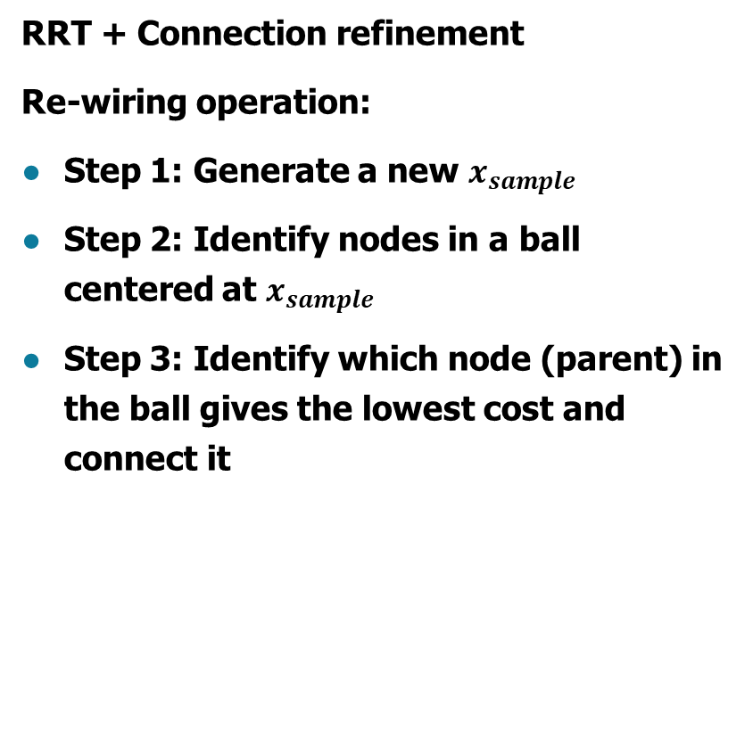
1. RRT and RRT*
b. RRT*
RRT + Connection refinement
Re-wiring operation:
Step 1: Generate a new $x_{sample}$
Step 2: Identify nodes in a ball centered at $x_{sample}$
Step 3: Identify which node (parent) in the ball gives the lowest cost and connect it
Notes:
Although RRT has probabilistic completeness, it does not converge to optimal path. Thus, rewiring operation was introduced to modify the tree to get optimal path. And this is the key difference between RRT and RRT*. Let me briefly explain this operation.
Rewiring operation replaces expand operation from RRT. So, we have to first sample a new configuration. Then we consider a ball centered at the sample. Among configurations in the ball, we find the one that makes the nearest path when connected to the sample. Then, we choose configuration with the nearest path and connect the configuration with sampled one. (다음 슬라이드)

Slide 12
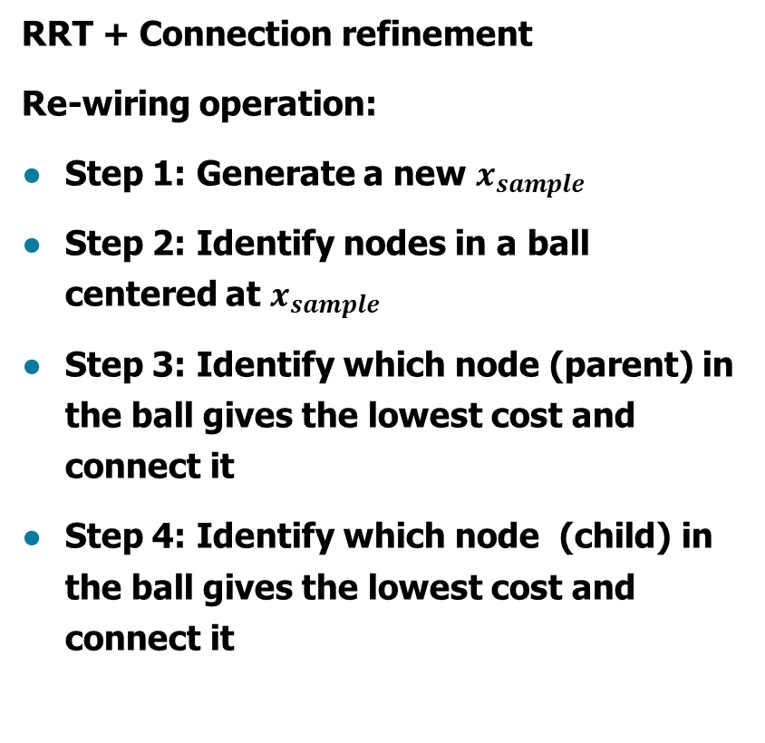
1. RRT and RRT*
b. RRT*
RRT + Connection refinement
Re-wiring operation:
Step 1: Generate a new $x_{sample}$
Step 2: Identify nodes in a ball centered at $x_{sample}$
Step 3: Identify which node (parent) in the ball gives the lowest cost and connect it
Step 4: Identify which node (child) in the ball gives the lowest cost and connect it
Notes:
Next, by re-considering each other configuration in the ball, we also connect them with the new path when it gives lower cost then current path.
Although RRT and RRT* are basic, we had to introduce them since they are used widely in backgrounds of our method.

Slide 13
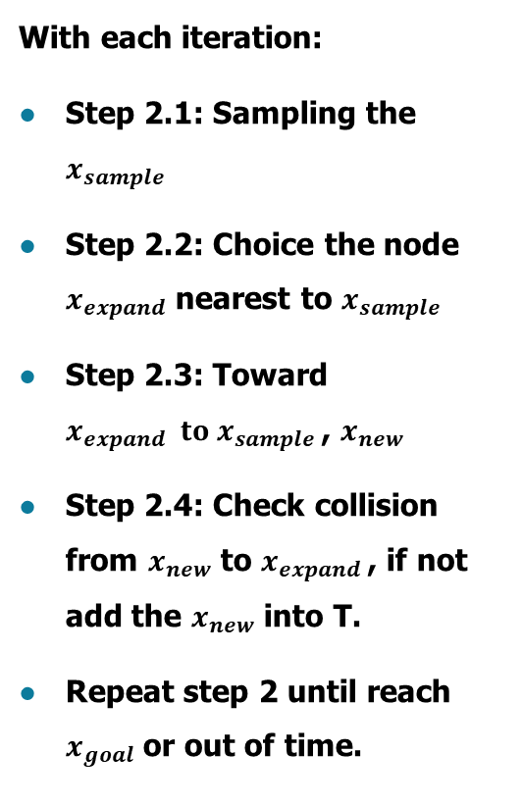
Trend in improving RRT method
With each iteration:
Step 2.1: Sampling the $x_{sample}$
Step 2.2: Choice the node $x_{expand}$ nearest to $x_{sample}$
Step 2.3: Toward $x_{expand} to x_{sample}$, $x_{new}$
Step 2.4: Check collision from $x_{new}$ to $x_{expand}$, if not add the $x_{new}$ into T.
Repeat step 2 until reach $x_{goal}$ or out of time.
Use autoencoder to project the state to a lower-dimension representation
Use some technique to generate the non-uniform sampling
Use the dynamic network to predict the next state
Use the neural network to check collision-free.
Notes:
Before introducing more direct backgrounds of our method, let me introduce recent trends to improve RRT and other sampling-based methods.
We found that many papers do not use C-space directly. Instead, they use autoencoder to project the state to a lower-dimensional representations.
Also, they introduced adaptive sampling, that is, they don’t uniformly sample the states; instead, they priory sample from more useful regions.
Furthermore, to determine next states, many papers used stochastic networks. And some of the methods used neural networks to check collisions.

Slide 14

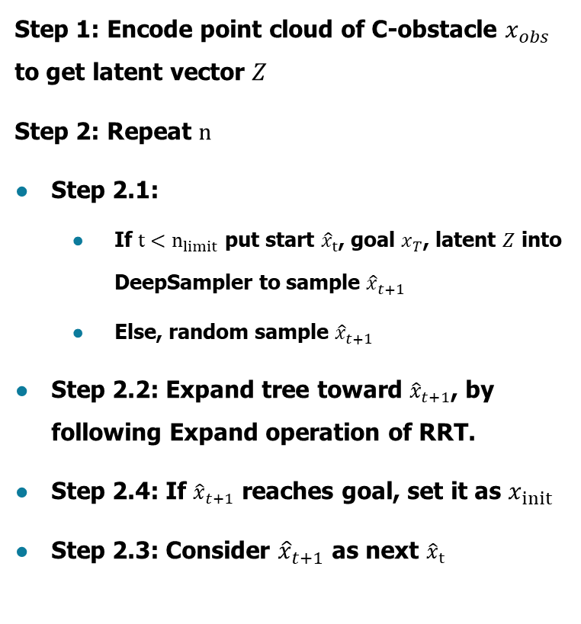


2. Deeply Informed Neural Sampling (DeepSMP)
Step 1: Encode point cloud of C-obstacle $x_{obs}$ to get latent vector $Z$
Step 2: Repeat $n$
Step 2.1:
  If $t<n_{limit}$ put start ${\hat{x}}_{t}$, goal $x_{T}$, latent $Z$ into DeepSampler to sample ${\hat{x}}_{t+1}$
  Else, random sample ${\hat{x}}_{t+1}$
Step 2.2: Expand tree toward ${\hat{x}}_{t+1}$, by following Expand operation of RRT.
Step 2.4: If ${\hat{x}}_{t+1}$ reaches goal, set it as $x_{init}$
Step 2.3: Consider ${\hat{x}}_{t+1}$ as next ${\hat{x}}_{t}$
$$x_{obs}$$
1.
Encoder
2.
$$(x_{T},{\hat{x}}_{t},Z)$$
DeepSampler
$${\hat{x}}_{t+1}$$
Neural Sampling
Notes:
Now, let me give you more direct backgrounds of our approach.
Let me explain “Deeply Informed Neural Sampling”.
In this paper, an encoder is used to project point cloud map into a compact latent space instead of using the map directly. Also, this paper introduced DeepSampler, which takes current state, goal state and latent vector of the map to generate next state. DeepSampler made up of stochastic deep feedforward network trained by paths from RRT*.
The authors claim that this framework can be used for any sampling-based approach, but they only used RRT* for the backbone. So just note that they replaced uniform sampling with DeepSampler, from RRT*. That is, they mixed learning based approach and sampling based approach.
This method greatly improved running time for planning up to 6 degree-of-freedom robot; however, this method cannot deal with higher dimensional C-space. It is because they only encode the map and does not sample from latent space, meaning that they do not fully utilize the latent space.
From the next method, Andrea will continue our presentation.

Slide 15
3. Motion Planning Networks
Two learning modules:
Encoder Network: observation encoding
Planning Network: next configuration
100% success rate if combined with SMP for worst case scenario

Slide 16
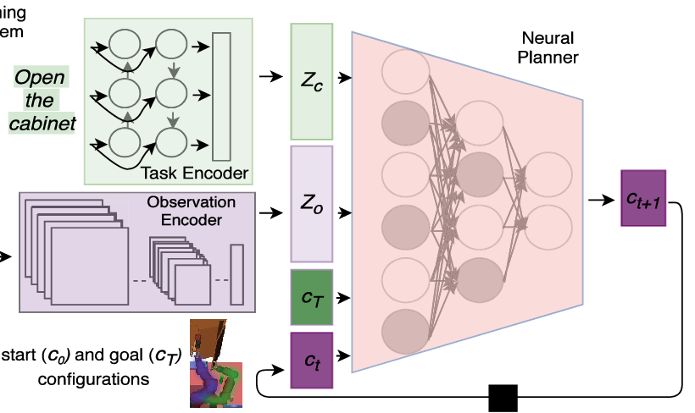
3b. Constrained Motion Planning Networks
Extension of MPNet, it has 3 learning modules:
Task Encoder: task encoding
Observation Encoder: observation encoding
Planning Network: next configuration

Slide 17
3b. Constrained Motion Planning Networks
Key features:
High performance even with hard kinematic constraints.
Trained with SMP-generated trajectories
Generalizes well in unseen environments

Slide 18
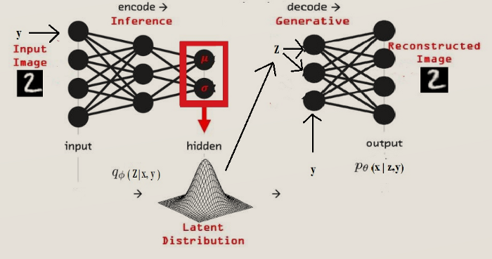
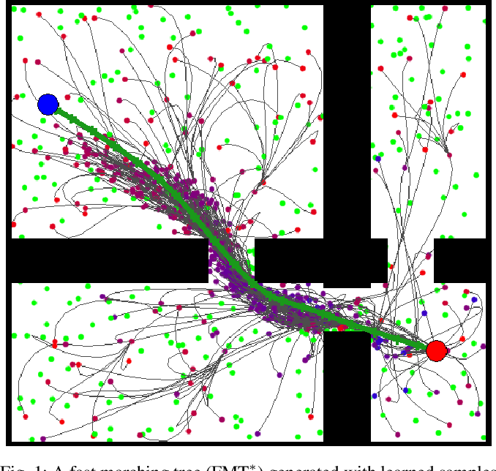
4. Learning Sampling Distributions
It exploits Conditional Variational Autoencoder to generate samples
Understanding Conditional Variational Autoencoders – towarddatascience.com

Slide 19
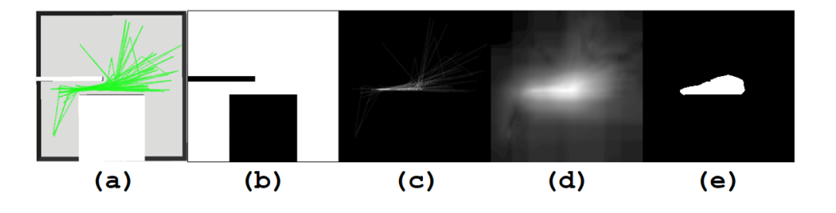
5. Learning Critical Regions
This approach consists of two steps:
Step 1: Generate training data:
  Step 1.1: With each environment, generate the problems until it fully cover the environment’s critical region.
  Step 1.2: RRT-Connect generate the near-optimal path for each problem. (Figure a)

Slide 20
5. Learning Critical Regions
  Step 1.3: Get the post raster scan for each problem. (Figure b) with black pixel is obstacle.
  Step 1.4: Assign a pixel value based on the µ-criticality of its region. (Figure c)
  Step 1.5: Use the Itti’s saliency model to extract salient information and smooth out the salient areas (Figure d)
  Step 1.6: Divide the map salient map in 1.5 into two labels: high saliency (while) and low saliency (black) (Figure e)

Slide 21
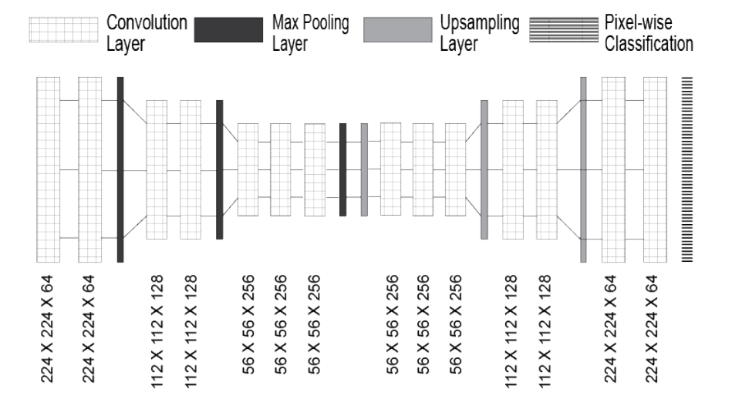
5. Learning Critical Regions
Output image with critical region
Input MP problem image
Step 2: Training model: In that, they use the CNN Autoencoder to predict each pixel in input image is high saliency or low saliency.

Slide 22
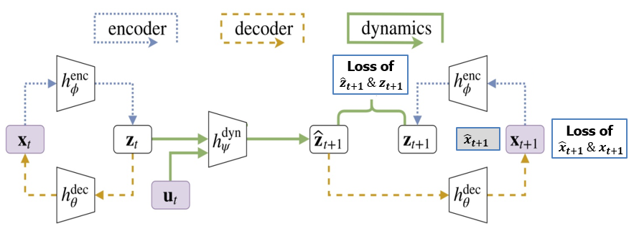
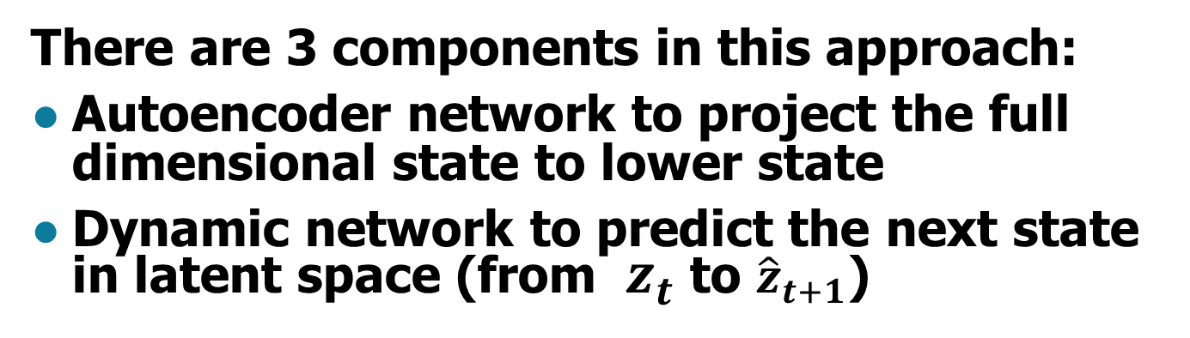
6. Learned Latent Rapidly-exploring Random Trees (L2RRT)
There are 3 components in this approach:
Autoencoder network to project the full dimensional state to lower state
Dynamic network to predict the next state in latent space (from ${ z}_{t}$ to ${\hat{z}}_{t+1}$)
Notes:
Both of those components are trained together with two different loss function!

Slide 23
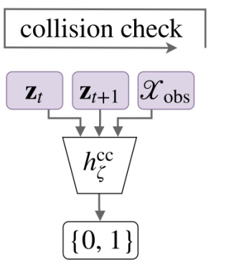

6. Learned Latent Rapidly-exploring Random Trees (L2RRT)
Checking collision network to identify whether $z_{t}$ and ${ z}_{t+1}$ is collision-free

Slide 24
6. Learned Latent Rapidly-exploring Random Trees (L2RRT)
The main idea of this method is project all of high-dimensional state to lower state and work all other procedure in this lower state.
From that, they can address the very high-dimensional robotic system such as Visual Planning and Humanoid Robot.

Slide 25
III. Problem of Current Technique
 | RRT | RRT* | LSD | LCR | DeepSMP | MPNet | L2RRT
Good performance |  | x | x | x | x | x
Formal completeness or optimality guarantees | x | x | x | x | x | x
Suitable for high-dimensional robot system |  |  |  |  |  |  | x
In review methods, there are only L2RRT is suitable for high-dimensional robot system, but it have not good enough performance.
It is required the better motion planner which can adapt with high-dimensional c-space

Slide 26
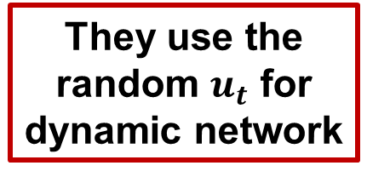
III. Problem of Current Technique
What is the main weak point of L2RRT
They use the random $u_{t}$ for dynamic network
Both of those loss function just use for checking whether latent predicted state is correct with real predicted state
So that, this approach just lead the dynamic network to learn the path of the random sampling. To improve that, we can adapt the neural network-based adaptive sampling for this case.

Slide 27
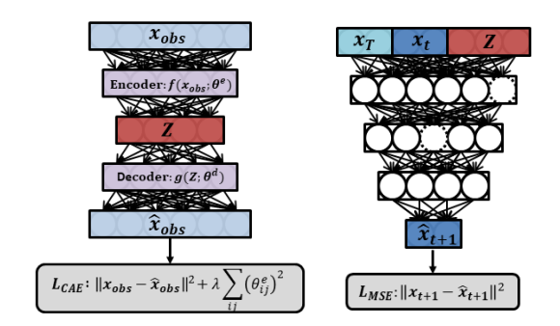
IV. Proposed Method
1. Post training for full state predictor:
ObsEncoder
DeepSampler
With the training data will be generated from the near-optimal path of L2RRT

Slide 28
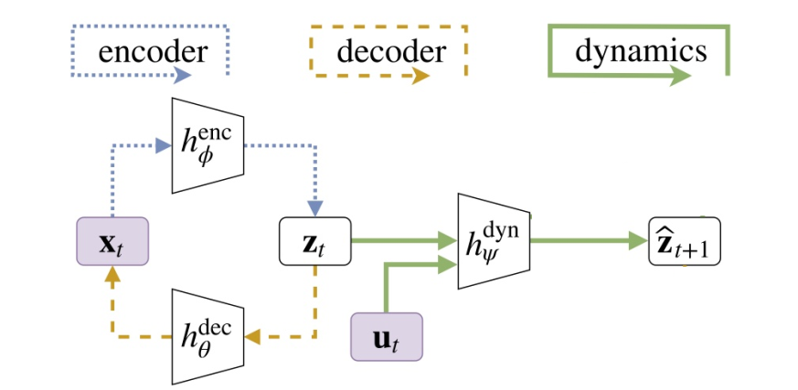
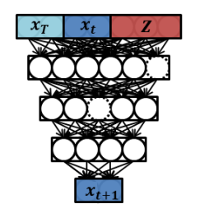
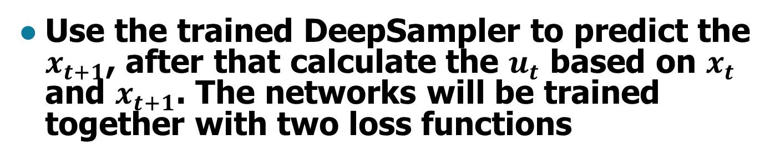
IV. Proposed Method
2. L-SBMP training:
Use the trained DeepSampler to predict the $x_{t+1}$, after that calculate the $u_{t}$ based on $x_{t}$ and $x_{t+1}$. The networks will be trained together with two loss functions

Slide 29
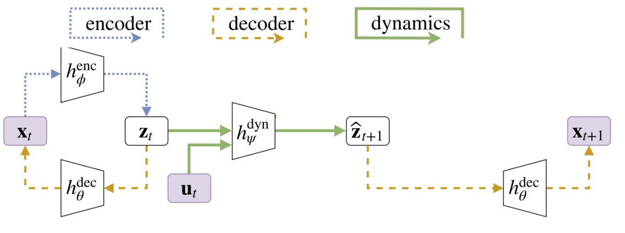
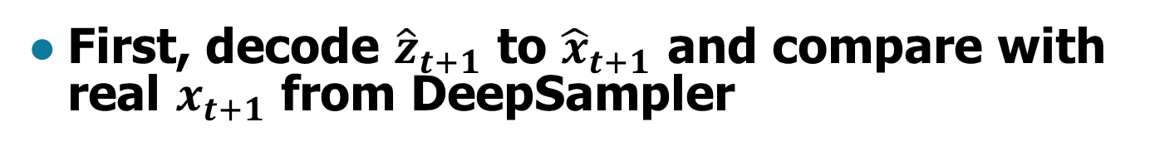


IV. Proposed Method
2. L-SBMP training:
$${\hat{x}}_{t+1}$$
Loss of
$${\hat{x}}_{t+1} \&{ x}_{t+1}$$
First, decode ${\hat{z}}_{t+1}$ to ${\hat{x}}_{t+1}$ and compare with real $x_{t+1}$ from DeepSampler

Slide 30
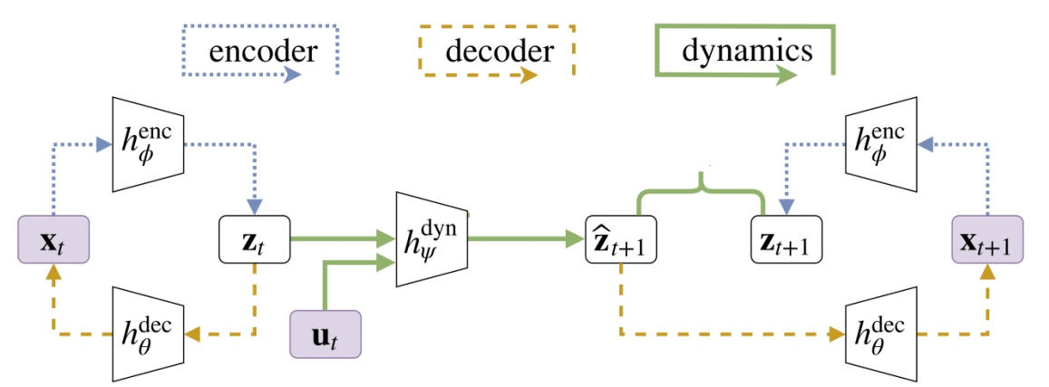
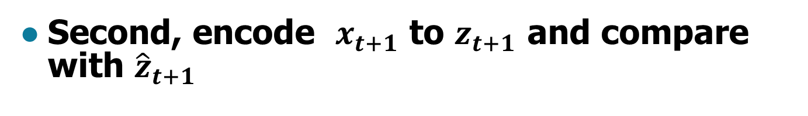



IV. Proposed Method
2. L-SBMP training:
Loss of
$${\hat{z}}_{t+1} \&{ z}_{t+1}$$
$${\hat{x}}_{t+1}$$
Loss of
$${\hat{x}}_{t+1} \&{ x}_{t+1}$$
Second, encode $x_{t+1}$ to $z_{t+1}$ and compare with ${\hat{z}}_{t+1}$

Slide 31

IV. Proposed Method
2. L-SBMP training:
Finally, We also have checking collision network to identify whether $z_{t}$ and ${ z}_{t+1}$ is collision-free

Slide 32
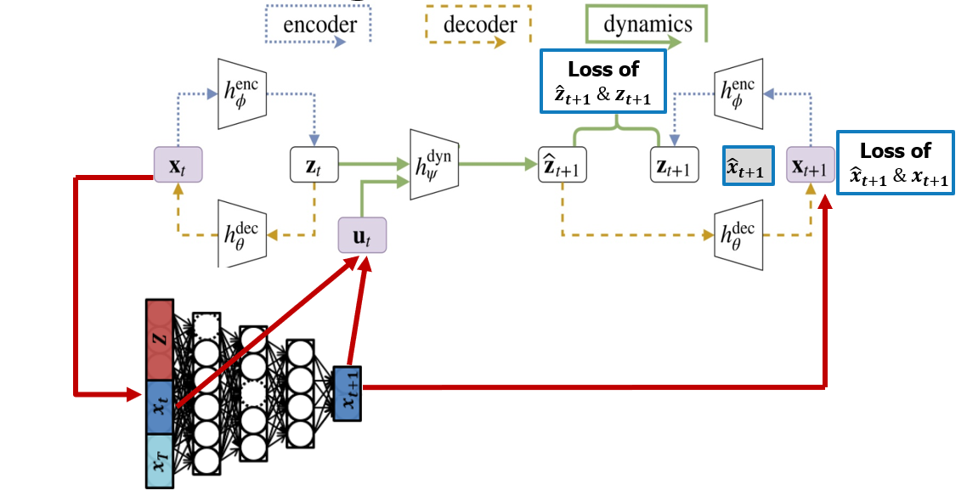
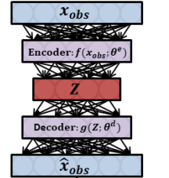
IV. Proposed Method
With this model, We can utilize both the efficiency of neural network-based predictors and the suitability for high-dimensional C-space of L2RRT.

Slide 33
V. Role of Members
Member | Role
Shinjeong Kim | Review: RRT, RRT*, Deep Informed Neural Sampling Write the Introduction Section and a part of Relative work section Discuss about proposed method
Andrea Finazzi | Review: Motion planning network and Learning Sampling Distributions Write a part of Relative work section Discuss about proposed method
Minh-Tuan Tran | Review: Motion planning network and Learning Sampling Distributions Write a part of Relative work section and Proposed method Discuss about proposed method

