Slide 1
CS686: Robot Motion Planning and Applications
Curiosity Driven Learning with Imagination
Changho Jo
(조창호)
Notes:
1

Slide 2
Index
Motivation
Goal
Experiment
Discussion
Summary

Slide 3
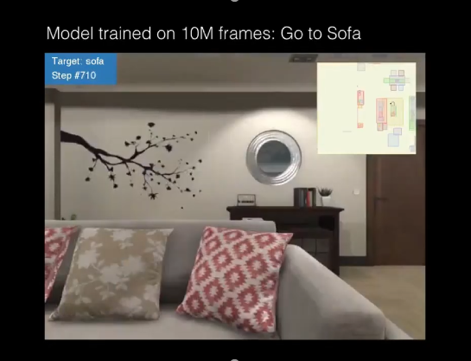
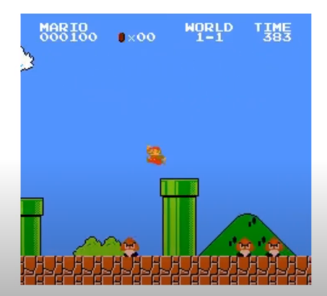
Motivation
Curiosity-based RL is cool and more human-like.
https://www.youtube.com/watch?v=eOuonMhEsxI: Target-driven Visual Navigation in Indoor Scenes using Deep Reinforcement Learning, ICRA 2017, Yuke Zhu
https://github.com/openai/large-scale-curiosity

Slide 4
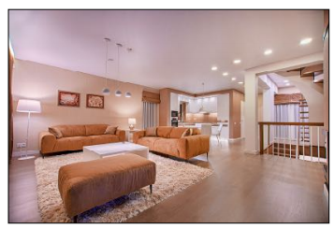
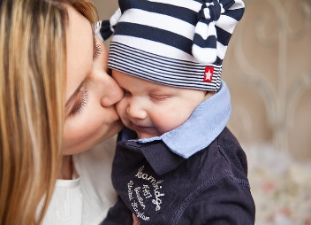
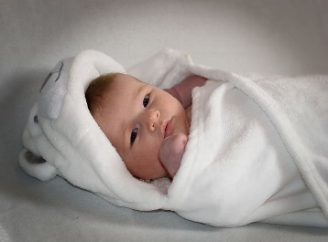
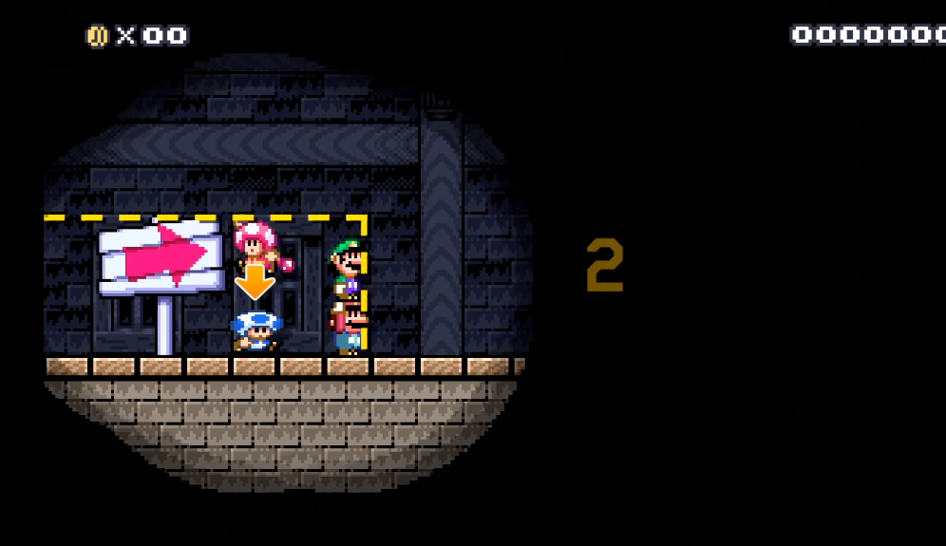
Motivation
But real human can do better; because we already have some knowledge to real world
Real world: find a spoon
Game
Bring me a spoon!

Slide 5
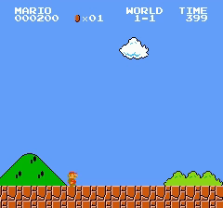
Goal
Outpainting to the large-scale-curiosity
Mario can see only inside the box
Semantic extrapolation
(Guess full view)
Large-Scale-Curiosity(AI)

Slide 6
Experiment
Limited-view(without outpainting)
Training 1 day..
Mario struggles because he can’t see him..
Mario can see only inside the box

Slide 7
Experiment
Limited-view(without outpainting)
Training 2 days..
Mario stucks at “the 1-1 underground”
Mario can see only inside the box

Slide 8
Experiment
Limited-view(without outpainting)
Training 4 days..
Mario clears 1-1 finally.
Mario can see only inside the box

Slide 9
Experiment
Limited-view(with outpainting, online-training)
Training 4 days...
Visually, it is worse(what??)
Mario can see only inside the box

Slide 10
Experiment
Ablation study
with outpainting network
4 days with 32 batch
n_updates: 174
best_ext_ret: 820
without outpainting
4 days with 32 batch
n_updates: 630
best_ext_ret: 4962
best_ext_ret(at n_updates==174): 4545

Slide 11
Discussion
He tries what he cannot see(the mushroom).
Mario can see only inside the box
with outpainting, 4 days

Slide 12
Discussion
If your predictions are not perfect,
sometimes just keep trying is faster.

Slide 13
What I learned
Very slow.
n_updates: 630 (4days, original)
n_updates: 174 (4days, with outpainting)
There was no gradient flow between GPU(outpainting) and CPU(large-scale-curiosity)
I’m trying pretraining now, but again “making a video to tfrecord and reading it in tensorflow” is too slow

Slide 14
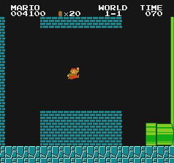
What I learned
Curiosity agent turn off the game when the game is too boring.
In limited view, the Mario had quit the game so many times at the 1-1 underground.

Slide 15
What I learned
There can be moments
great luck is needed.

Slide 16
Summary
It is difficult to predict many variables.
just do it.

