Slide 1
Navigation with Probabilistic Generative Models : About Efficient Conditioning and its Architectures
2025. 04. 28 CS586: Robot Motion Planning and Applications Team #1 Student Lecture
20253338 Jiwon Park
20243490 Jeongyong Yang

Slide 2
Index
What is Probabilistic Generative Models ?
Key concepts and major model types
Why Probabilistic Generative Models fit Planning tasks
Diffusion
Diffusion in planning and navigation
Efficient conditioning and constraint integration
Flow Matching Models
Comparison with Diffusion models
^{[1]}

Slide 3
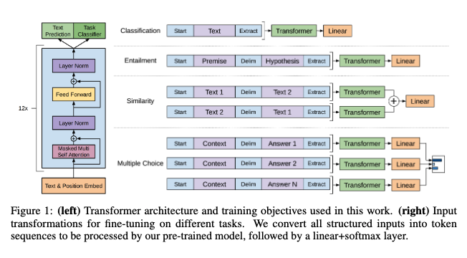
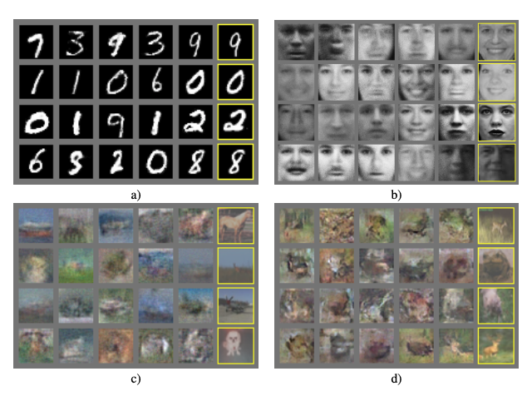
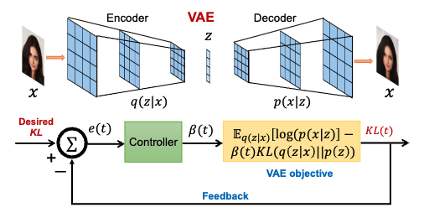
Probabilistic Generative Models
What is Probabilistic Generative Models ?
Models that learn the distribution of data and generate new samples based on the learning
Work by modeling probability distributions and sampling from them
Key functions
Density estimation : estimating the probability distribution of real data
Sampling : generating new data from learned distribution
Latent representation learning : learning meaningful low-dimensional representations of data
Autoregressive Model : GPT ^{[2]}
Generative Adversarial Nets : GAN ^{[3]}
Variational AutoEncoders ^{[4]}

Slide 4
Probabilistic Generative Models
Why do we have to use Probabilistic Generative Models in Planning tasks?
Planning
Probabilistic Generative Models
Modeling various env. and sensor data
Modeling complex distributions (Latent space)
Considering uncertainties
in env. and sensors
Uncertainty
Generating paths that adapt to various constraints
Conditional Generation
Generating diverse paths
Sample Diversity

Slide 5
Timeline
2020
2021
2022
2023
2024
2025
👉
Generative Probabilistic Models
DDPM
DDIM
Flow Matching for Generative Modeling
Diffusion
NoMaD
Diffusion Policy
Diffuser
Potential Based
SafeDiffuser
LDP
DTG
Dipper
DiPPest
Flow matching
FlowMP
FlowPolicy

Slide 6
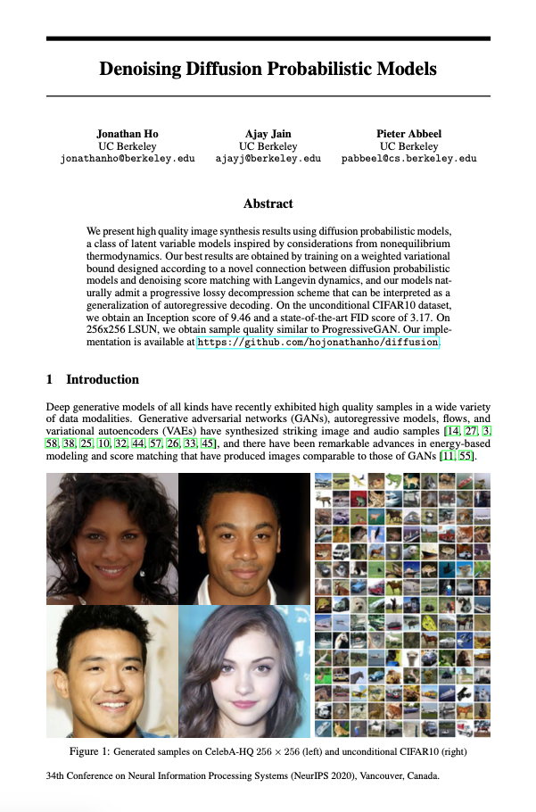
Diffusion Models
Denoising Diffusion Probabilistic Models^{[5]}

Slide 7
Diffusion Models in Planning
Diffusion Policy^{[6]}
NoMaD^{[7]}

Slide 8
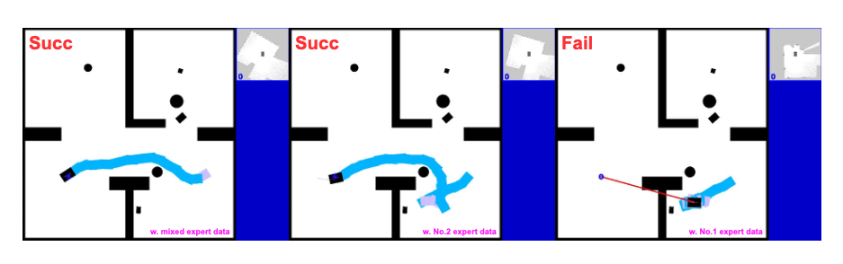
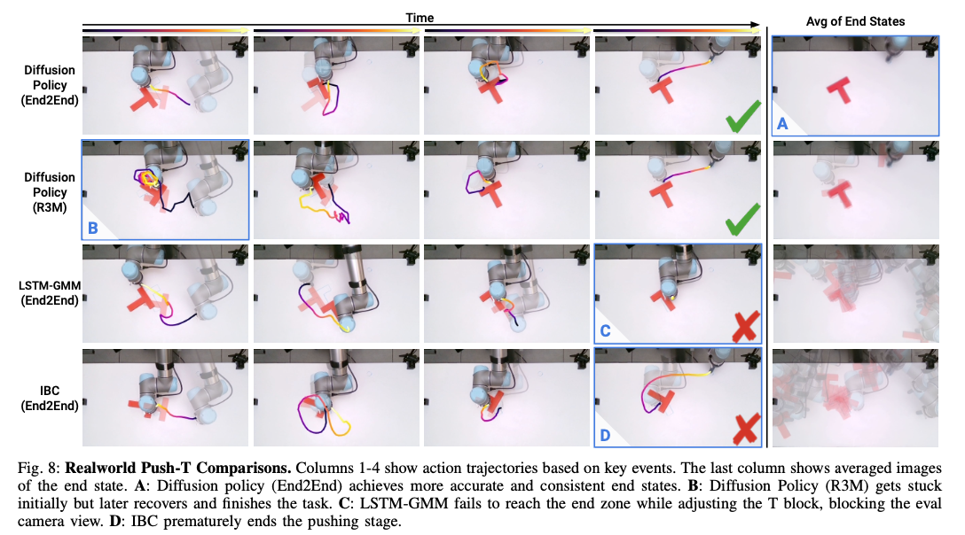
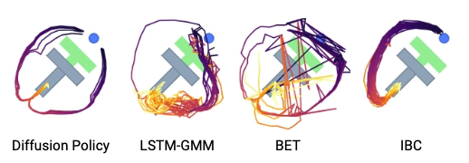
Diffusion Models in Planning
Advantages of Probabilistic Generative Models for Planning Tasks
Effective non-greedy planning
Local trap^{[8]}
Multi-modality^{[6]}

Slide 9
Conditions in Diffusion
Condition
Guides the generative process toward desired outputs
Give guidance to model about how to use this condition
Gradient guidance during denoising
Diffuser : Classifier-free guidance
$p_{θ}\left(x_{t−1} | x_{t}, c\right)= 𝒩(x_{t−1}|μ_{θ}\left(x_{t}, c\right),σ)$
Guide function
Perturbation

Slide 10
Conditions in Diffusion
Condition
Guides the generative process toward desired outputs
Give guidance to model about how to use this condition
Gradient guidance during denoising
Diffuser : Classifier-free guidance
$p_{θ}\left(x_{t−1} | x_{t}, c\right)= 𝒩(x_{t−1}|μ_{θ}\left(x_{t}, c\right),σ)$
Gradient of reward
Reward to trajectory

Slide 11
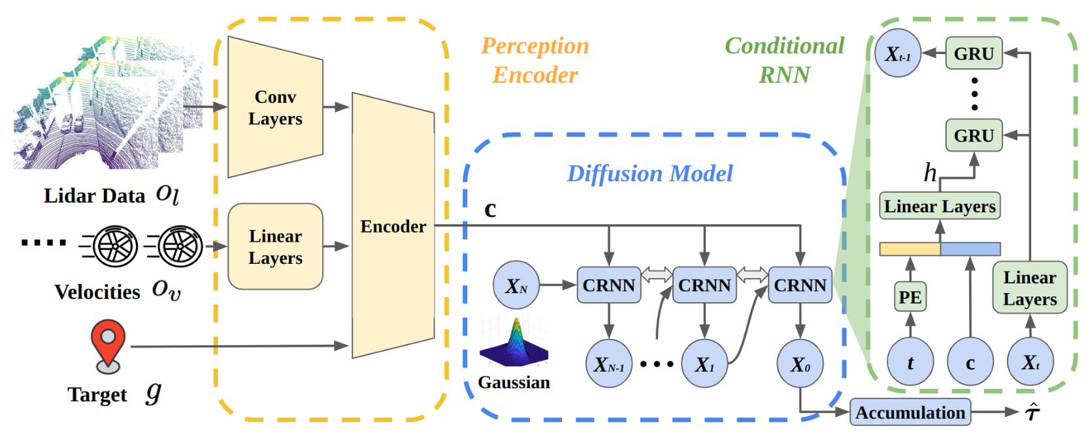
Constraints in Diffusion
DTG : Diffusion-based Trajectory Generation for Mapless Global Navigation^{[9]}
Jing Liang and Amirreza Payandeh and Daeun Song and Xuesu Xiao and Dinesh Manocha
Traversability Loss : Adaptive Training

Slide 12
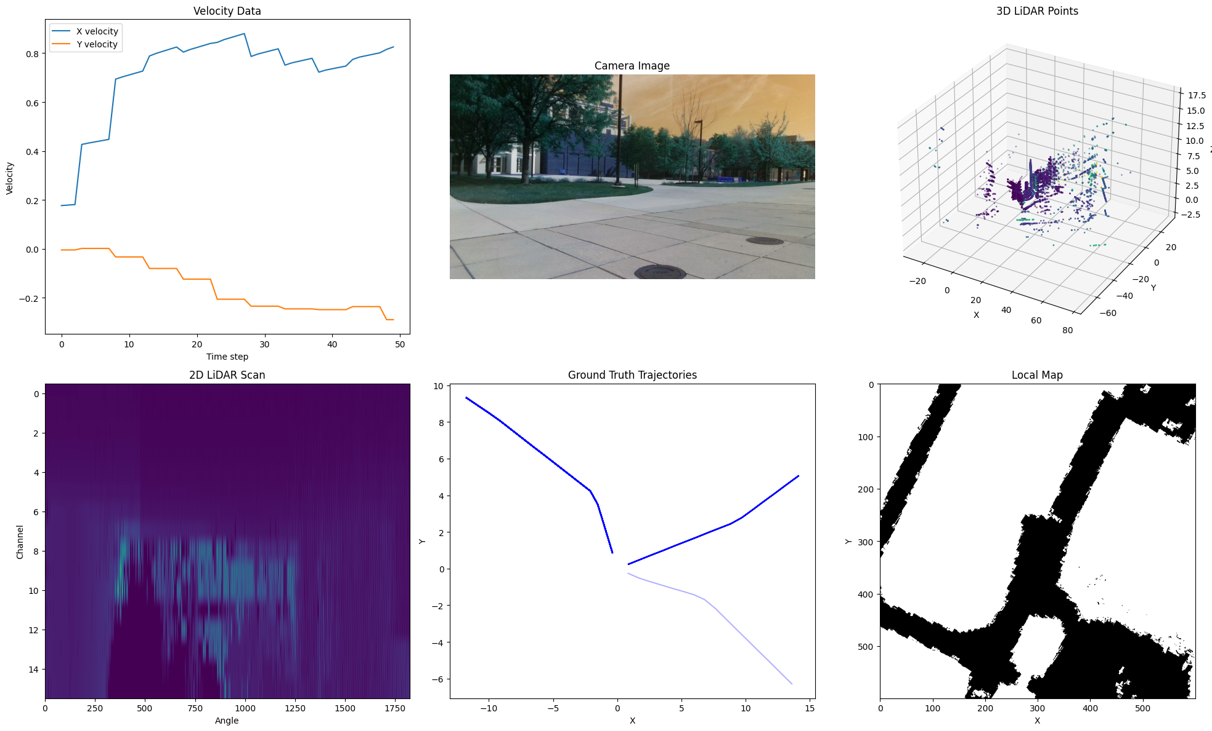
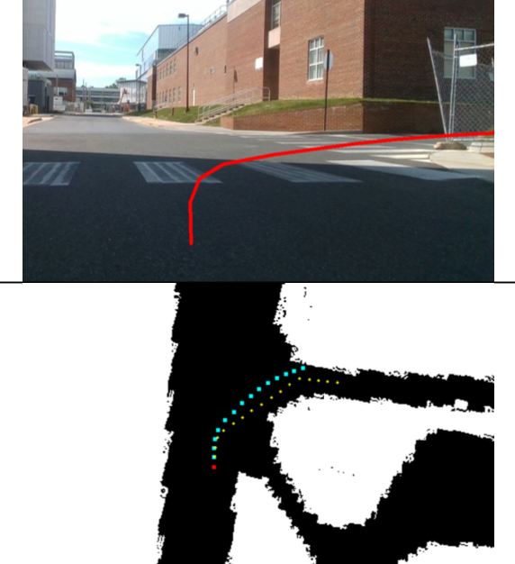
Constraints in Diffusion
DTG : Diffusion-based Trajectory Generation for Mapless Global Navigation
Jing Liang and Amirreza Payandeh and Daeun Song and Xuesu Xiao and Dinesh Manocha
[ DTG : Input and Inference Result ]

Slide 13
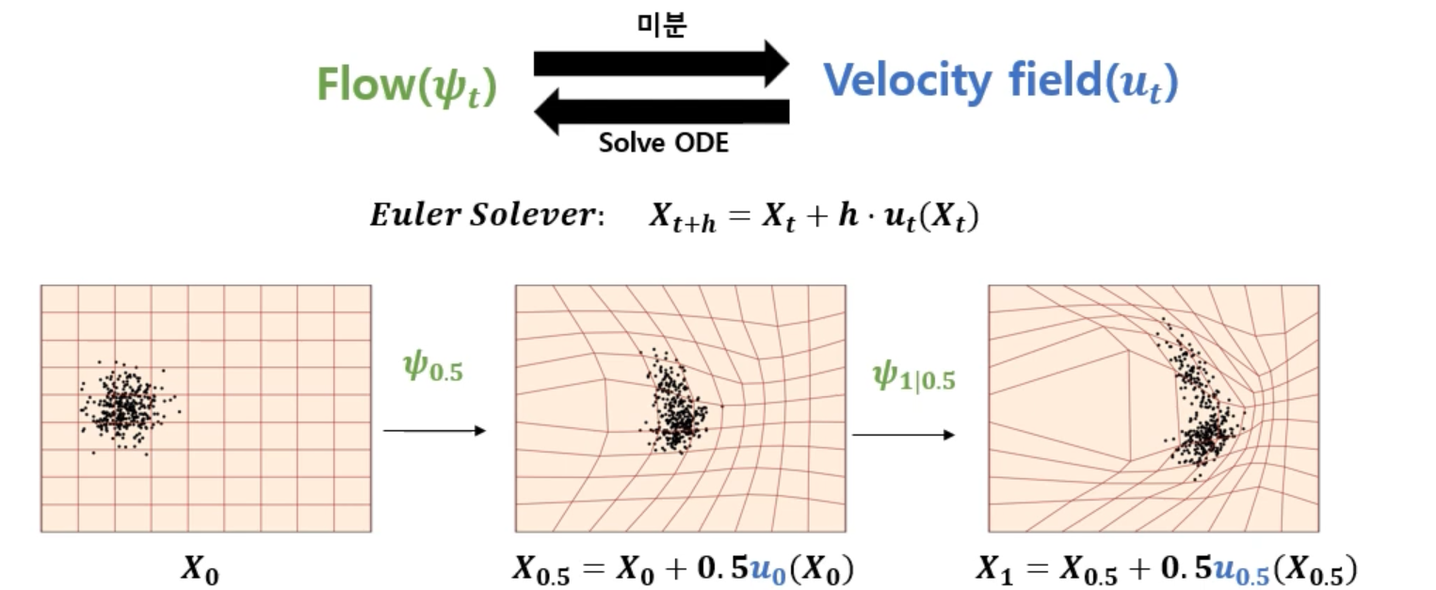
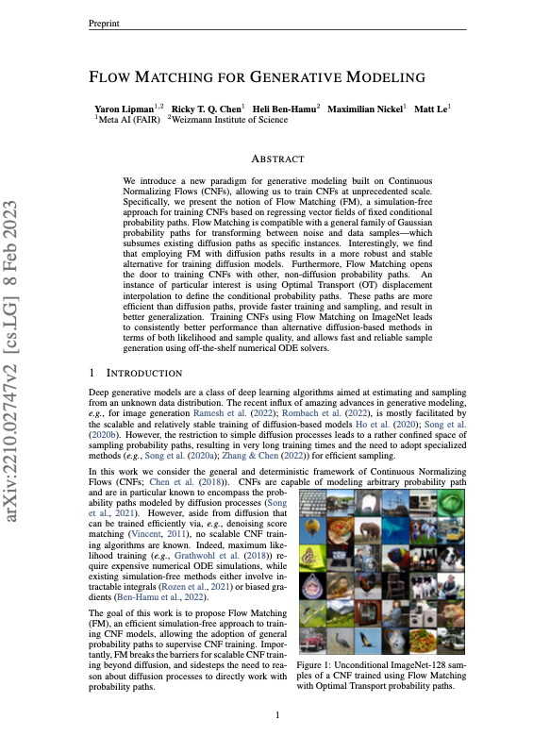
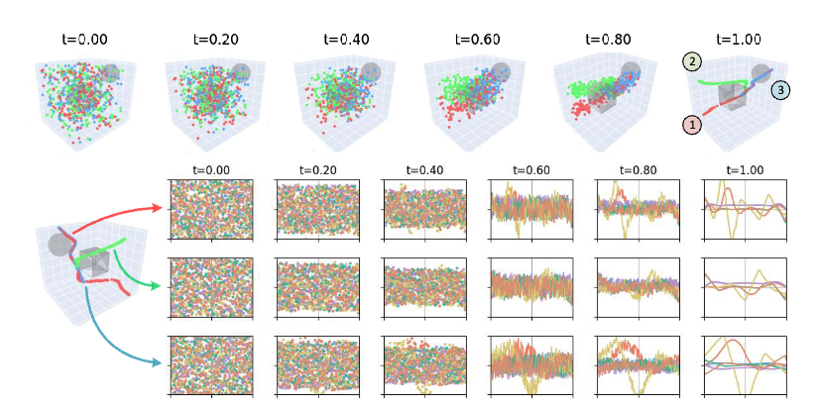
Flow Matching
Flow matching
[10]
[11]
[ Flow Matching : Vector Field ]
[12]
[ Flow Matching in Planning Task ]

Slide 14
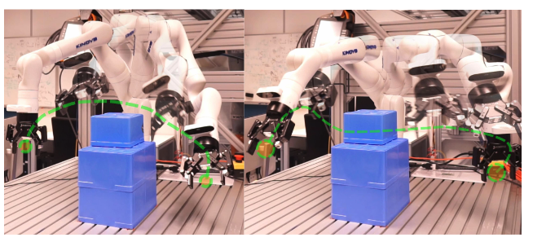
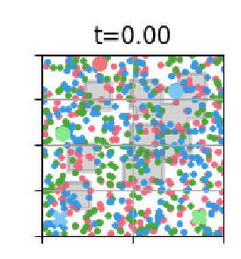
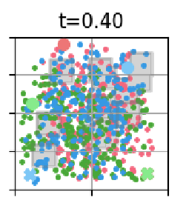
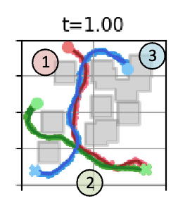
Flow Matching
FlowMP: Learning Motion Fields for Robot Planning with Conditional Flow Matching^{[13]}
Khang Nguyen and An T. Le and Tien Pham and Manfred Huber and Jan Peters and Minh Nhat Vu
Motion Field
Acceleration Field
Jerk Field

Slide 15
Flow Matching
Vector Field^{[14]}

Slide 16
Flow Matching
Diffusion vs. Flow matching
Time
[ Diffusion ]

Slide 17
Flow Matching
Diffusion vs. Flow matching
Time
Direct!
[ Flow Matching ]

Slide 18
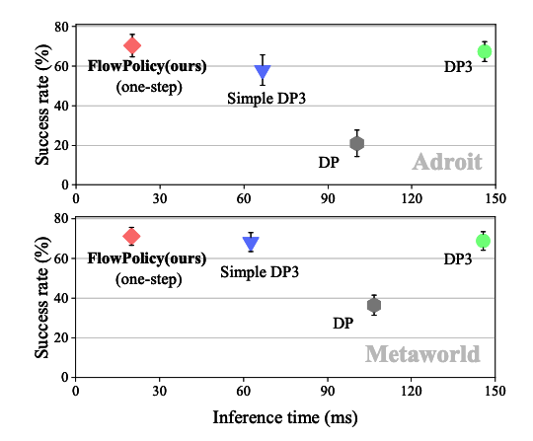
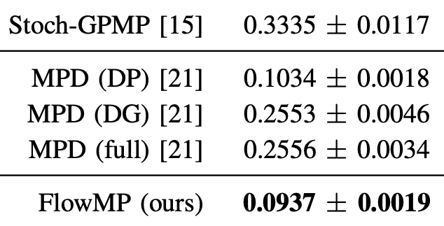
Flow Matching
Diffusion vs. Flow matching
Time
[ Time Comparison of FlowPolicy^{[15]}]
[ Time Comparison of FlowMP^{[13]}]

Slide 19
Flow Matching
Diffusion vs. Flow matching
 | Diffusion | Flow Matching
Process | Step-by-step noise addition and denoising | Continuous transformation via Velocity fields
Mathmatical Base | Stochastic process | Deterministic ODE
Sampling | Many steps | Few steps
Best for | High-fidelity, complex generation | Fast, controllable planning
[ Comparison between Diffusion and Flow Matching ]

Slide 20
References
https://www.youtube.com/watch?v=T6K2KaLmlt4&ab_channel=SungjoonChoi
Brown, T., Mann, B., Ryder, N., Subbiah, M., Kaplan, J. D., Dhariwal, P., ... & Amodei, D. (2020). Language models are few-shot learners. Advances in neural information processing systems, 33, 1877-1901.
Goodfellow, I. J., Pouget-Abadie, J., Mirza, M., Xu, B., Warde-Farley, D., Ozair, S., ... & Bengio, Y. (2014). Generative adversarial nets. Advances in neural information processing systems, 27.
Kingma, D. P., & Welling, M. (2013, December). Auto-encoding variational bayes.
Ho, J., Jain, A., & Abbeel, P. (2020). Denoising diffusion probabilistic models. Advances in neural information processing systems, 33, 6840-6851.
Chi, C., Xu, Z., Feng, S., Cousineau, E., Du, Y., Burchfiel, B., ... & Song, S. (2023). Diffusion policy: Visuomotor policy learning via action diffusion. The International Journal of Robotics Research, 02783649241273668.
Sridhar, A., Shah, D., Glossop, C., & Levine, S. (2024, May). Nomad: Goal masked diffusion policies for navigation and exploration. In 2024 IEEE International Conference on Robotics and Automation (ICRA) (pp. 63-70). IEEE.
Yu, W., Peng, J., Yang, H., Zhang, J., Duan, Y., Ji, J., & Zhang, Y. (2024, October). Ldp: A local diffusion planner for efficient robot navigation and collision avoidance. In 2024 IEEE/RSJ International Conference on Intelligent Robots and Systems (IROS) (pp. 5466-5472). IEEE.
Liang, J., Payandeh, A., Song, D., Xiao, X., & Manocha, D. (2024, October). Dtg: Diffusion-based trajectory generation for mapless global navigation. In 2024 IEEE/RSJ International Conference on Intelligent Robots and Systems (IROS) (pp. 5340-5347). IEEE.
Lipman, Y., Chen, R. T., Ben-Hamu, H., Nickel, M., & Le, M. (2022). Flow matching for generative modeling. arXiv preprint arXiv:2210.02747.
https://youtu.be/NEqHBKiMA0k
Nguyen, Khang, et al. "FlowMP: Learning Motion Fields for Robot Planning with Conditional Flow Matching." arXiv preprint arXiv:2503.06135 (2025).
Nguyen, K., Le, A. T., Pham, T., Huber, M., Peters, J., & Vu, M. N. (2025). FlowMP: Learning Motion Fields for Robot Planning with Conditional Flow Matching. arXiv preprint arXiv:2503.06135.
https://jmtomczak.github.io/blog/18/18_fm.html

Slide 21
Quiz
Quiz 1.
In planning, it is better to generate only one fixed path instead of multiple possible trajectories.
O / X
Quiz 2.
Diffusion models always achieve faster planning performance than Flow Matching
O / X

