Slide 1

SOLAR: Second-Order Loss and Attention for Image Retrieval
(ECCV 2020)
Jinhwan Seo
(서진환)
2024/04/29
Notes:
1

Slide 2
RECAP
Global Features are All You Need For Image Retrieval and Reranking
P1: GeM pooling + ArcLoss: Sub-optimal for p-value
  SuperGlobal Pooling
    Regional GeM: Local feature representation
    GeM+: Second stage fine-tuning for p-value
    Scale GeM: GeM on multi-scale image
P2: Re-ranker(GV): Local feature, computationally expensive
  SuperGlobal Reranking
    Select Top-M from global descriptor
    KNN for each of M candidates
    Refine descriptor via weighted avg pooling (among K)

Slide 3
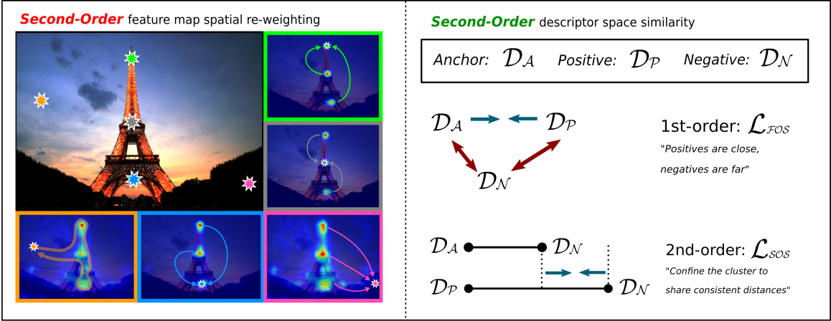
Brief Summary
Re-weighting local descriptors prior to GeM
Distribute global descriptors
in descriptor space

Slide 4



Motivation
1. Second-order Attention
CNN
GeM
Local
Global
Only focus on information within receptive, and
no correlation between them

Slide 5
Motivation
2. Second-order Similarity Loss

Slide 6
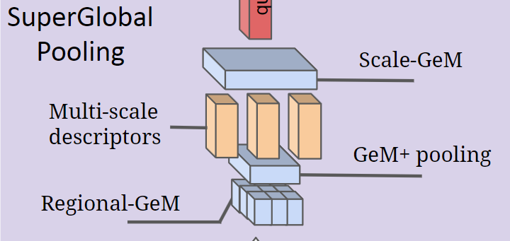
Background
Local to Global Descriptor
SPoC
CroW
MAC
GeM
  Regional-GeM
  Scale-GeM
  GeM+
Shao, et al. “Global Features are All You Need for Image Retrieval and Reranking” ICCV 2023

Slide 7
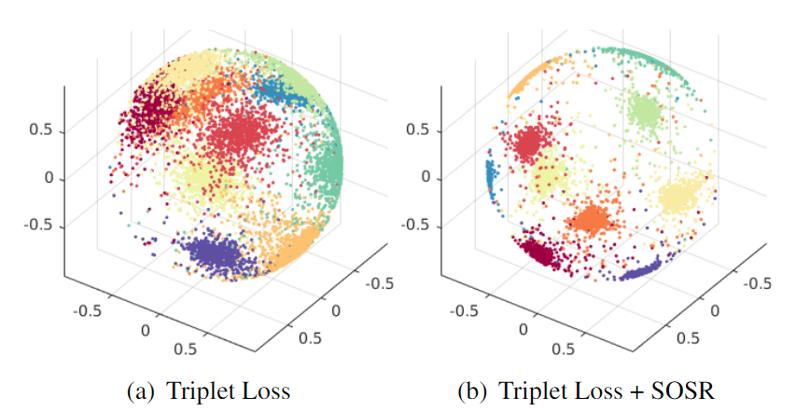
Background
Higher order similarity
Enhance discriminative power
Used as regularization term with first order loss
More compact individual clusters
Tian, et al. “SOSNet: Second Order Similarity Regularization for Local Descriptor Learning” CVPR 2019

Slide 8

Overview
1. Second-order Spatial Pooling
GeM
CNN
GeM
GeM with SOA
SOA
GeM
CNN

Slide 9
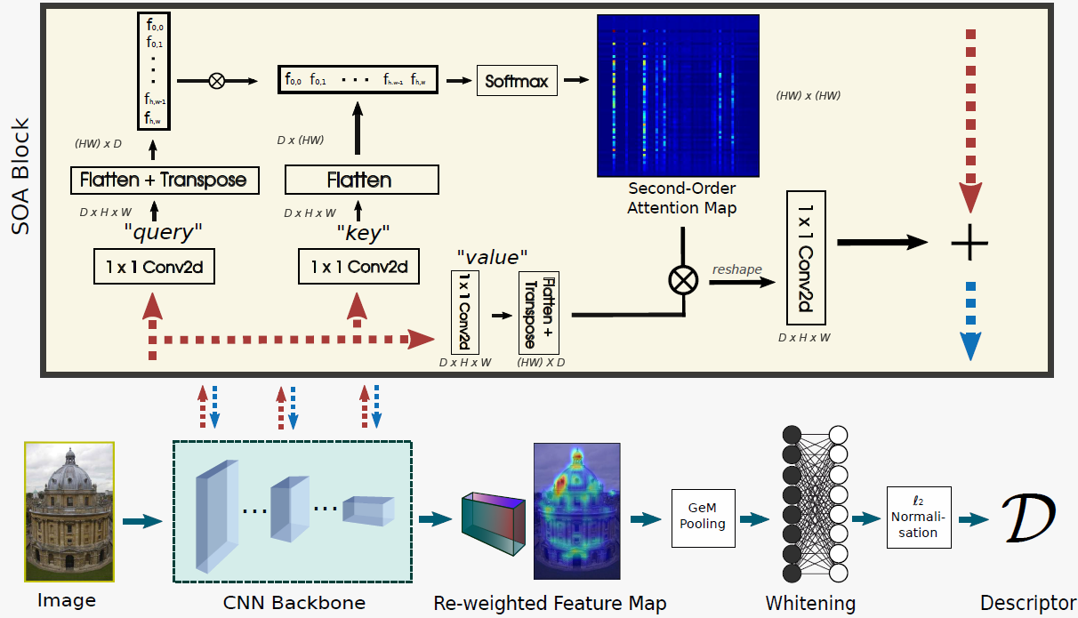
Main Idea
Overall Architecture
Re-weight via SOA, then GeM pooling
with whitening and l2 norm

Slide 10
Main Idea
1. Second-Order Attention (SOA)
Key - (D, H*W)
Matmul,
Softmax
Query -
(H*W, D)
…
…
Attention map
(H*W, H*W)
1 x 1 CONV
1 x 1 CONV
Reshape,
1 x 1 CONV
1 x 1 CONV
…
(H, W, D)
(H, W, D)
Value - (H*W, D)

Slide 11



Overview
2. Second-order Similarity Loss
P
P
A
A
N
N
First-order Similarity
Second-order Similarity

Slide 12
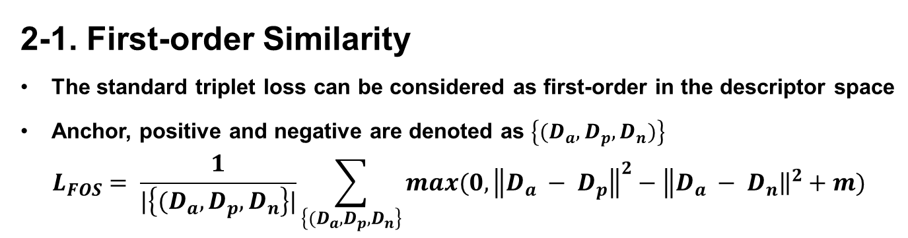
Main Idea
2-1. First-order Similarity
The standard triplet loss can be considered as first-order in the descriptor space
Anchor, positive and negative are denoted as $\left\{(D_{a},D_{p},D_{n})\right\}$
$$L_{FOS}= \frac{1}{|\left\{(D_{a},D_{p},D_{n}\right\}|}\sum_{\left\{(D_{a},D_{p},D_{n}\right\}}{max(0,\left\|D_{a}\right. − {\left.D_{p}\right\|}^{2}−\left\|D_{a}\right. − {\left.D_{n}\right\|}^{2}+m)}$$
P
A
N

Slide 13

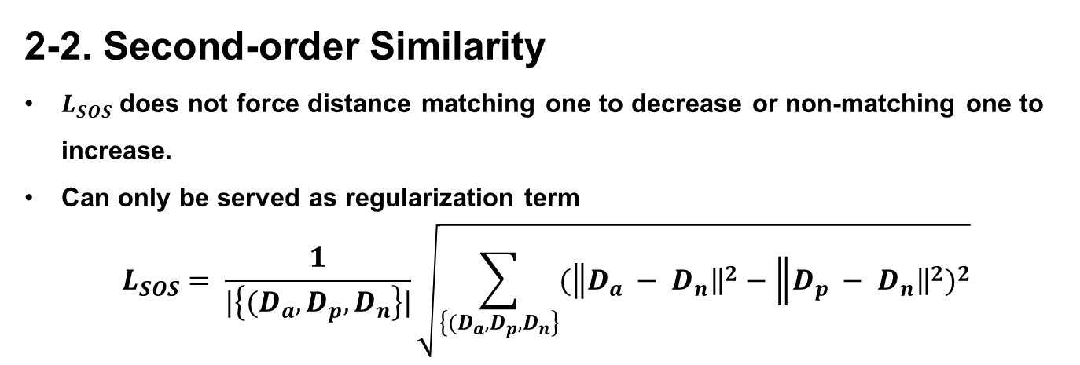
Main Idea
2-2. Second-order Similarity
$L_{SOS}$ does not force distance matching one to decrease or non-matching one to increase.
Can only be served as regularization term
$$L_{SOS}= \frac{1}{|\left\{(D_{a},D_{p},D_{n}\right\}|}\sqrt{\sum_{\left\{(D_{a},D_{p},D_{n}\right\}}{{(\left\|D_{a}\right. − {\left.D_{n}\right\|}^{2}−\left\|D_{p}\right. − {\left.D_{n}\right\|}^{2})}^{2}}}$$
P
P
A
A
N
N

Slide 14
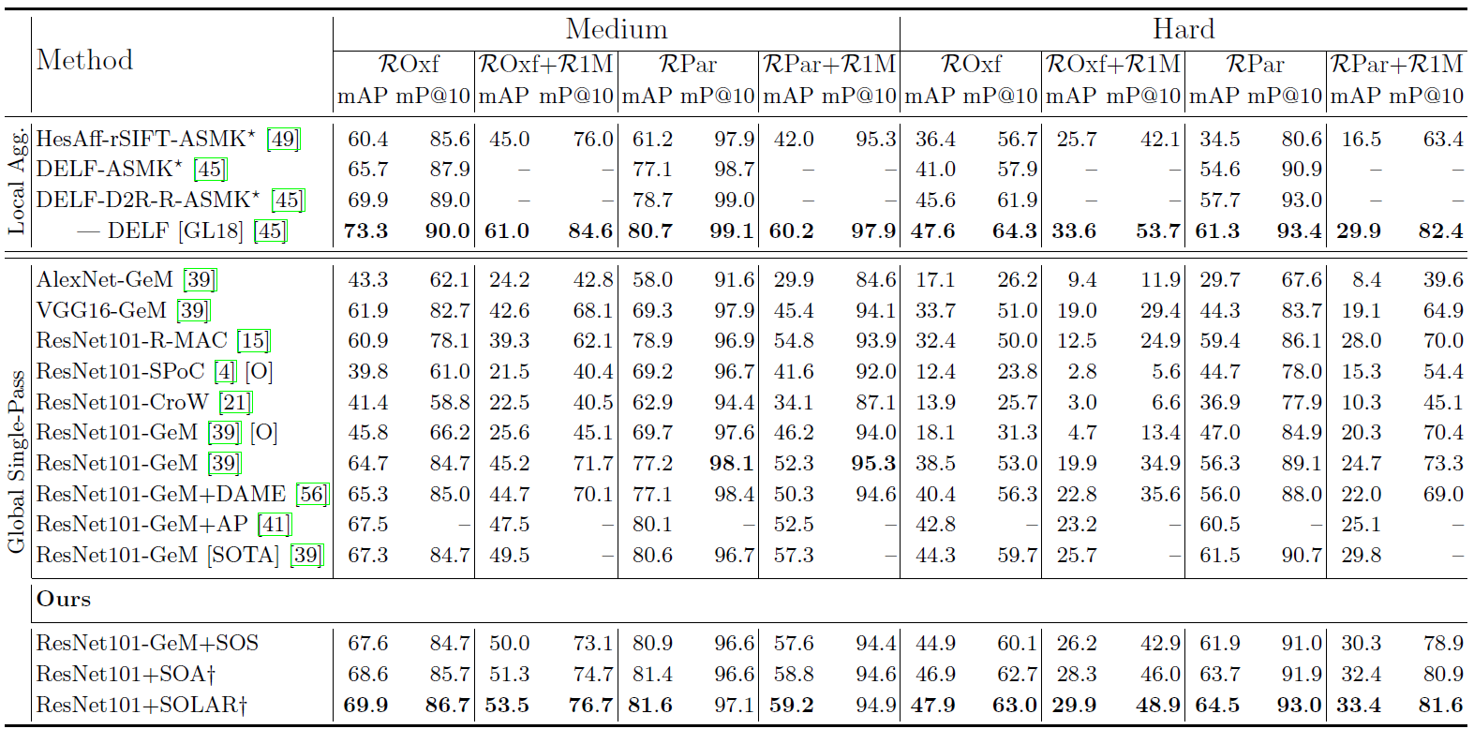
Result
SOTA on global single-pass way

Slide 15
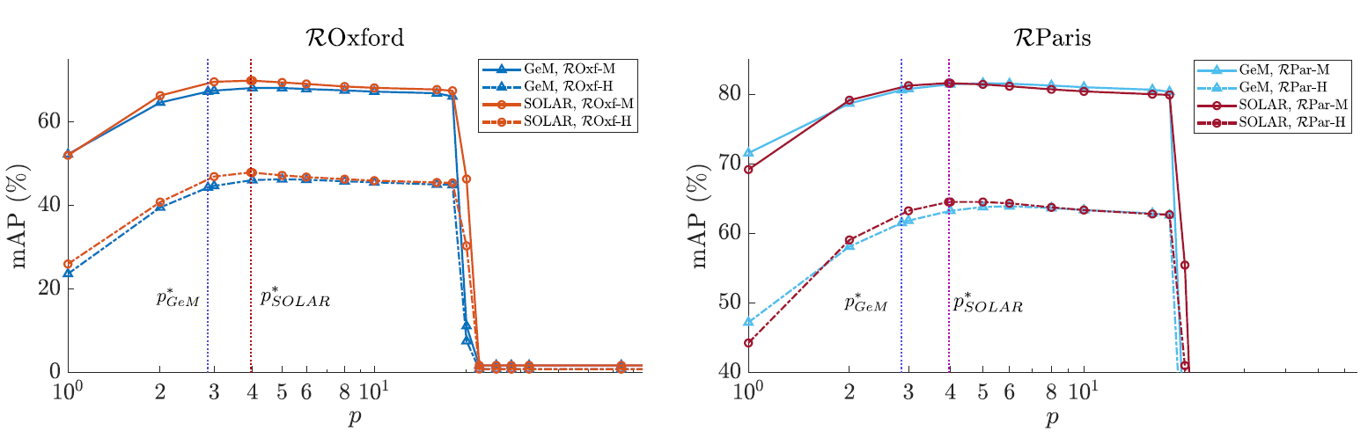
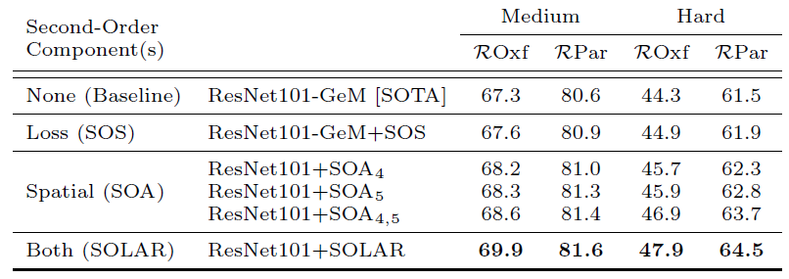
Result
SOTA on global single-pass way

Slide 16
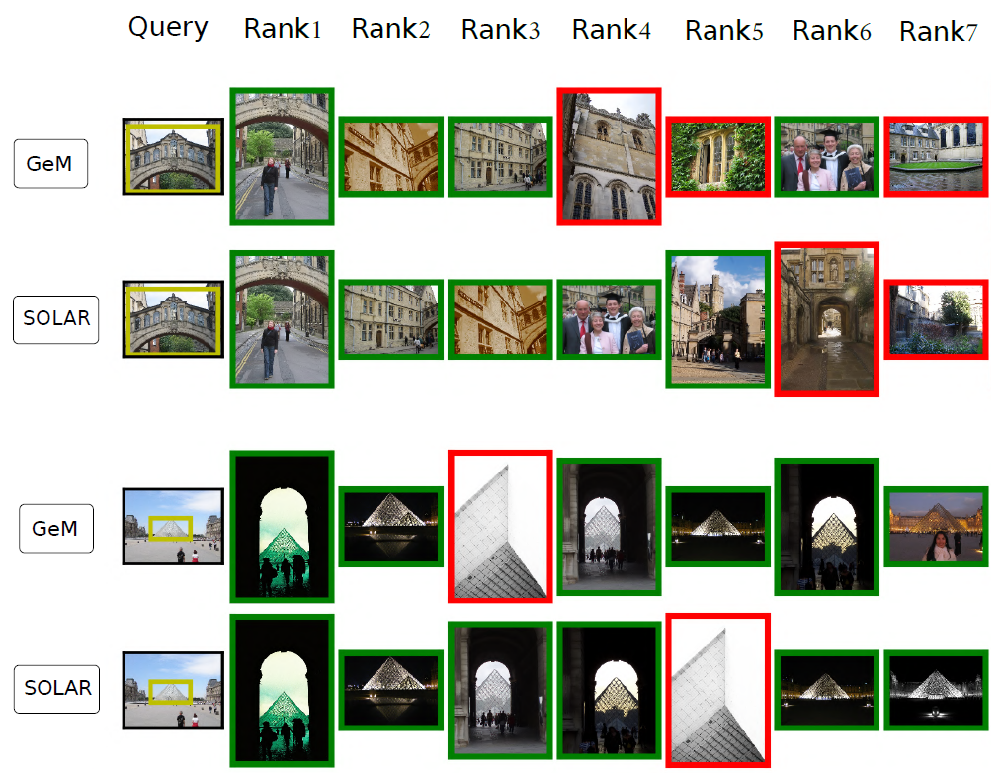
Result

Slide 17
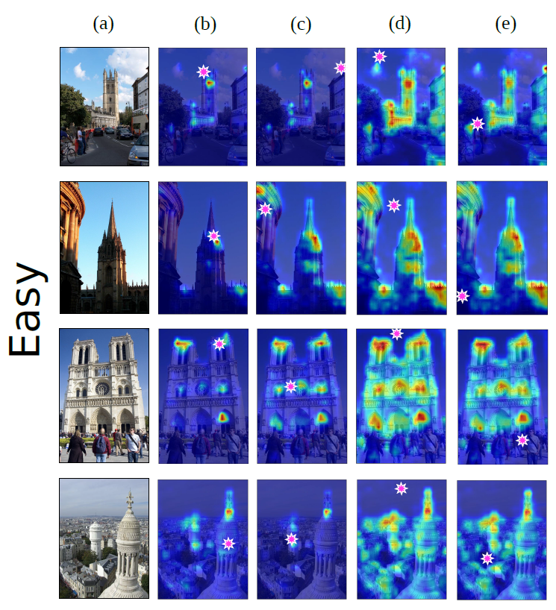
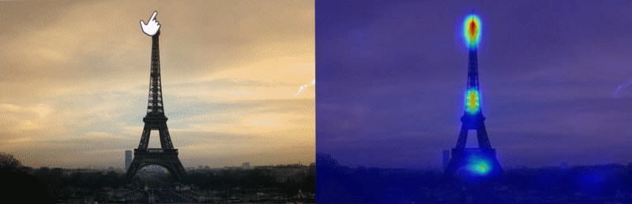
Result

Slide 18
Conclusion
Strength:
Simple but effective solution for image retrieval
Re-weighting local descriptor
Second order loss for additional constraint
Weakness
Novelty, not much different from self-attention
Dependence on specific architecture

Slide 19
Quiz

