Slide 1
A Learned Shape-Adaptive Subsurface Scattering Model
D. Vicini, V. Koltun, W. Jakob, SIGGRAPH 2019
Team 2
Janu Kim 20190158
Yiwen Mao 20236409
Tamana Pirzad 20236318

Slide 2
Contents
01
04
07
review
main idea
  quiz
02
05
background on related work
results
03
06
motivation
strengths/weaknesses

Slide 3
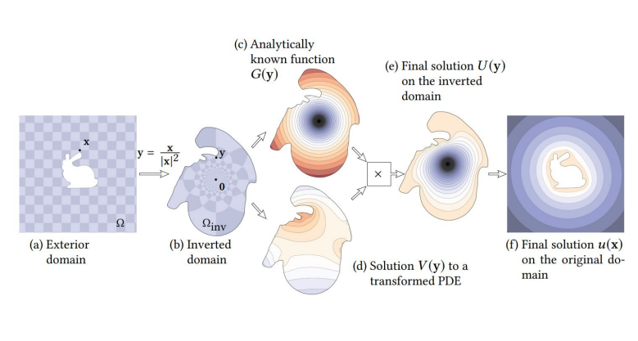
Review: Kelvin Transformations for Simulations on Infinite Domain (presented by Team 1)
MOHAMMAD SINA NABIZADEH, RAVI RAMAMOORTHI, ALBERT CHERN

Slide 4
Background on related work

Slide 5
Background on related work
1. Radiative Transfer Equation (RTE)
2. BSSRDF
3. Variational autoencoder (VAE)

Slide 6
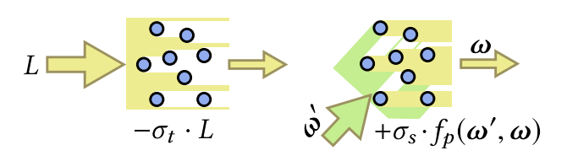
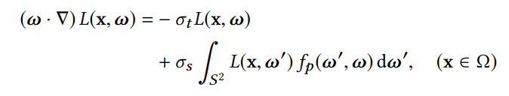
1. Radiative Transfer Equation (RTE)
Light transport within the interior of an object is generally simulated using RTE
The RTE represent the directional change of radiance
direction
radiance
extinction
direction
how the radiance L(x, ω) decreases at the point x along the direction ω
directional change of radiance
light arriving from other directions ω' is scattered into the direction ω at the point x

Slide 7

2. BSSRDF (bidirectional scattering-surface reflectance distribution function)
lower-dimensional integral over surface positions and incident direction (lower cost than volumetric path tracing)
the relationship between outgoing and incident radiance
Lo(x, ω): outgoing illumination
Li(x, ω) : incident radiance function
ω: outward-facing directions
S: BSSRDF
Notes:
Due to the high costs of volumetric path tracing, many works have proposed BSSRDF models that cast subsurface scattering into a considerably lower-dimensional integral over surface positions and incident direction
At a first glance an eight dimensional function, the BSSRDF is in fact much higher-dimensional due to its dependence on the properties of the interior medium φΩ = (σt , σs ,д) and the shape of the boundary ∂Ω.

Slide 8
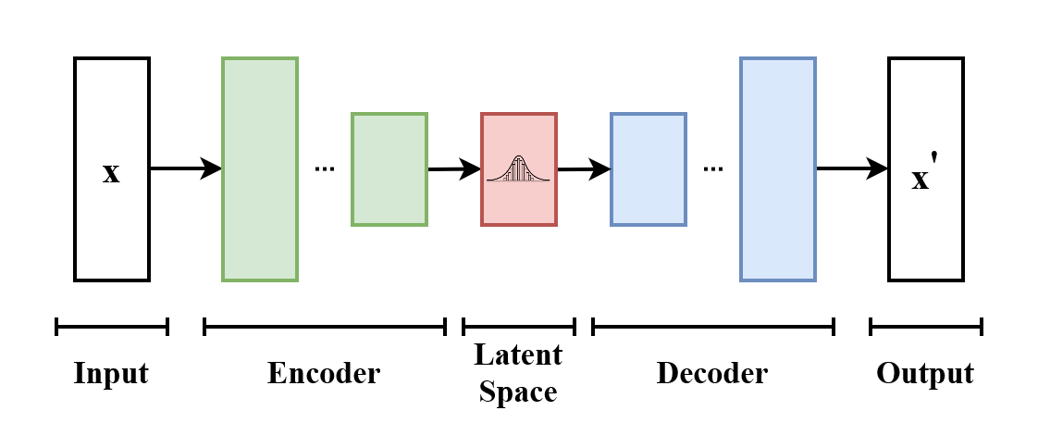
3. Variational autoencoder (VAE)
Goal:
To learn and reproduce the distribution of input data.
Architecture:
Utilizes an Encoder-Decoder structure.
Latent Space Z:
· The dimensionality of Z can be significantly smaller than the full path space.
· It is assumed that latent variables are normally distributed.
https://upload.wikimedia.org/wikipedia/commons/4/4a/VAE_Basic.png

Slide 9
Motivation
Monte Carlo sampling of the Radiative Transfer Equation (RTE)
  Generally used
  Inefficient e.g. Highly scattering material; expensive to track long sequence of internal scattering interactions
BSSRDF (Bidirectional Scattering-Surface Reflectance Distribution Function)
  Efficient; directly encode surface-to-surface transport
  Severe assumptions that are almost always violated make error in rendered images e.g. planar geometry, isotropy, low absorption
=> A New Shape-Adaptive BSSRDF Model
Take Efficiency of 2) and improve Accuracy
Notes:
Goal of this paper:
To create a probabilistic generative algorithm that can efficiently sample pairs of values (x', ω') (outgoing direction and position) proportional to Sφ (·, ·, x,ω) (BSSRDF) given a fixed incident ray ri = (x,ω) and parameters φ = (φΩ,φ∂Ω) describing the interior and boundary
dependence of Sφ on both ri and φ is highly nonlinear -> Neural Network

Slide 10
Main idea

Slide 11
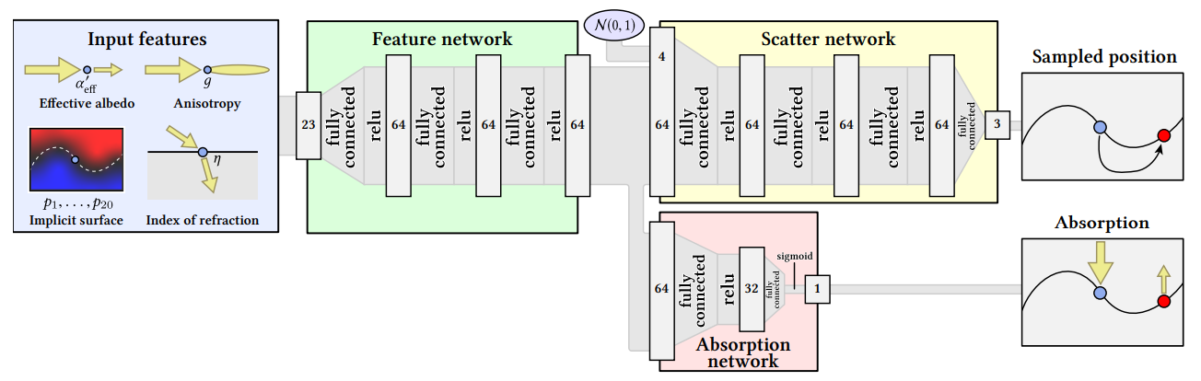
Main idea
architecture
Shape Descriptor fed into network alongside Albedo, Anisotropy, Refraction Features
Scatter Network samples outgoing location
Absorption Network computes absorption probability
Notes:
In this paper, the encoder and decoder are jointly trained, but during rendering, the decoder receives input from a sample drawn from the standard normal distribution instead of the encoder, enabling the generation of more diverse samples

Slide 12
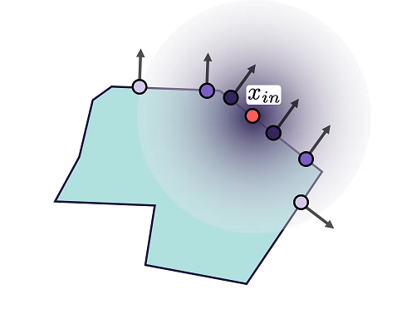
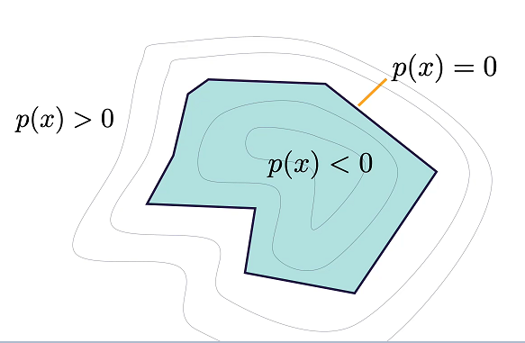
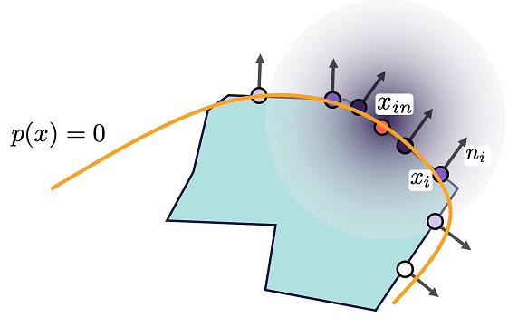
Main idea
polynomial shape descriptors
given incident location x, polynomial for that neighborhood is created
function needs to be equal to zero on surface, larger than zero outside, smaller inside
coefficients of resulting polynomials used as shape descriptor
Notes:
TAMANA

Slide 13
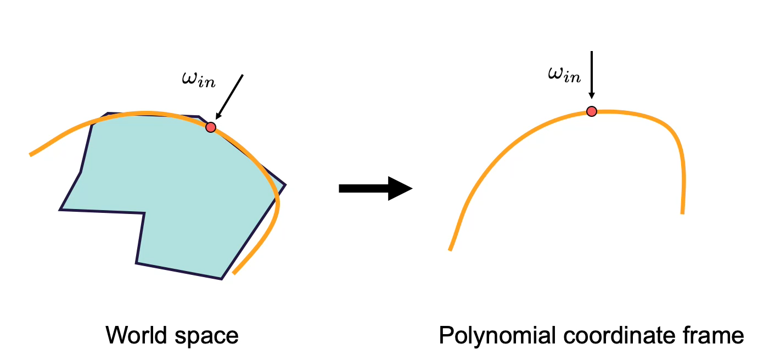
Main idea
polynomial shape descriptors
incident direction does not need to be explicitly passed
Notes:
z-axis !
Adaptation to the incident direction
Rotating Point Clouds: Aligns the z-axis with the initial light propagation direction.
Model Learning: Recognizes this alignment to generate stretched and shifted distributions at various angles.
Consistency in Training and Rendering: Implements a hard constraint (c1 = 0) in the equation to ensure the polynomial passes through the reference point x for accurate geometry approximation.

Slide 14
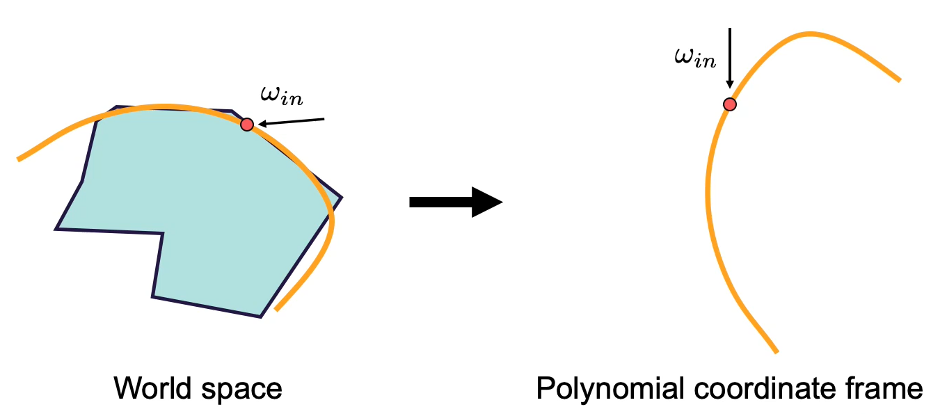
Main idea
polynomial shape descriptors
incident direction does not need to be explicitly passed

Slide 15
Main idea
neighborhood size
Why Control Neighborhood Size?
Essential for accurate local geometry approximation when creating the polynomial.
overly local fit will be sensitive to minute shape variations
too large neighborhood will lack adaptivity

Slide 16
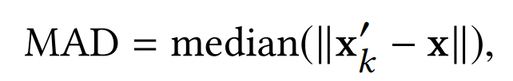
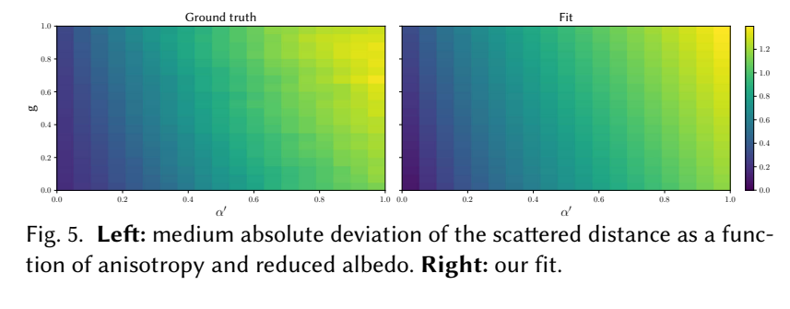
Main idea
neighborhood size
How to Control?
Size inversely related to medium density.
-> related to spread of samples x’(outgoing positions) drawn from ground-truth BSSRDF
Computed the median absolute deviation (MAD) => provides estimator of this spread
Used for curve fitting, which they use to determine the neighborhood size depending on the incident location

Slide 17
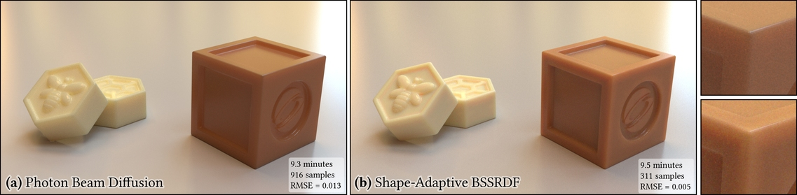
Results
Shallow architecture -> training performed on CPU
Evaluate performance and accuracy with:
ground truth and
prior work (Forward Scattering Dipole [Frederickx and Dutré 2017], Directional Dipole [Frisvad et al. 2014], Photon Beam Diffusion [Habel et al. 2013], PBRT [Pharr et al. 2016])

Slide 18
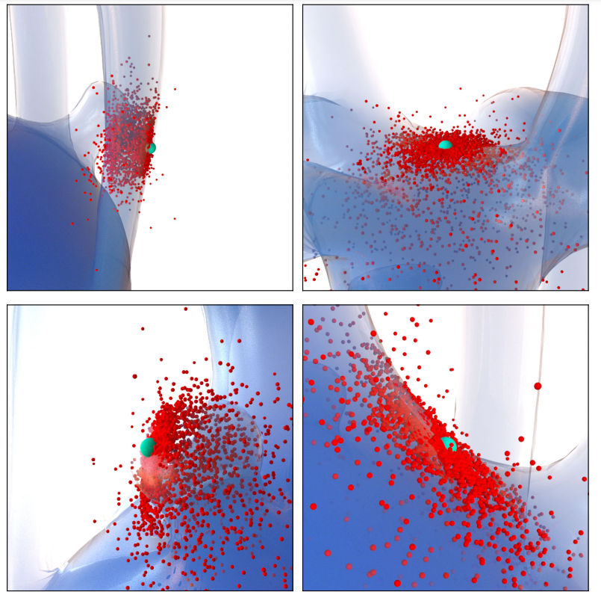
Results
shape-adaptive distributions
point distributions produced by model
points align with underlying polynomial
points are projected back onto the underlying mesh -> tracing rays along gradient direction of polynomial

Slide 19
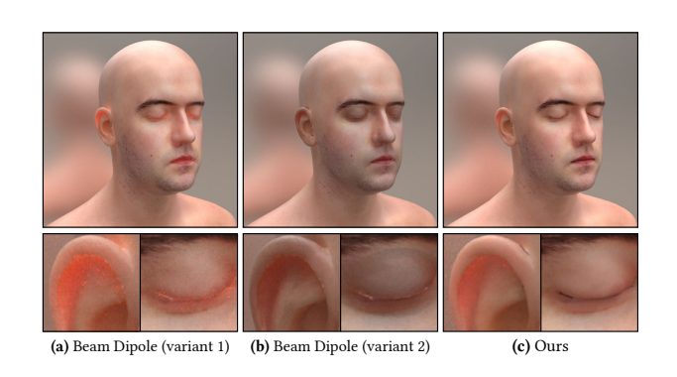
Results
Energy conservation
depending on how points
are projected back onto
the surface, they either
suffer from
energy gains (a)
energy losses (b)
paper`s model (c) doesn`t create excess energy or suffer from energy loss;
guided by local approximation of underlying shape (polynomial)

Slide 20
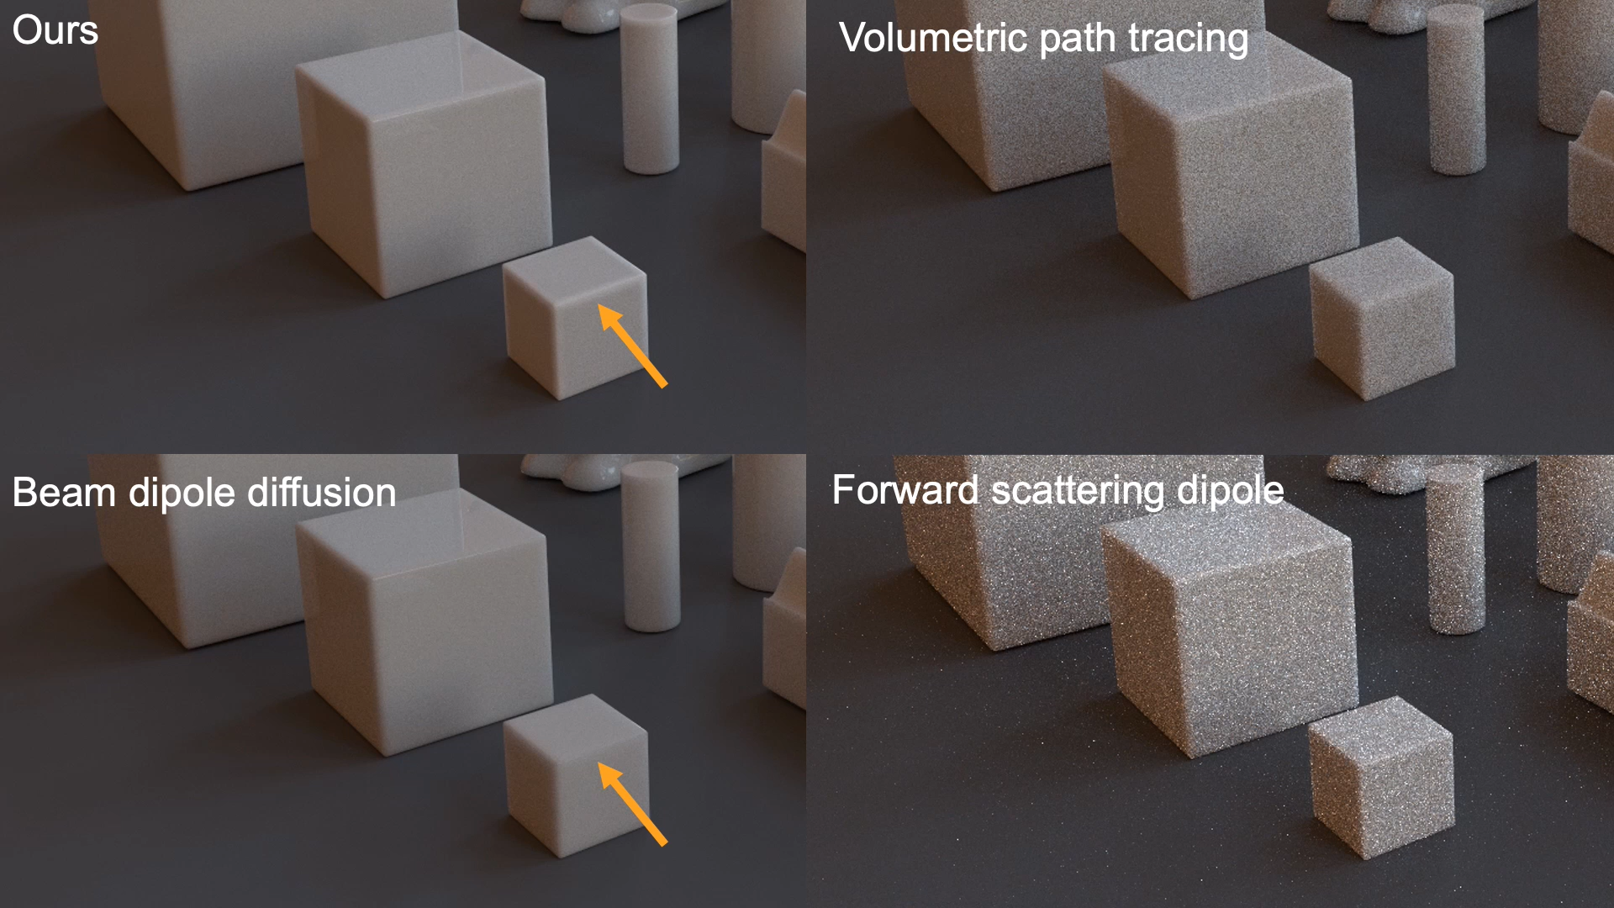
Results

Slide 21
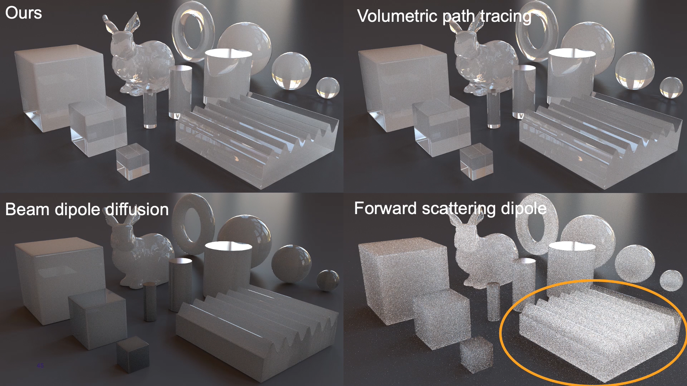
Results

Slide 22
Contributions
· Avoids limiting assumptions of prior analytic models: planar geometry, isotropy, low absorption, etc. …
· Generalizes the concept of spatio-directional separability.
Limitations
· It assumes diffuse, but not suited for thin anisotropic materials.
Translucent materials are typically anisotropic, meaning light retains its preferred direction.
Notes:
=> last contribution: basically, we didnt get it.

Slide 23
Thank you！
*Most pictures and video are from the authors’ paper and video

Slide 24
Quiz
( T / F ) Monte Carlo sampling of the RTE is efficient in highly scattering material.
2. Draw lines and connect them.
overly local fit lack of adaptivity
too large neighborhood sensitive to minute shape variations

