Slide 1



Progressive Denoising of
Monte Carlo Rendered Images
*
†
Arthur Firmino
Jeppe Revall Frisvad
Henrik Wann Jensen
EuroGraphics ‘22
†
*
Presenter : Jaehyun Ha
*
†
*
Notes:
Hello everyone, this is Jaehyun Ha from NetS&P Lab. The paper I am going to share is “Progressive Denoising of Monte Carlo Rendered Images” by Arthur Firmino, Jeppe Revall Frisvad, and Henrik Wann Jensen from luxion and technical university of denmark. This paper was presented in Eurographics ’22.

Slide 2
Recap: Last week’s presentation
Towards practical physical-optics rendering (Steinberg et al.,) presented by Philipp
Presents a framework for practical physical-optics rendering that can reproduce diffraction and wave-interference effects in complex scenes.
The proposed frame work uses coherence-aware, physical optics mateials and restricts the spatial coherence shape of light to an anisotropic Gaussian, making PLT algorithms practical for real-world scenes.

Slide 3
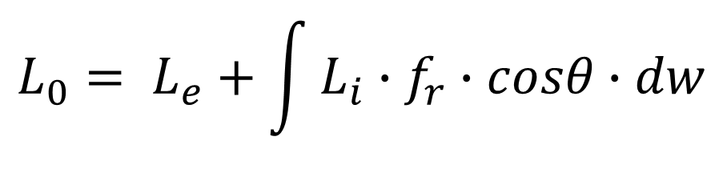
Background: Monte Carlo Rendering
Monte Carlo light transport algorithm (e.g., path tracing) have been widely used
Simplicity & ability to render scenes with complex light transport
$$L_{0}= L_{e}+\int{L_{i}∙f_{r}∙cosθ∙dw}$$
[J. T. Kajiya, 1986]
Notes:
Monte Carlo light transport algorithms such as path tracing have been widely used since the introduction of the rendering equation over here,
Thanks to their simplicity and ability to render scenes with complex light transport.

Slide 4
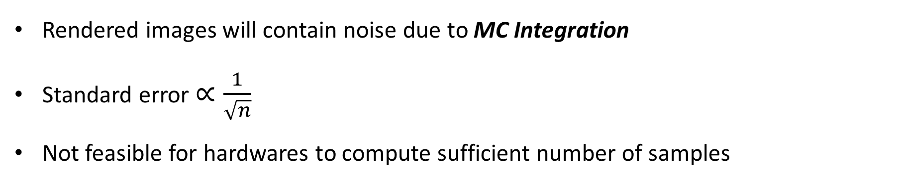
Background: Downside of Monte Carlo Rendering
However…
Rendered images will contain noise due to MC Integration
Standard error $∝\frac{1}{\sqrt{n}}$
Not feasible for hardwares to compute sufficient number of samples
=> Denoising!
Notes:
However, the downside of these algorithm is such that rendered images will contain noise due to Monte Carlo Integration.
Knowing that standard error is proportional to one over square root of number of samples, it takes much more number of samples to reduce the error.
Despite the advent of powerful hardware dedicated to ray tracing, it is often not feasible to compute sufficient number of samples.
So, how did the researchers tried to address this problem? [CLICK] This is where the term denoising in MC rendering comes from.

Slide 5
Background: Denoisers
Denoisers are used as a post-processing step to remove noise from MC rendering
Deep Learning techniques are used for enhancing the quality of denoisers
  Predicting parameters of classical filters [Sen et al., 2015]
  Predicting filter kernel [Bako et al., 2017]
  Predicting final radiance value using GAN [Xu et al., 2019], Residual networks [Wong et al., 2019], and Autoencoders [Chaitanya et al., 2017]
Drawback of deep learning based MC denoisers:
May suffer from bias that is sufficient to be perceived as a loss of detail and image blurring
Notes:
Denoisers are often used as a post-processing step to remove residual noise from MC rendering in recent years.
Their quality have been dramatically improved due to the advancement of neural networks and machine learning.
Deep learning techinques are used for predicting both the parameters of classical filters and filter kernel, and also used for prediciting final radiance value using GAN, residual networks, and auto encoders.
However, these denoisers are not perfect, of course; It may suffer from bias that is sufficient to be perceived as a loss of detail and image blurring.

Slide 6
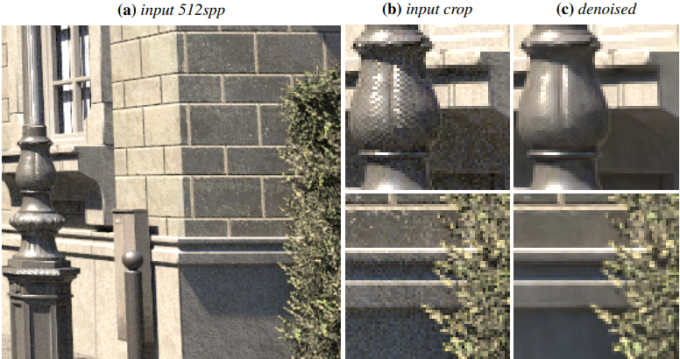
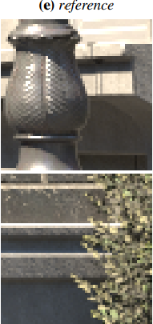
Denoising Error Estimation
Loss of detail comparison between rendered and denoised image
Input: 512spp, Denoised: OIDN, Reference (for error measurement): 65K+ spp
Notes:
This loss of detail can often be seen when comparing denoised and non-denoised images.
The example over here is rendered image with 512spp, denoised image of the first image using Intel open image denoise – OIDN in short, and ground-truth image for measuring errors are rendered at very high spp; say, 65K or higher.
[CLICK] As you see in this red box over here, the varying specular reflections from the light post seen in the input image are made smooth and blurred by the denoiser. Such loss of detail is also observed on the scene’s rough wall.

Slide 7
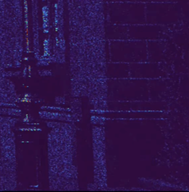
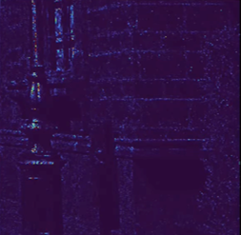
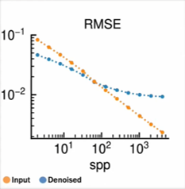
Denoising Error Estimation
Denoising reduces error almost everywhere in the scene, while error has actually increased in few spots
Denoising becomes counterproductive if spp > 80
Error: Non-denoised
Error: Denoised
Notes:
The difference can be made clearer by comparing error images; you can see that denoising reduces error almost everywhere in the scene, while error has actually increased in few spot.s
Plot of the error of denoised and non-denoised images against the number of samples per pixel shows this decreasing utility of denoisers;
This plot over here, yellow line is non-denoised image, and blue line is denoised image where x axis and y axis indicates the spp and RMSE, respectively.
As you see, if the spp is high enough, denoising becomes counterproductive and decrease the overall image quality-which is undesirable.

Slide 8

Question: How to improve overall image quality?
“Denoise only when it reduces error
compared to not denoising”
How to estimate in easier way?
“Computing error requires rendering
ground-truth image (65K spp)”
Notes:
Then, we have simple question here: how to improve overall image quality?
Best way would be denoise only when it reduces error compared to not denoising.
But the problem is, computing an error requires rendering ground-truth image with a very large number of spp – which is very bulky.
Therefore, we need a easier way to estimate the image error without knowing the ground-truth image.

Slide 9
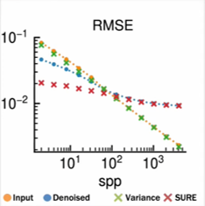


Using SURE to estimate error
SURE (Stein’s Unbiased Risk Estimate)
Statistical technique for estimating the MSE of estimator without requiring the true underlying model or parameters to be known.
Notes:
Authors used SURE (Stein’s Unbiased Risk Estimate) to address this problem: yeah, the formula looks scary, right? Actually it’s not that hard to understand what each terms mean, but since it’s not that important for understanding the high-level ideas of this paper, I would not go over it.
Just remember that SURE is a statistical technique for estimating the MSE of estimator without requiring the true underlying model or parameters to be known, which is very useful method in computer graphics for optimizing parameters of denoising functions.
As you can see from this plot, what you have to focus on it the blue line (which is the actual error of denoised image), and red line (which is error derived by SURE) – you can see that the accuracy of estimation is practical as the sample count increases.

Slide 10

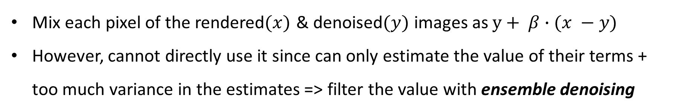
Optimal denoising mix using SURE
Mix each pixel of the rendered$(x)$ & denoised$(y)$ images as $y+ β∙(x −y)$
However, cannot directly use it since can only estimate the value of their terms + too much variance in the estimates => filter the value with ensemble denoising
Notes:
Authors used SURE for deriving the optimal per-pixel mix parameter between rendered (denoted as x) and denoised (denoted as y) images; where sigma is standard deviation, and f(x) is denoising function. again, I would not go over the details about this.

Slide 11
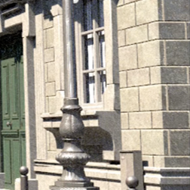
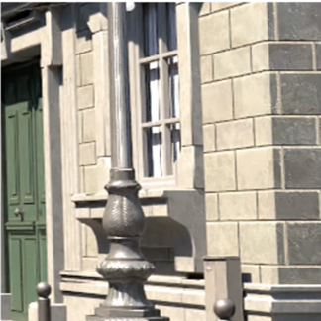

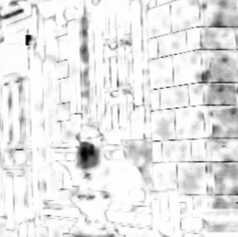
Core idea of progressive denoising
Take two images (rendered, denoised) as an input
Produce optimal per-pixel mix parameter (which takes the best pixels of each image)
Input 1: Rendered
Input 2: Denoised
Per-pixel mixing param
Notes:
Based on the preceding contents, this is the overall core idea of progressive denoising.
First take two images (which is rendered, and denoised) as an input, and then produce optimal per-pixel mix parameter for finding the best pixels of each image.
[CLICK] And the final output would be higher quality and lower error than either of the inputs.

Slide 12
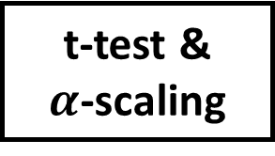
Pipeline of progressive denoising
1. A pre-existing image denoiser is employed, for which compute the SURE of its output
Color
Variance
Image
Denoiser
SURE
Computation
Neural Network
t-test &
$α$-scaling
Final
Image
Notes:
This slide simplifies the overall pipeline of progressive denoising into five essential steps:
The first step consists of denoising the rendered image with the pre-existing denoiser and computing an error estimate of its output using SURE.
Authors claim that they have tested denoisers with different neural network architectures, and found out that their method worked well to either of them.

Slide 13
Pipeline of progressive denoising
2. The rendered and denoised images, and estimates of their errors are inputs to the
neural network
Color
Variance
Image
Denoiser
SURE
Computation
Neural Network
t-test &
$α$-scaling
Final
Image
Notes:
Then, the rendered and denoised images along with estimates of their per-pixel error computed using SURE and sample variance respectively are fed as inputs into a neural network.
Authors have used relatively small convolutional neural network six layers deep with residual skipped connections between the layers.

Slide 14
Pipeline of progressive denoising
3. The neural network predicts a per-pixel mixing parameter $α∈[0, 1]$
Color
Variance
Image
Denoiser
SURE
Computation
Neural Network
t-test &
$α$-scaling
Final
Image
Notes:
The neural network then predicts a per pixel parameter alpha with which to mix the rendered and denoised images.
During training, authors have performed random swaps of the inputs switching denoised and rendered images along with their error estimates.
They found out that this prevented the network from falling into the local optimum of simply returning a value of 1, corresponding to a hundred percent of the denoise image, as this image is nearly always have lower error than the non-denoised image.

Slide 15
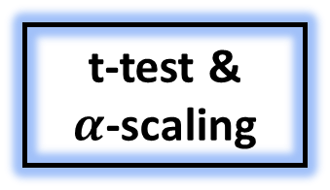
Pipeline of progressive denoising
4. The t-statistic is calculated for the mixed output, and $α$ is scaled if the output
deviates significantly from the rendered input.
Color
Variance
Image
Denoiser
SURE
Computation
Neural Network
t-test &
$α$-scaling
Final
Image
Notes:
To ensure the output is consistent in the limit of many samples, authors have calculate by how much the mixed output deviates from the rendered image by computing the t-statistic of the weighted average of each pixels’ neighborhood pixels.
If the absolute value of t-statistic is found to be large, meaning the predicted value deviates significantly from the rendered value then the mixing parameter alpha is scaled towards zero.

Slide 16
Pipeline of progressive denoising
5. The final image is computed using the rescaled $α.$
Color
Variance
Image
Denoiser
SURE
Computation
Neural Network
t-test &
$α$-scaling
Final
Image
Notes:
Finally, the rescale per pixel parameter alpha is used to mix the denoised and rendered images and this final image would be the output.

Slide 17
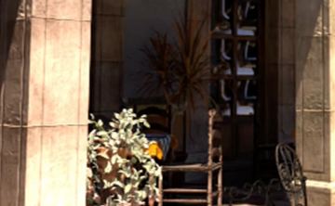
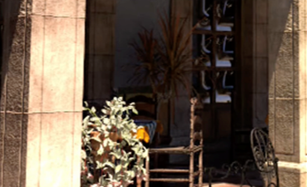
Results
Progressively denoised image recovers loss of detail occurred by denoising
Denoised (1024 spp)
Progressively Denoised (1024 spp)
Notes:
These are the results – comparison between denoised images and progressively denoised images.
You can see that loss of detail from denoised image on the left (the rough and bumpy surface from the red box) is recovered by progressive denoising, which is shown in the right image.

Slide 18
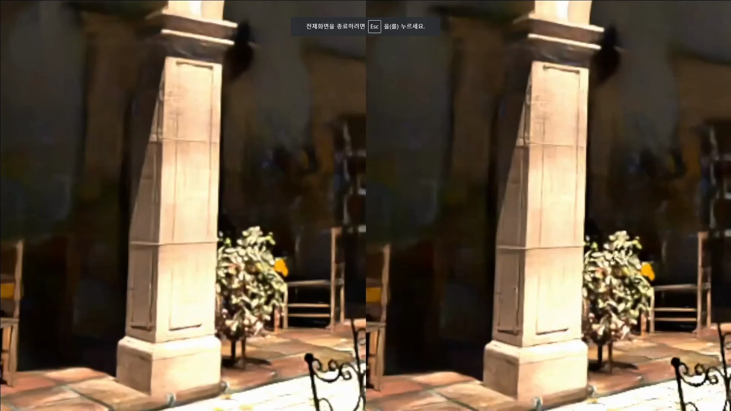
Notes:
This short clip of the same scene shows the novelty of progressive denoising;
With regular denoising on the left the image stops improving despite the increasing sample count, while progressive denoising on the right the details are getting recovered in the image.

Slide 19
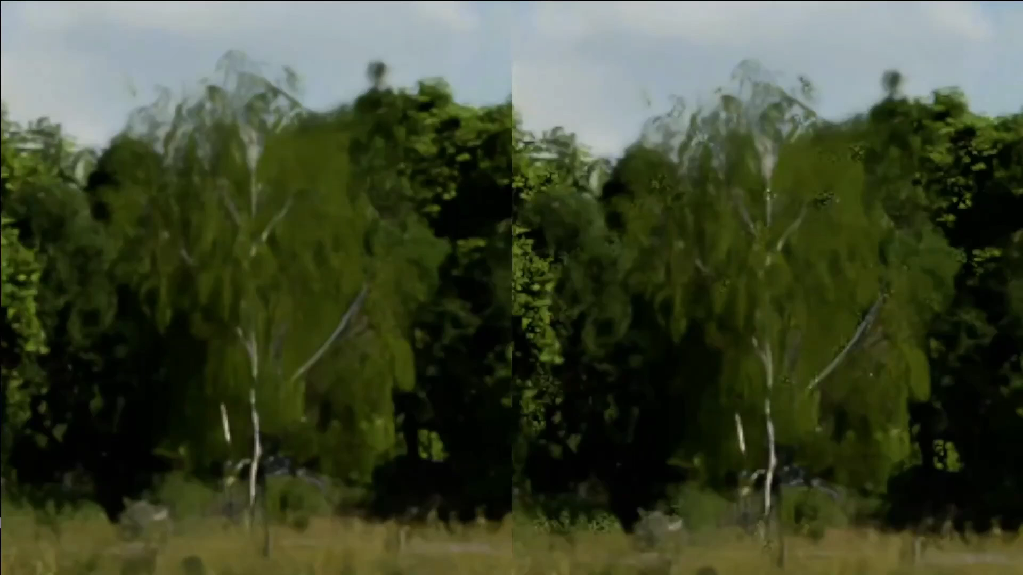
Notes:
This is another example
Landscape scene containing many small elements and high frequency details are actually a big challenge for existing denoisers; as you see in the left scene the small leaves in the distance often become blurred out, while progressive denoising on the right is well able to address such problem.

Slide 20
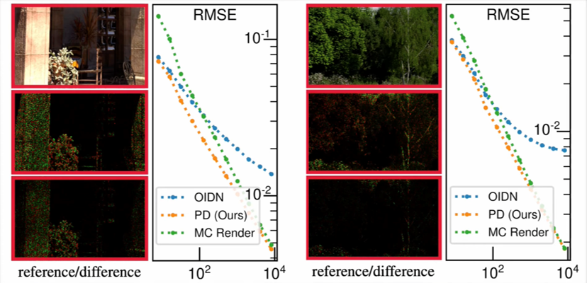
Results
Progressively denoised image recovers loss of detail occurred by denoising
Notes:
This plot shows the consistency of progressive denoising method.
In both plot, blue line is denoised image, yellow line is progressive denoised image, and green line is rendered image where x axis indicates spp and y axis indicates RMSE, respectively.
As the sample count increases, progressive denoising addresses the problem of whether to denoise or not to denoise while considering the risks for each decision.

Slide 21
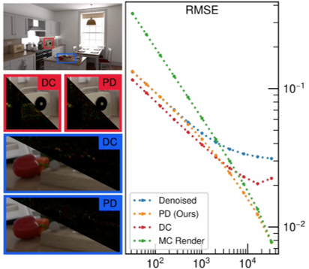
Results
Progressive denoising outperforms Deep combiner
Deep combiner combines estimates from denoised/rendered images and use neural networks
It predicts full rank kernel; which is costly compared to progressive denoising
Notes:
This plot shows that progressive denoising outperforms deep combiner: which is a title of related work
Deep combiner is somewhat similar with progressive denoising: it combines estimates from denoised and non-denoised images and use neural network to do so,
however unlike progressive denoising predicts a single mix parameter per pixel, deep combiner predicts a full rank kernel which will be applied to the input images which incurs additional computational cost compared to progressive denoising.

Slide 22
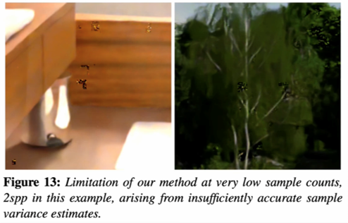
Limitations
Progressive denoising shows limitations at very low sample counts
Notes:
This slide illustrates the limitation of progressive denoising.
At very low sample counts, the t-statistic test sometimes fail due to insufficiently accurate sample variance estimates.
Many of these artifacts were mitigated by instead calculating the variance of a weighted average of each pixel’s neighborhood – but still, it can be a issue at low sample counts such as 2 spps like this example.

Slide 23
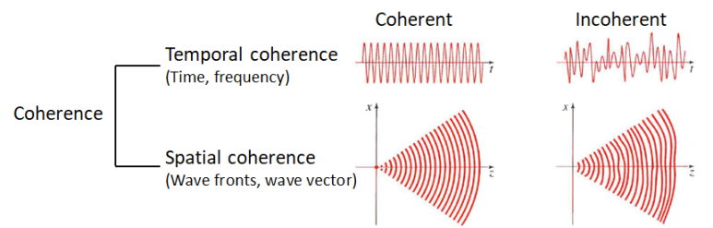
Limitations
Progressive denoising does not address the challenge of temporal coherency
Temporal coherence : characterizes how well a wave can interfere with itself at a different time. High temporal coherence in scenes appear to move seamlessly, without abrupt jumps or disruption
Notes:
Another limitation is that progressive denoising does not address the challenge of temporal coherency.
We got new terminology here, temporal coherency: this characterizes how well a wave can interfere with itself at a different time. In other words, high temporal coherence in scenes appear to move seamlessly, without abrupt jumps or disruption. Due to the stochastic nature (which involves randomness from samples) of monte carlo denoising methods, it is likely to disrupt the temporal coherency of the video sequence.

Slide 24
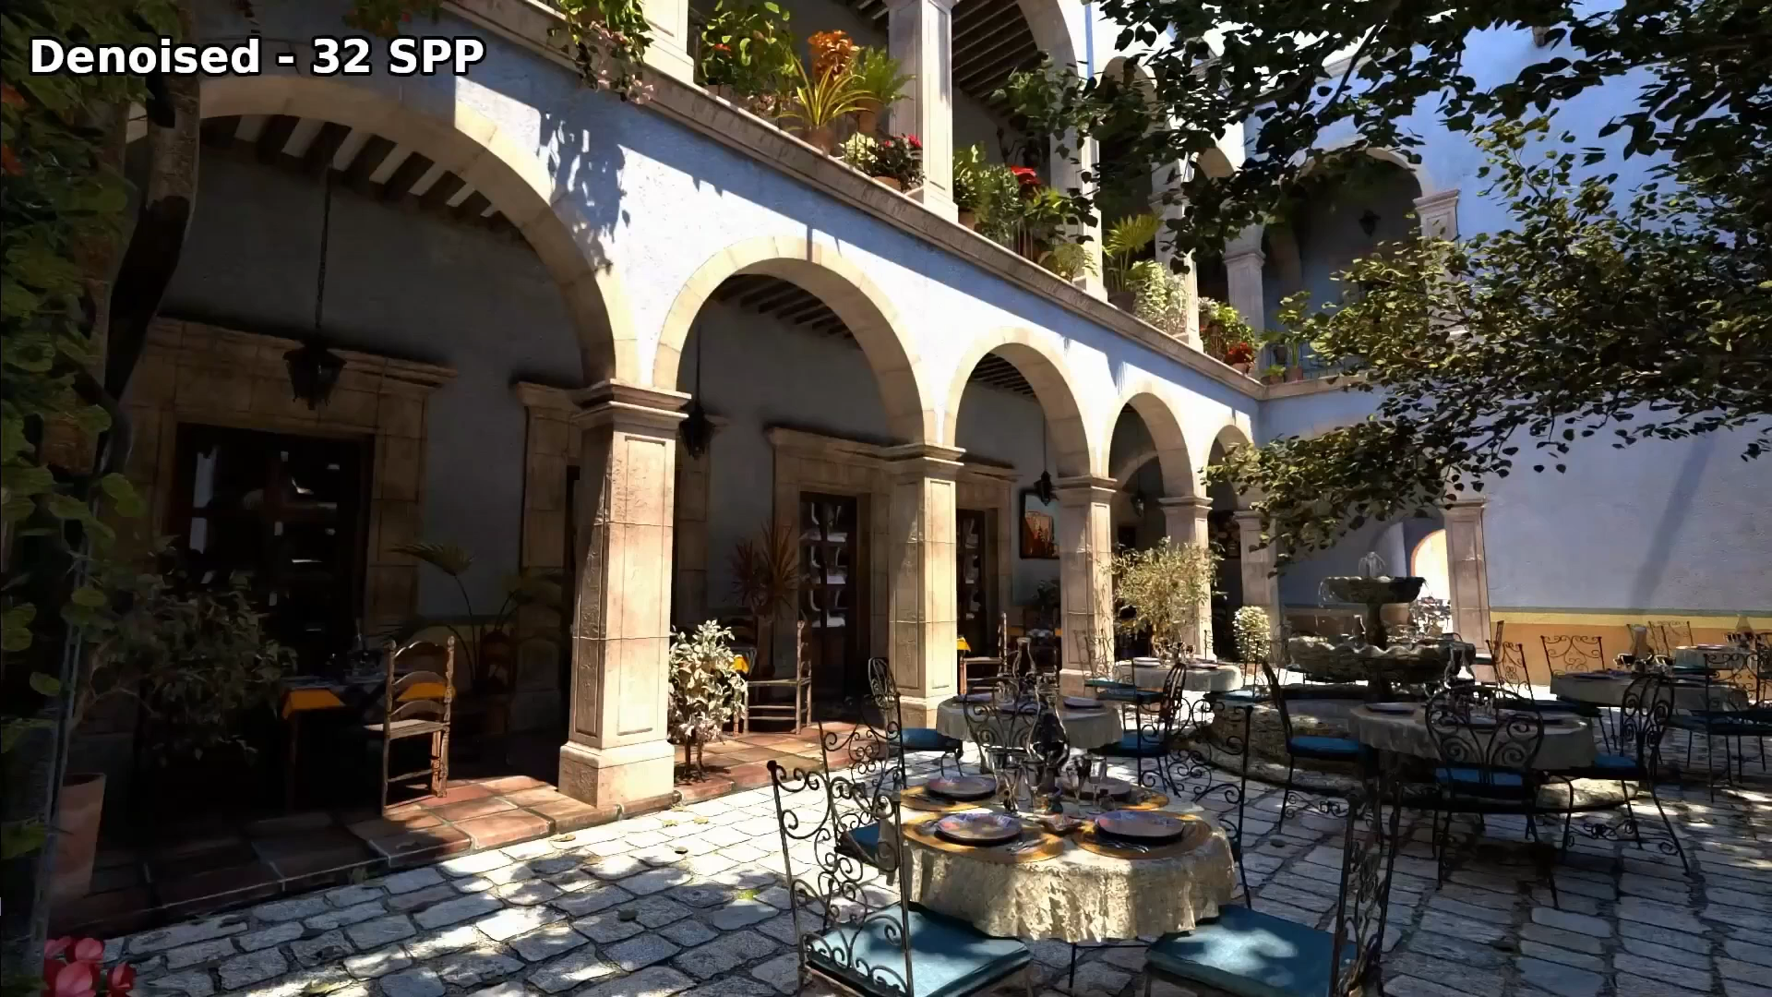
Notes:
Authors say that when compared to the same sequence denoised without progressive denoising, they found no visual improvement in terms of temporal coherency. So they leave this as a future work, to investigate how approaches used to construct temporally coherent denoisers could be combined with the progressive denoising method.

Slide 25
Takeaways
Progressive Denoising is a technique that improves denoising by applying it only when it is beneficial.
  Incorporates error estimates to infer a per-pixel mixing parameter between denoised and rendered images.
  Makes denoising asymptotically unbiased
  Can be applied to existing high-quality denoisers
Future Work
  Improve robustness at very low sample counts
  Improve temporal coherency
Notes:
To conclude, these are the takeaways: progressive denoising is a technique that improves denoising by incorporating it only when it is beneficial over the rendered input.
It makes denoising asymptotically unbiased, and can be used on top of existing high-quality denoisers.
Future works would be improving robustness at very low sample counts, and improving the temporal coherency.

Slide 26
Thank You
Jaehyun Ha jaehyunh1@kaist.ac.kr
Notes:
This is end of our presentation, thank you for listening.

Slide 27
Quiz
Notes:
This was all what I have prepared, and I will go for some good & best questions from you guys.

Slide 28
Quiz
Quiz 1.
Which is true about progressive denoising?
It produces optimal mix parameter for every pixel.
Requires ground-truth image for estimating MSE.
Used CNN with seven layers-deep.
Works well for every sample counts.
Quiz 2.
Fill in the blank.
Progressive denoising should improve addressing _________________ coherency problem.

Slide 29
