Slide 1
Rendering Volumes
20193169 Hyunsoo Kim
Contents
Introduction
Spectral and Decomposition Tracking for Rendering Heterogeneous Volumes
(Peter Kutz, Ralf Habel, Yining Karl Li, and Jan Novák, ACM SIGGRAPH 2017)
Lighting Grid Hierarchy for Self-illuminating Explosions
(Can Yuksel, and Cem Yuksel, ACM SIGGRAPH 2017)

Slide 2
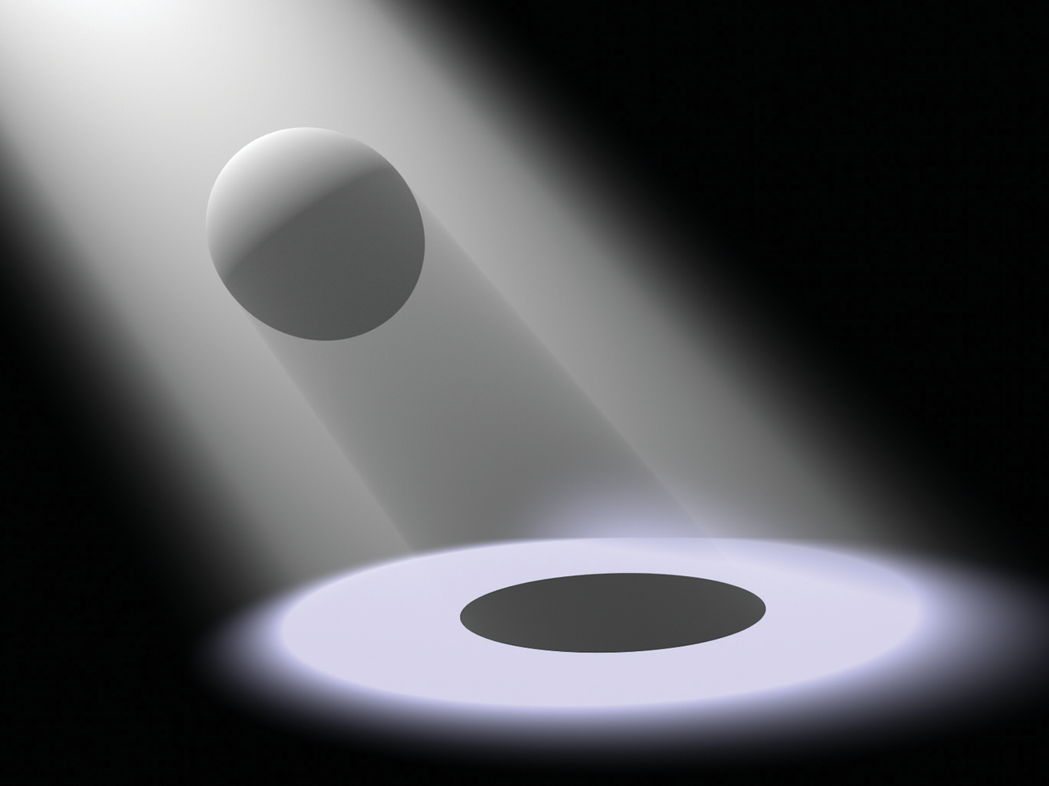
0. Introduction
Volume scattering process & Radiative transport equation
Notes:
Slides from Monte Carlo Methods for Volumetric Light Transport Simulation
(http://drz.disneyresearch.com/~jnovak/publications/VolumeCourse/index.html)

Slide 3
Volume scattering process
Q: How do lights interact with volumes?
A:
- absorption coefficient
- scattering coefficient
- in-scattered radiance
- emitted radiance
Losses
Extinction coefficient
Phase function

Slide 4
Radiative transfer equation
(a.k.a Volume rendering equation)
Absorption
Out-scattering
Extinction coefficient
Losses
Losses
Gains
Emission
In-scattering

Slide 5
Radiative transfer equation
Transmittance
Emission
In-scattering

Slide 6
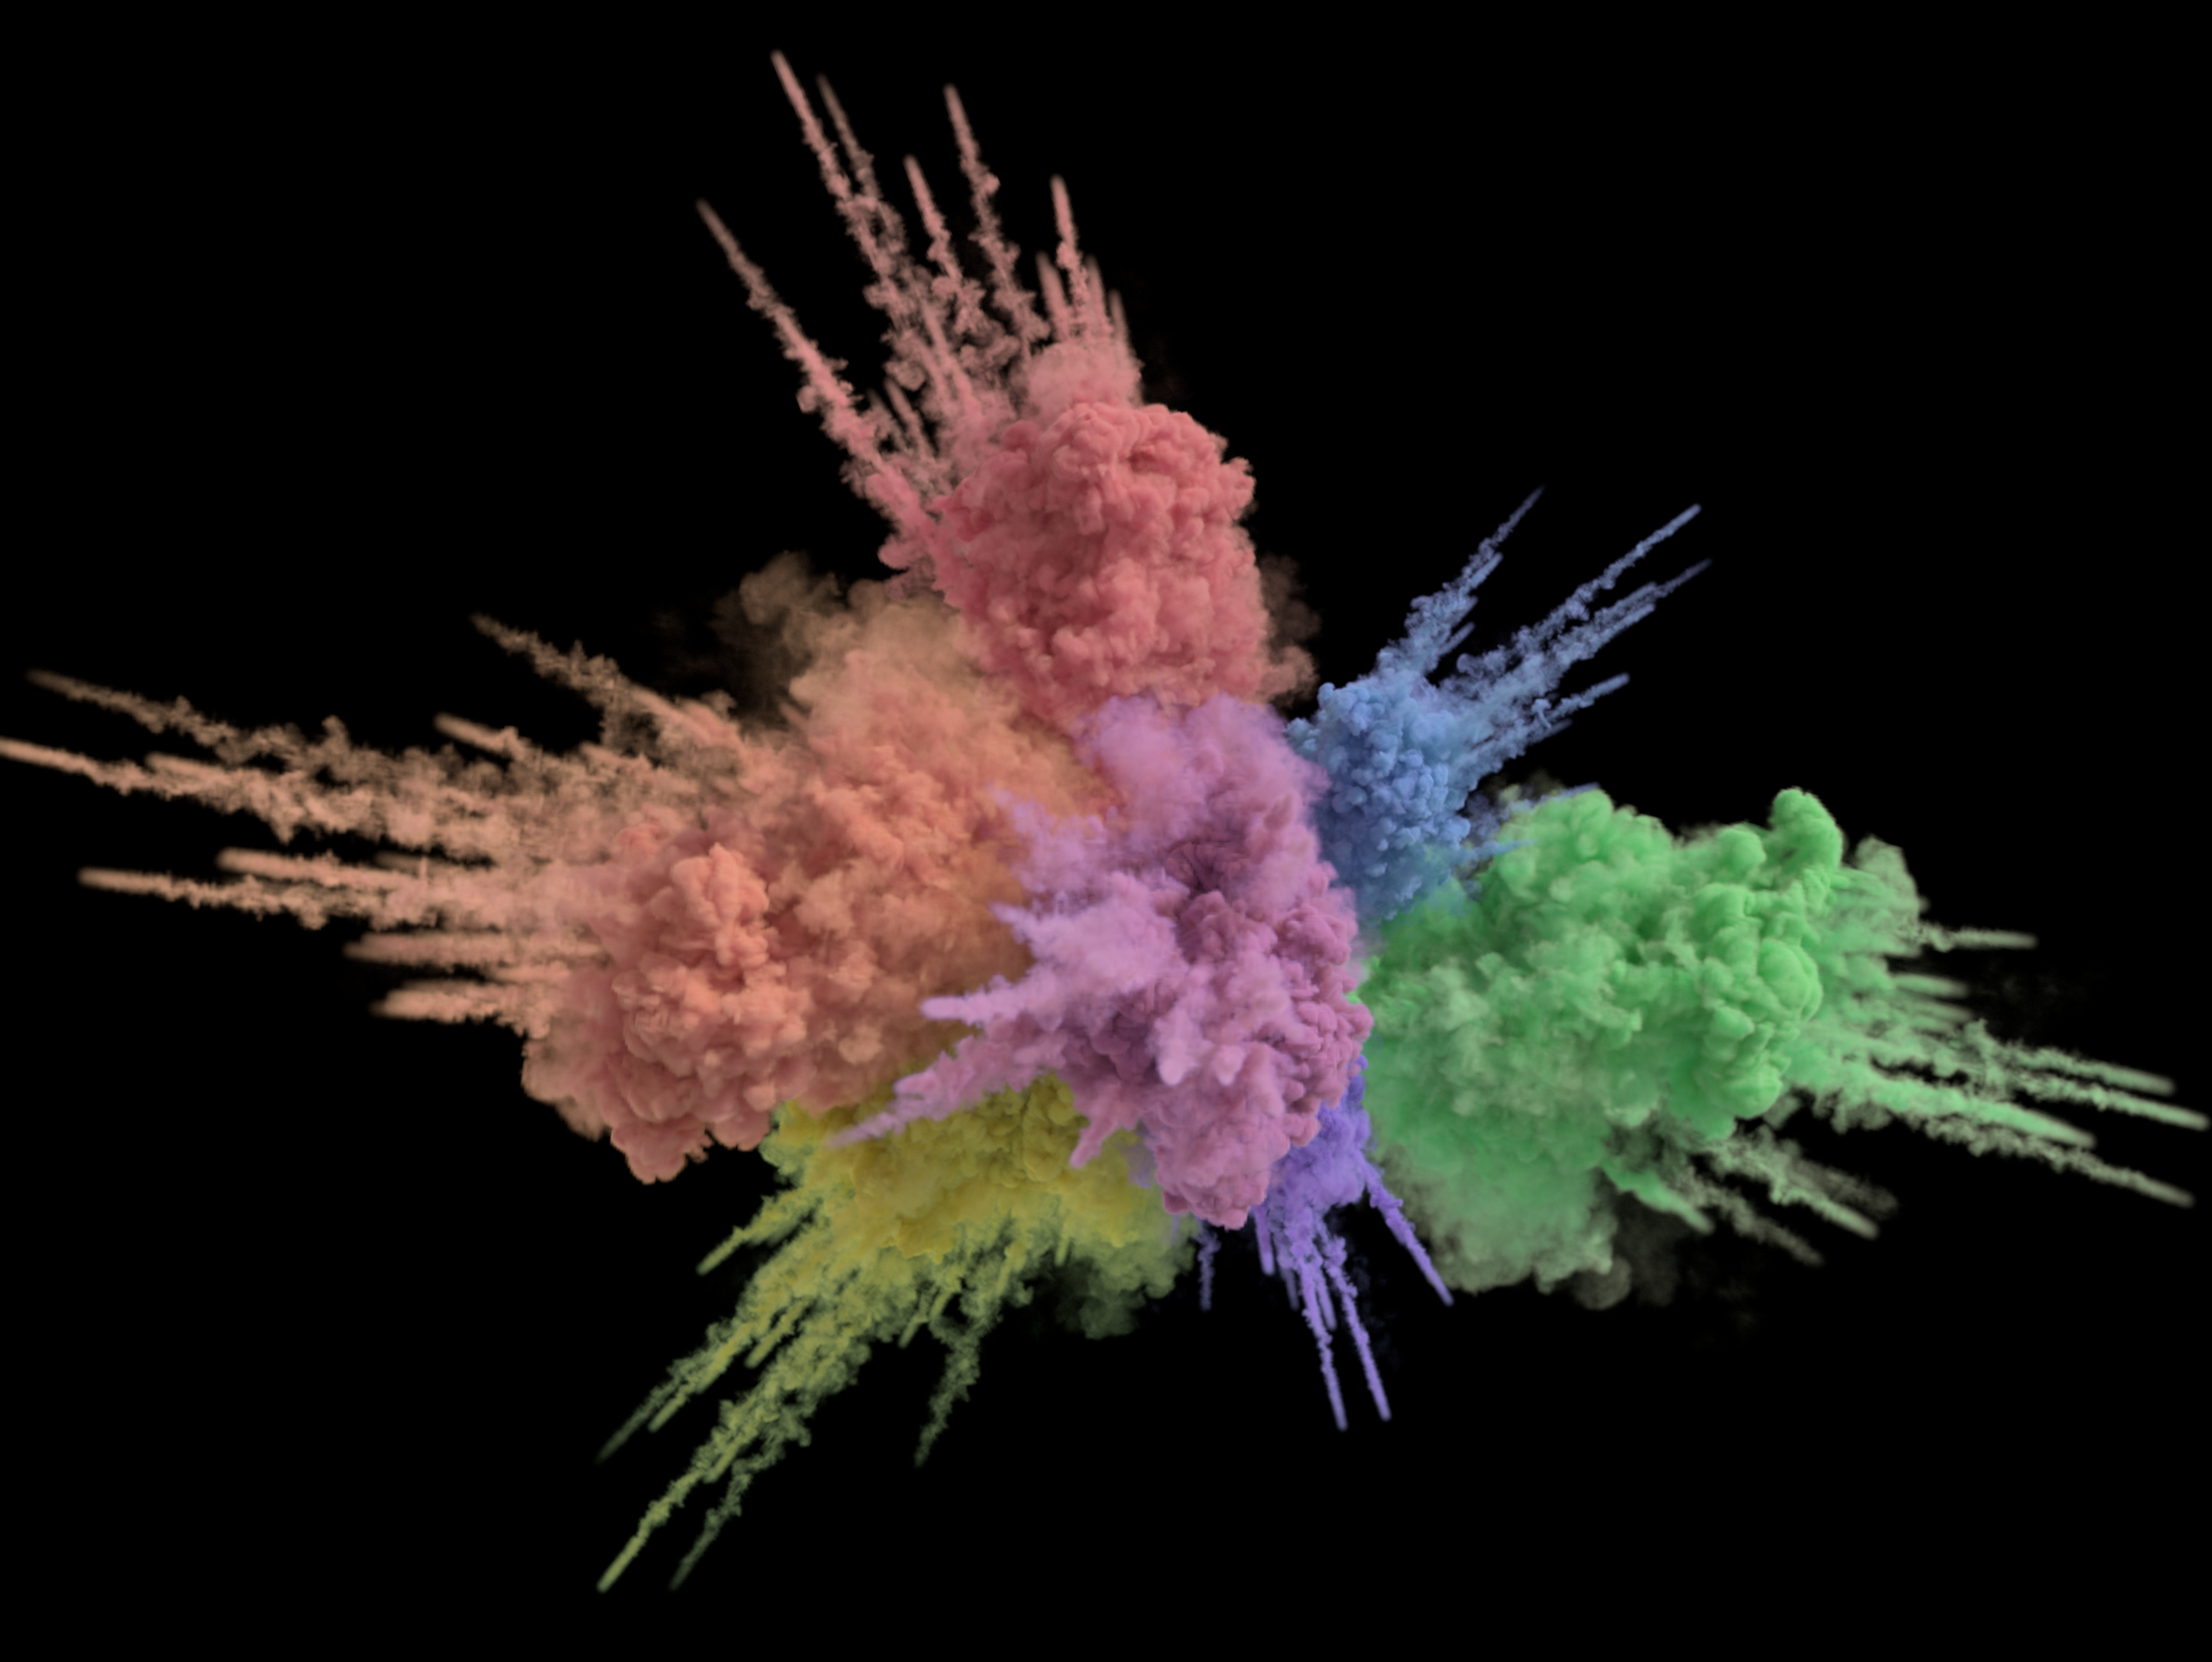
Spectral and Decomposition Tracking for Rendering Heterogeneous Volumes
Peter Kutz, Ralf Habel, Yining Karl Li, and Jan Novák
ACM Transactions on Graphics (Proceedings of SIGGRAPH 2017), vol. 36, no. 4
Notes:
Slides from the original authors (http://drz.disneyresearch.com/~jnovak/publications/SDTracking/index.html)

Slide 7
Distance sampling

Slide 8
Closed-form tracking
Relative probability
1
Analytic → Easy, fast
Only for homogeneous medium!
= constant extinction coeff. $μ_{t}$
1/2
1/4
1/8
1/16
1/32
0
1
2
3
4
5
Ray distance

Slide 9
Heterogeneous volume

Slide 10
Delta tracking
Delta tracking
= real
lookup
lookup
= fictitious
extinction
How to reduce #lookups?
distance
Heterogeneous volume support
Unbiased
Distance is sampled as if $\overline{μ_{t}}=\max_{x}{μ_{t}(x)}$
= more ray fragments, more lookups = SLOW!!
Notes:
Here’s a plot of the extinction along the ray. We take a step forward as if the volume were homogeneous with the maximum extinction coefficient of the combined volume, look up the ratio of real and fictitious media at the point, draw a random number, and check whether it corresponds to the real or fictitious medium. We repeat this process until we hit the real medium.

Slide 11
Decomposition tracking
Distance sampling with closed-form tracking
Control medium (homogeneous)
Distance sampling with delta tracking
Only lookup if $d_{r}<d_{c}$
Original medium
Residual medium + fictitious medium

Slide 12
Decomposition tracking
= fictitious
= residual
lookup
= control
extinction
distance
Less lookups → less volume data access
Also unbiased!

Slide 13
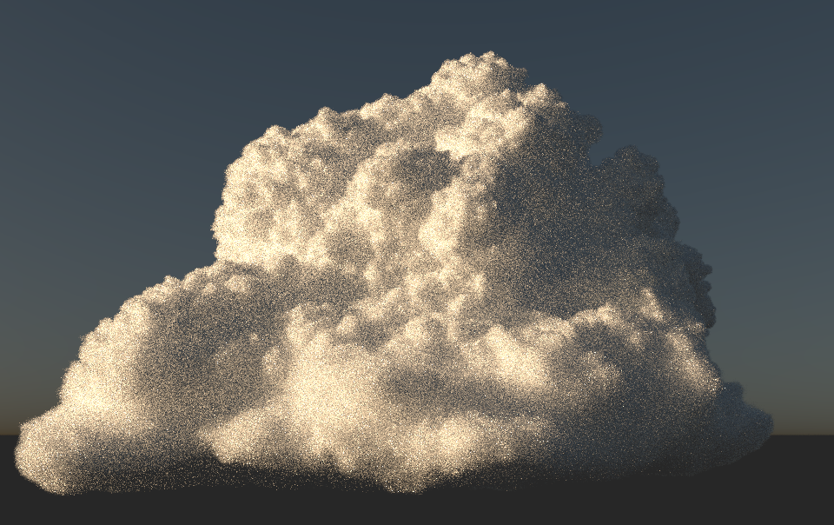
Performance comparison
Delta tracking
Decomposition tracking
☺ 42% fewer lookups

Slide 14
Scattering with colors
How to reduce variance?
In real world, scattering properties vary as wavelength changes
e.g. sky is blue, sunset is red
Requires separate distance sampling for each wavelength
☹ High variance

Slide 15
Spectral tracking
Using same distance sampling, but different weights
Less variance!
Unbiased
Repeat:
Step forward using fpsc.
If scat using scat prob:
Apply (weight1, weight2, weight3).
Change direction.
Else if fict using fict prob:
Apply (weight1, weight2, weight3).

Slide 16
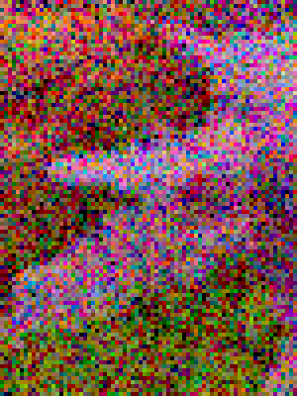
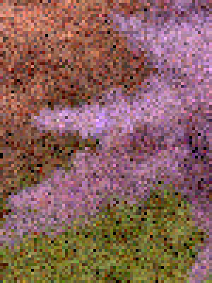
Performance comparison
Delta tracking
Spectral tracking
Reference
☺ 2.7x faster converging

Slide 17
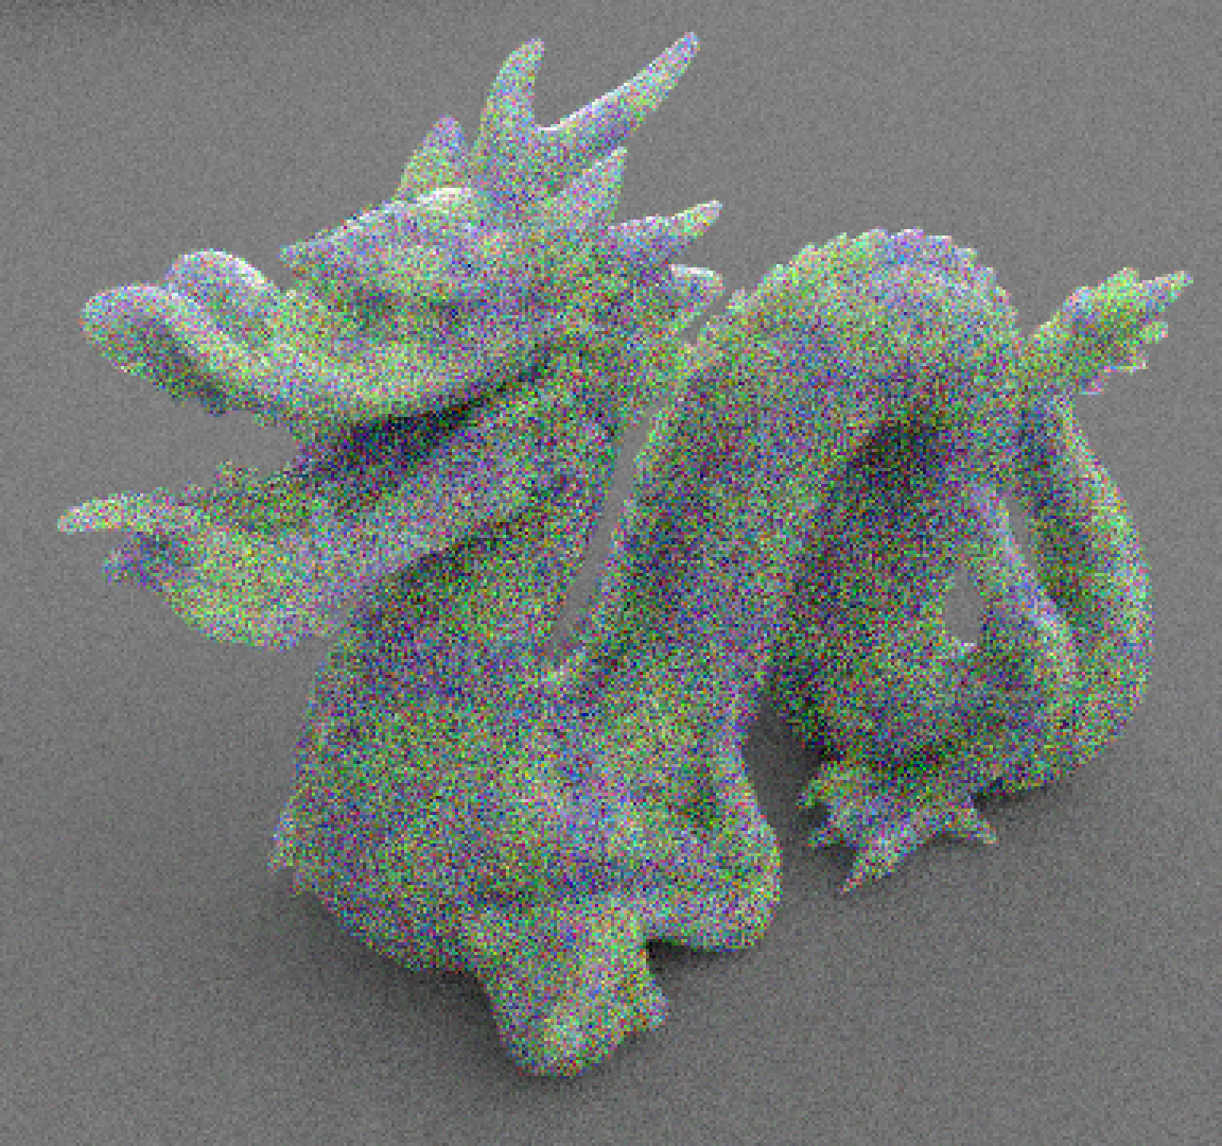
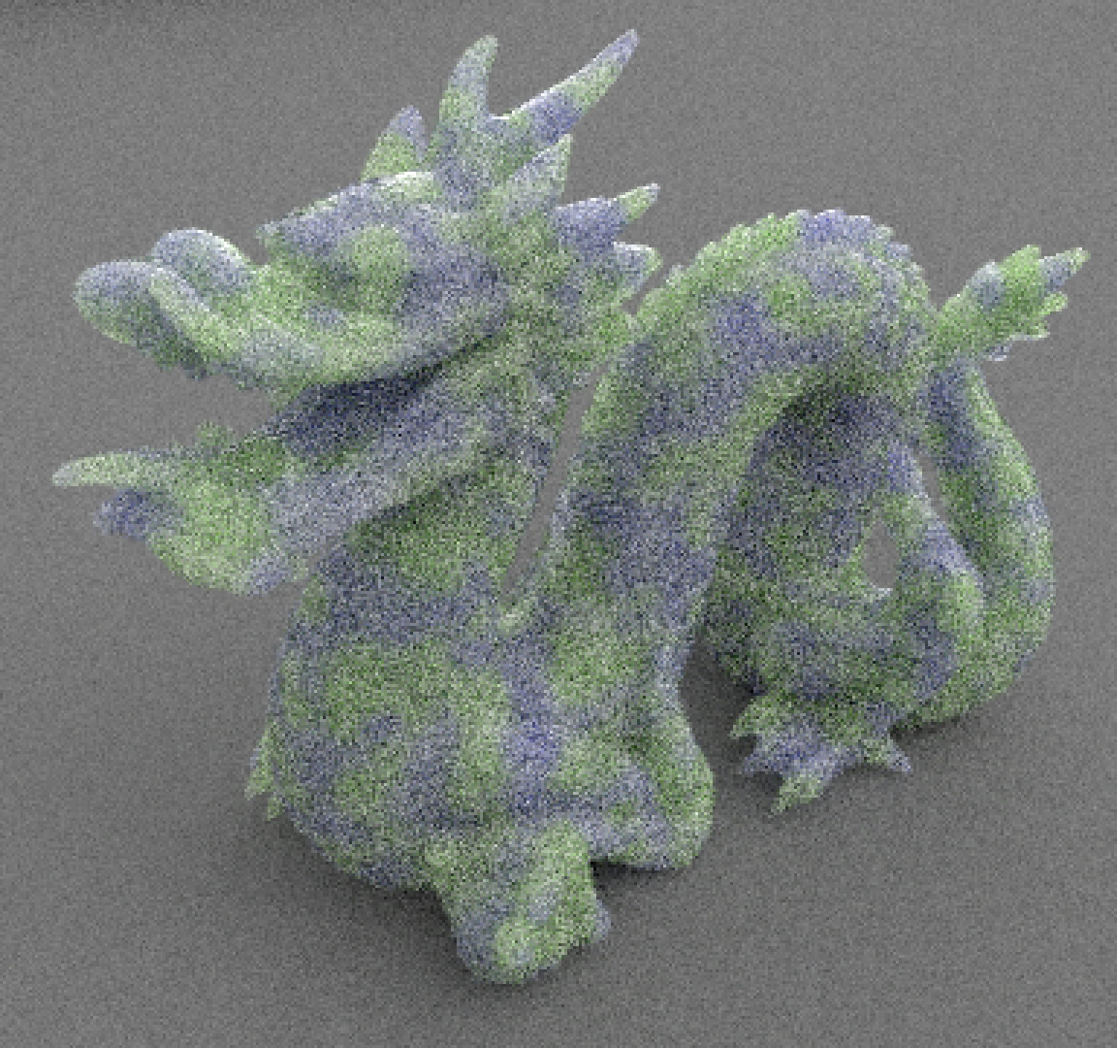
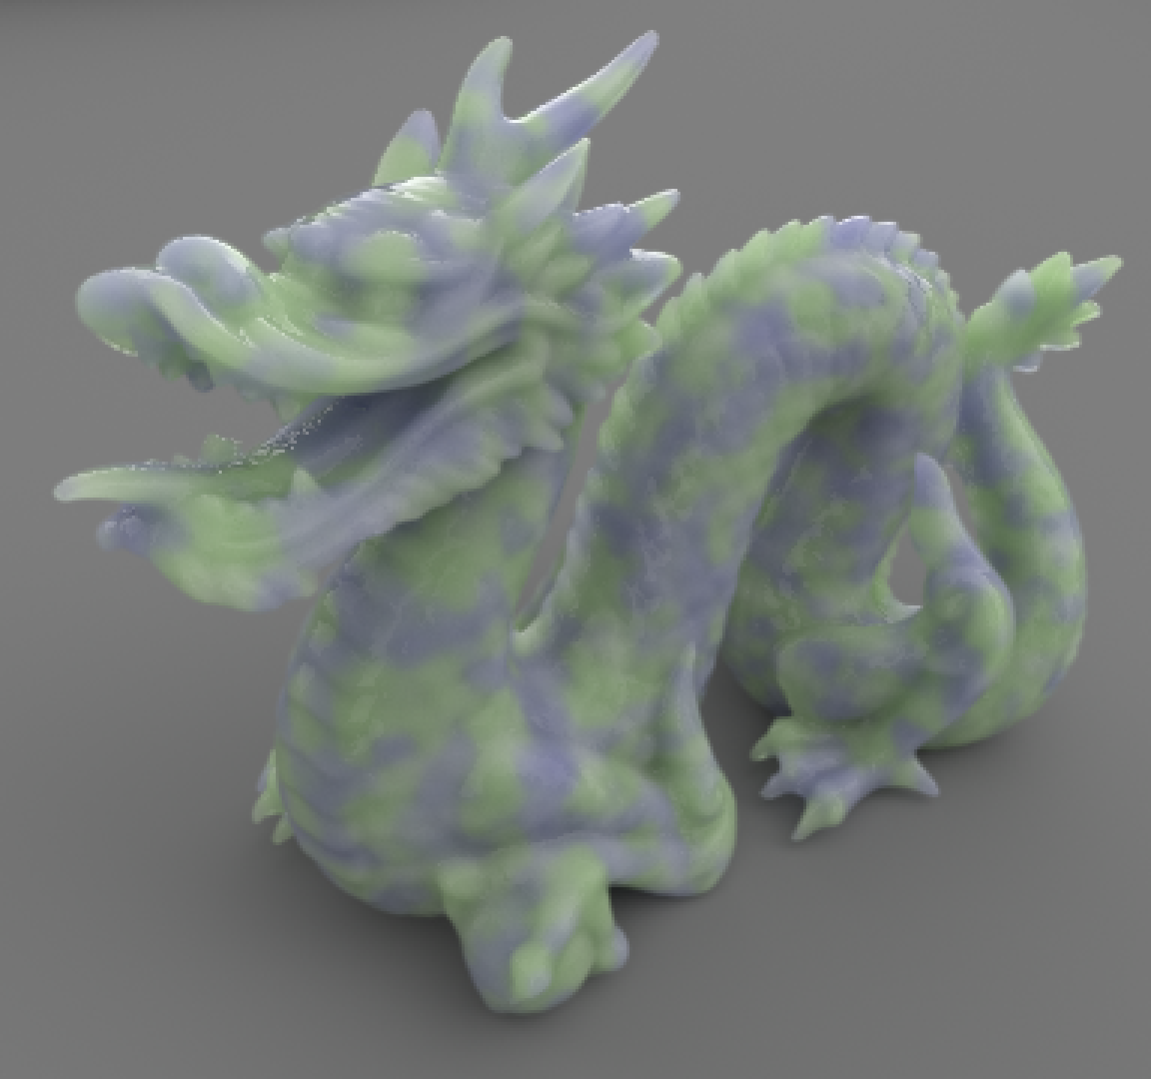
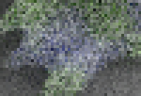
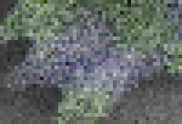
Putting it all together
Delta
Spectral
Spectral + Decomp.
Reference
3.4x Faster
4.1x Faster

Slide 18
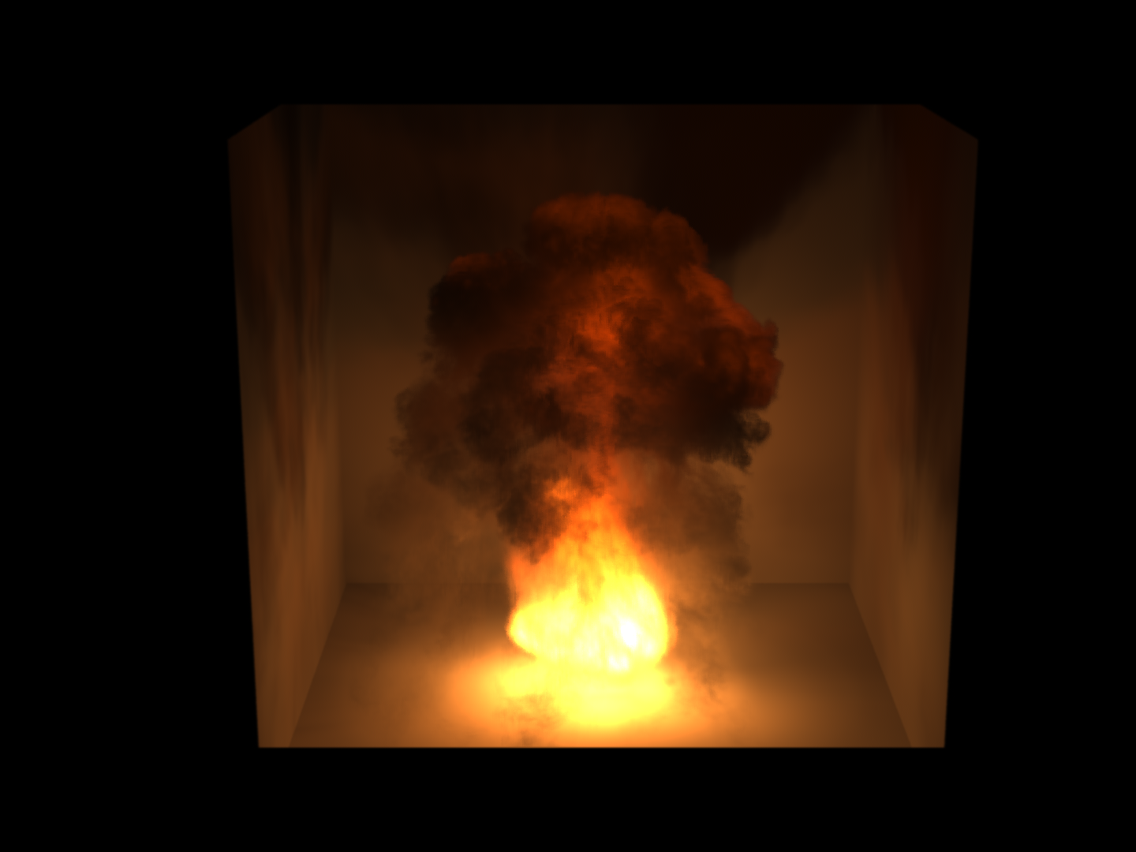
Lighting Grid Hierarchy for Self-illuminating Explosions
Can Yuksel, and Cem Yuksel
ACM Transactions on Graphics (Proceedings of SIGGRAPH 2017), vol. 36, no. 4
Notes:
Names pronunciation: John Yuksel and Jem Yuksel

Slide 19
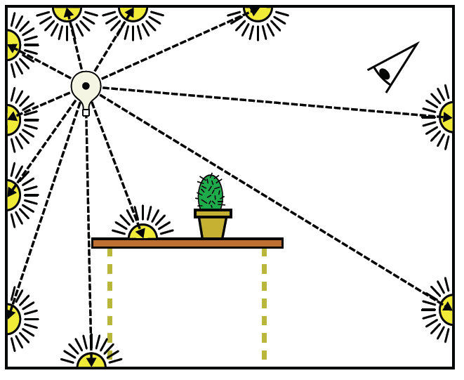
Volumetric lighting problem
Still expensive + noisy
How to shade with
so many point lights?
Approximate with many point lights (light emitting voxels)

Slide 20
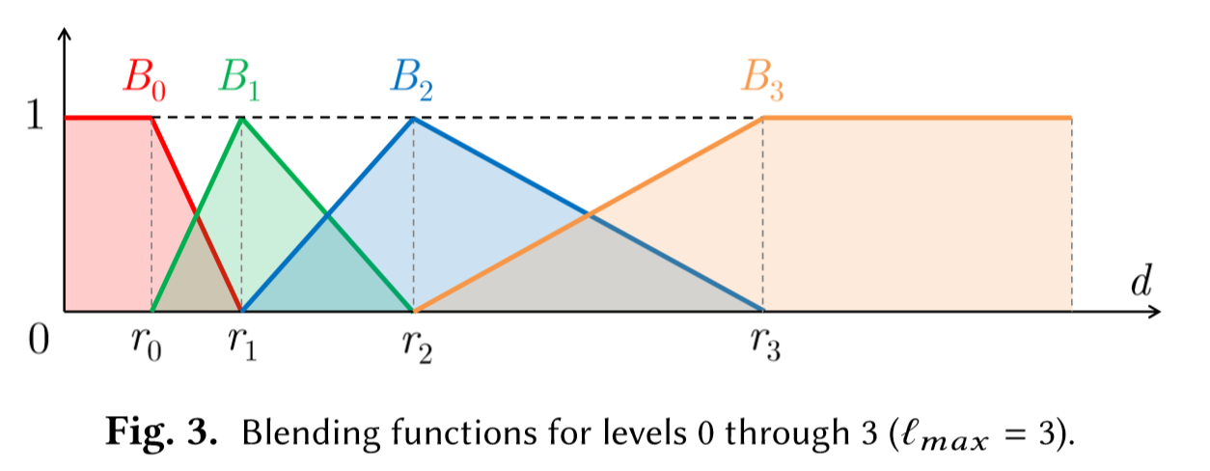
Lighting grid hierarchy
Build a lighting grid hierarchy from VPLs
Shade by blending levels together

Slide 21
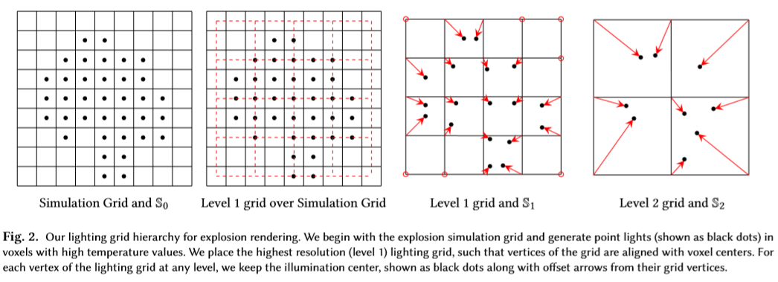
Building LGH
Build new level upon previous level
Each level is a coarser version of previous level
Procedural, deterministic → Temporally coherent
→ No flickering

Slide 22
Estimating lighting
Lights in each level has a limited range
Efficient computation!
Smooth blending
☺ Avoid binary decision → Spatially coherent

Slide 23
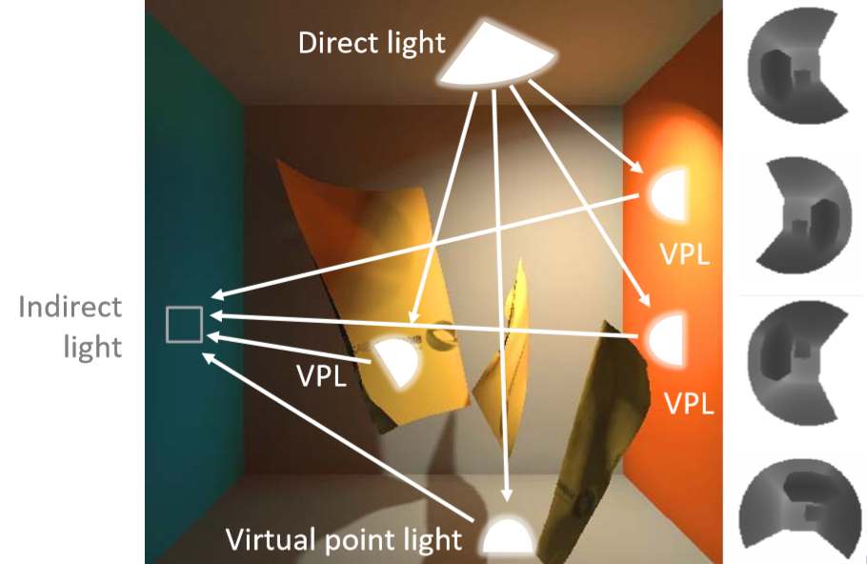
Shadowing
Shadow mapping?
Too many shadow maps!

Slide 24
Shadowing
Shadow mapping?
Too many shadow maps!
Well, actually…
Finer levels have limited ranges → Small cube-map is sufficient!
☺ Affordable number of shadow map texel computation

Slide 25
Scattering
So far, direct illuminations only
What about indirect illuminations?
Approximate out-scattering with VPL, too!
No special step needed, just another iteration
Only for isotropic mediums

Slide 26
Performance comparison

Slide 27
Thank you!
Questions?

Slide 28
Quiz!
1. What is the benefit of decomposition tracking?
2. Is shadow mapping feasible for LGH? Why?
It required fewer volume lookups
It computes distance samples analytically
It creates fictitious particles
It reduces variance due to separated color rays
No, because there are millions of lights
No, because shadow map does not fit for hierarchical structures
Yes, because lights have limited ranges of shading
Yes, because only lights on the finest level will have shadow maps

