Slide 1
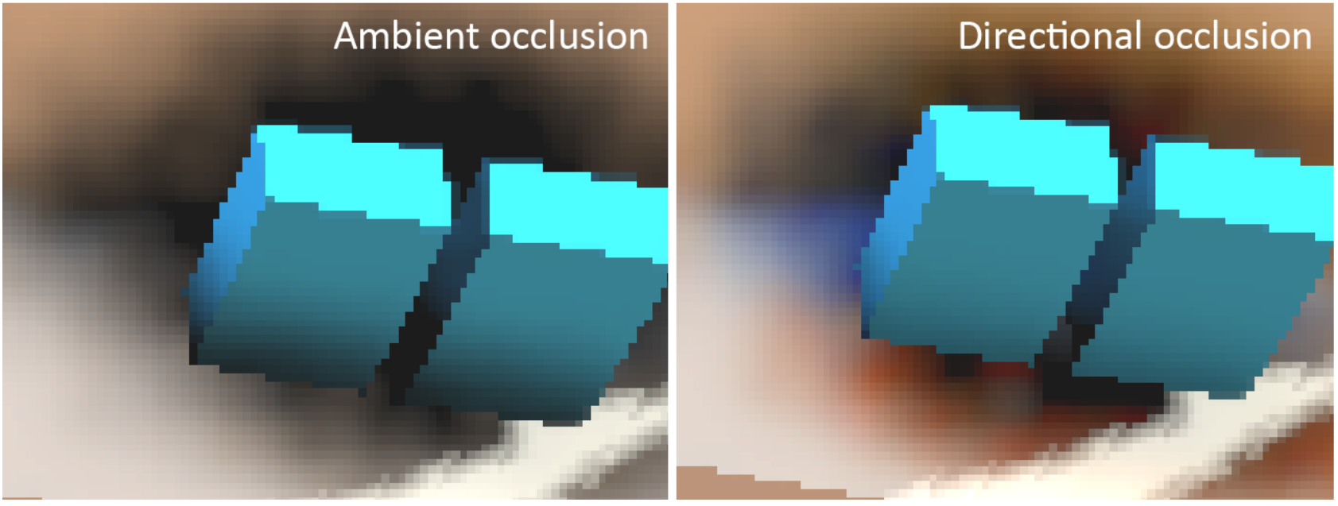
Directional Occlusion with
Neural Network
Team 2
20184230 Saehun Kim
20193138 Jaeyoon Kim

Slide 2
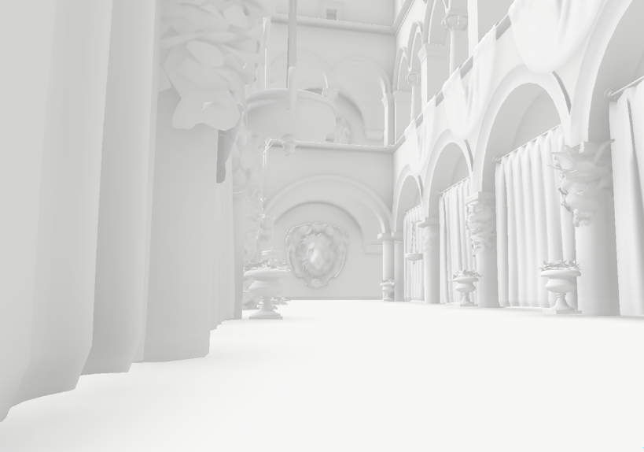
Ambient Occlusion
Ambient occlusion
  After modeling ambient lighting with local illumination
Notes:
중간발표에서 봤듯이 AO는 local illumination에서 light를 조금 더 사실적으로 표현하기 위한 기법 중 하나이다.
먼저 일반적인 방법으로 ambient light를 만든 다음에

Slide 3
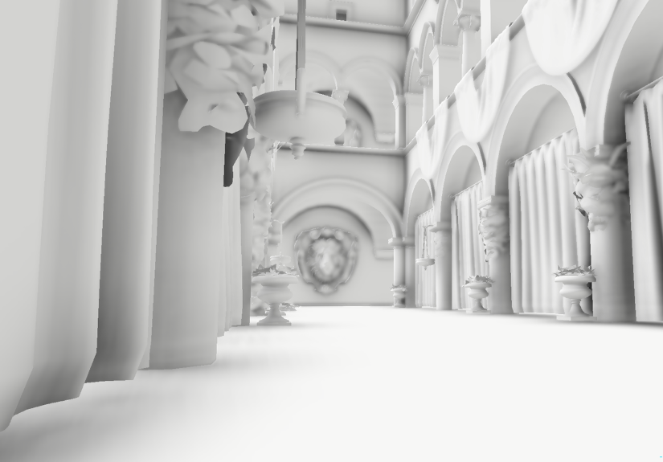
Ambient Occlusion
Ambient occlusion
  Add shading
Notes:
그림자를 추가한다.
You can feel the image with AO is more realistic.

Slide 4
Why AO?
Why use ambient occlusion
Ray tracing
Perfect shadow
Too slow
3D scene
Simple render
Ambient occlusion
Approximate shadow
3D scene
Notes:
Then, why do we use this technique?
Global illumination, for example ray tracing, gives high quality and realistic images, but it takes very long time.
On the other hand, ambient occlusion gives less realistic images, but it can be done very fast.

Slide 5
Directional Occlusion
Directional occlusion
  Consider direction of light & indirect light when adding shadows
  Support color bleeding
  More realistic shadows
Dirty shadow
Realistic shadow
Notes:
And there is another technique, directional occlusion.
DO is advanced form of AO.
DO considers the direction of light, and indirect lighting.
DO gives more realistic images than AO.

Slide 6
AO? DO?
Ambient occlusion (Scalar value)
Directional occlusion (vector)
    ‘Blue indirect light coming’
    40% occluded
    Shade the point 40% darker
    ‘We know what direction the light comes from’
Notes:
AO only calculate how much percent of light is occluded.
But DO calculate what color of light is coming from what direction, and how much of the light is occluded.

Slide 7
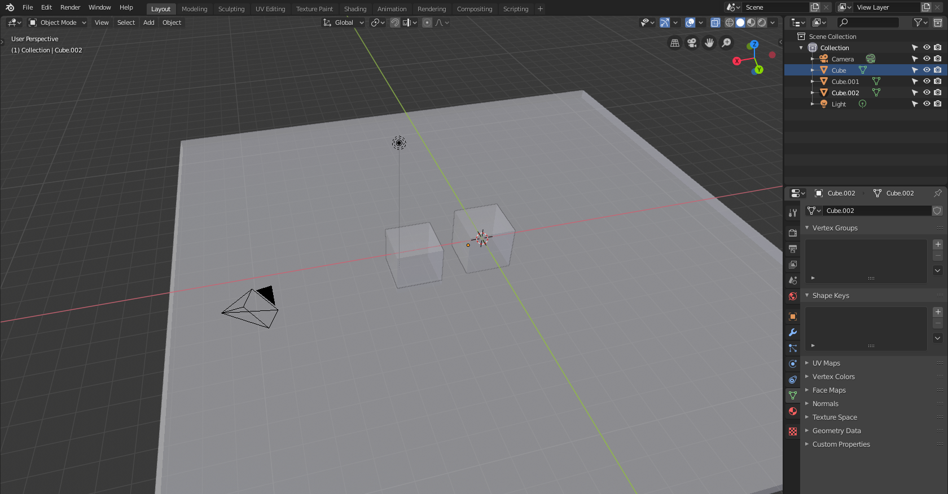
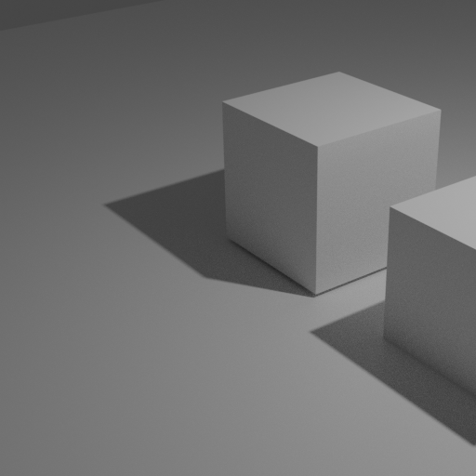
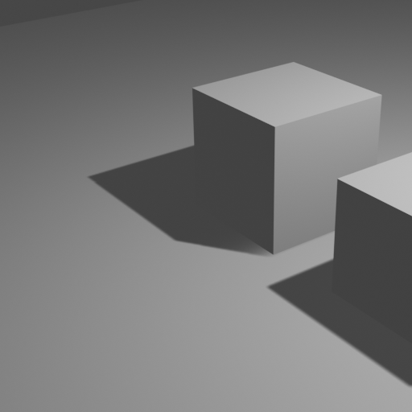

Previous Works
Realistic scene by
global illumination
Machine learning
for real time
Simple render
Awkward scene
Thanks to Benjamin Keinert
(2018)
Ambient occlusion
Add shadow
Machine learning
for real time
Notes:
As 세훈 introduced in his presentation, Benjamin Keinert et al. introduced a real-time AO technique using machine learning.

Slide 8
What we want to do
Realistic scene by
global illumination
Machine learning
for real time
Simple render
Awkward scene
Directional occlusion
Machine learning
for real time
Notes:
Our goal is to modify the network and make a real-time DO technique using ML.

Slide 9
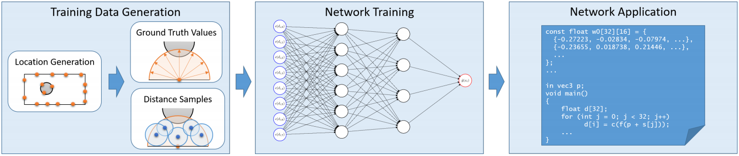
Previous Works
Keinert et al., Learning Real-Time Ambient Occlusion from Distance Representations (I3D2018)
Additional shader program
distance sample
MLP
AO value
shader
Image w/ AO
Neural Network Learning
Image w/o AO
Notes:
Let’s see more about Keinert’s network.

Slide 10
Benchmark
Our own network for DO
distance sample
MLP
DO value
shader
Image w/ DO
color
Image w/o DO
light info
…
Notes:
We can add color input, light information, and some other thing.

Slide 11
Problems
We cannot use existing dataset used in previous works.
It is difficult to calculate distance samples in OpenGL.

Slide 12
Problem 1
We cannot use existing dataset used in previous works.
We need additional data such as distance samples, which requires 3D modeling data.
But there is no 3D modeling information in datasets of previous works.
  Only 2D normal, position image
Therefore, we need to make new 3D models and scenes, and construct our own dataset.

Slide 13
What renderer to use?
 | OpenGL | Mitsuba | 3ds max | Blender | OptiX
Directional Occlusion | X | O | O | O | O
G-buffer | O | △ | X | X | △
Distance Samples | △ | X | X | X | △
O: immediately possible △: possible with little efforts X: impossible or possible with a lot of efforts
Unfortunately, there is no renderer that can make all data we want.
We decided to make DO ground truth images using Mitsuba renderer and make G-buffer and distance samples using openGL.
Notes:
Then, how can we make our own dataset?
Which renderer can we use?
The table shows the comparison among some renderers.
O means …, X means …, and △ means …
Unfortunately, there is no renderer that can make all of what we want.
So we chose two things: mitsuba renderer for DO and OpenGL for G-buffer and distance samples.

Slide 14
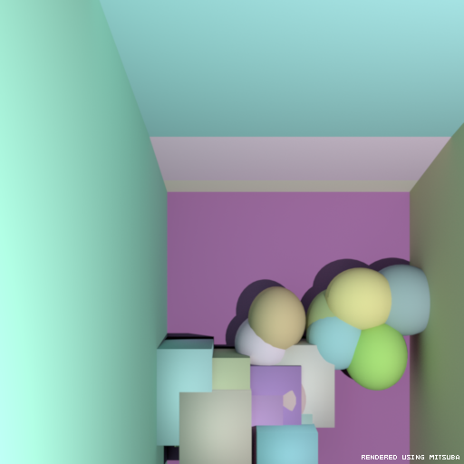
Data 1: Directional Occlusion Ground Truth
Ground truth images with directional occlusion can be made by path tracing of light path length ≤ 3.
We rendered 512×512 px images using mitsuba renderer. (spp 1024)
Mitsuba renderer requires xml scene files and obj 3D modeling files.
Scene files and modeling files are made by our own data generator.

Slide 15
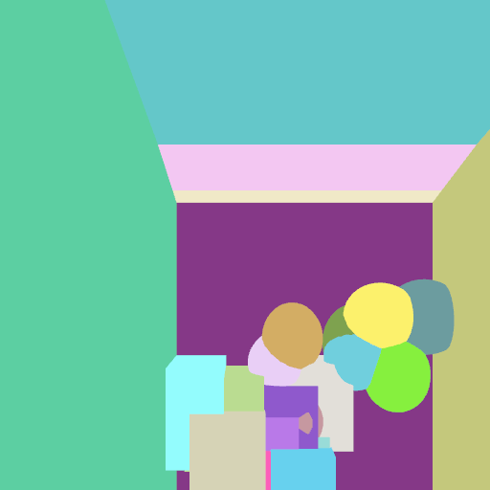

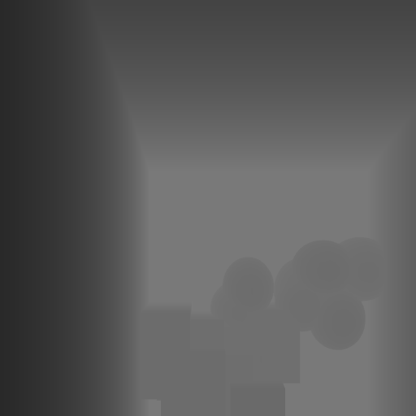
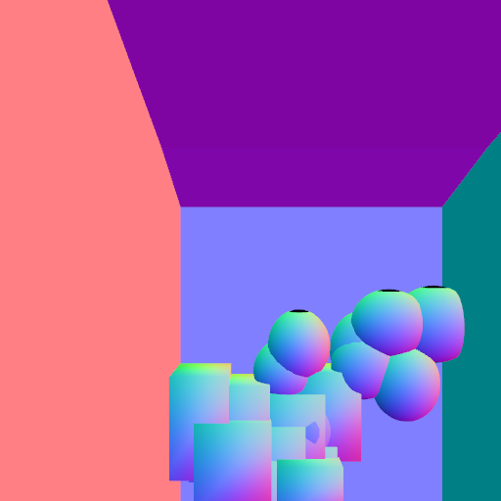
Data 2: G-Buffer
G-buffer: A screen space representation of geometry and material information
We use color, normal vector, and depth buffers.
G-buffer can be easily created by openGL
Color
Position
Depth
Normal

Slide 16
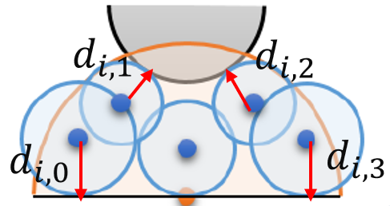
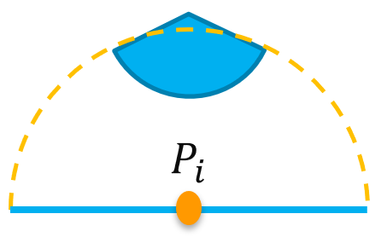
Data 3: Distance Samples
Distance Samples: vector of distances between samples and nearest faces.
With distance samples, we can know
approximation of geometry around
the point Pi

Slide 17
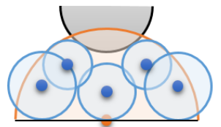
Problem 2
It is difficult to calculate distance samples in OpenGL.
To calculate distance samples:
  For a surface point, sample 3D points
  inside a hemisphere. (orange)
  Get distance values of sampled points. (blue)
In OpenGL shader programs, it is impossible to access data of all faces.
  cannot calculate the distances between samples and faces.
The purpose of distance samples is to help to know geometry information.
  This can be done with depth map!
Instead of distance samples, we used depth map.

Slide 18
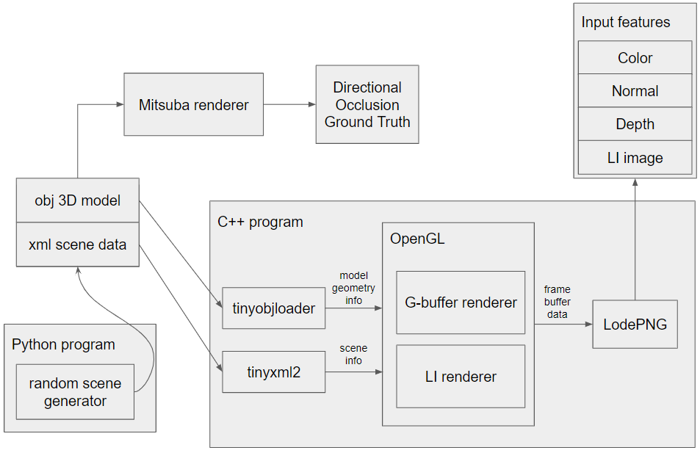
Automatic Data Generator
Notes:
This is a diagram for our own “Automatic Data Generator”
Our generator is separated into two parts.
One part is a python program, “random scene generator”.
It randomly makes some objects, and creates corresponding obj files.
Then, it assigns a random color for each objects, and export the xml scene file.
The scene files and obj files are used to render DO GT images using Mitsuba renderer,
and also used in the other part of ADG.
In the C++ program, tinyxml2 and tinyobjloader libraries helps to read scene and modeling information.
OpenGL renderers make G-Buffer data and local illumination images from the information.
The G-buffer data contains color, depth, normal data.
Finally, use lodePNG library to export them as png files.

Slide 19
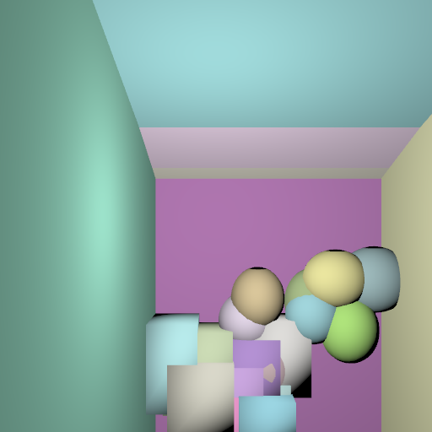
Automatic Data Generator
Notes:
This is a diagram for our own “Automatic Data Generator”
Our generator is separated into two parts.
One part is a python program, “random scene generator”.
It randomly makes some objects, and creates corresponding obj files.
Then, it assigns a random color for each objects, and export the xml scene file.
The scene files and obj files are used to render DO GT images using Mitsuba renderer,
and also used in the other part of ADG.
In the C++ program, tinyxml2 and tinyobjloader libraries helps to read scene and modeling information.
OpenGL renderers make G-Buffer data and local illumination images from the information.
The G-buffer data contains color, depth, normal data.
Finally, use lodePNG library to export them as png files.

Slide 20


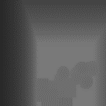

What we want to do
Our own network for DO
Depth map
MLP
DO value
shader
Image with DO
color
Image w/o DO
Normal
Neural Network Learning
Notes:
We can add color input, light information, and some other thing.

Slide 21
What we want to do
Our own network for DO
How to get ground truth DO value for shader??
Depth map
MLP
DO value
shader
Image with DO
color
???
Image w/o DO
Normal
Failed to program
ground truth DO value..
Neural Network Learning
Notes:
We can add color input, light information, and some other thing.

Slide 22
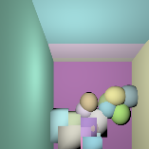
What we want to do
Lets just go directly to DO image by end-to-end neural network
Depth map
MLP
Image with DO
color
Normal
Ambient image
Neural Network Learning
(End-to-End)
Notes:
We can add color input, light information, and some other thing.

Slide 23
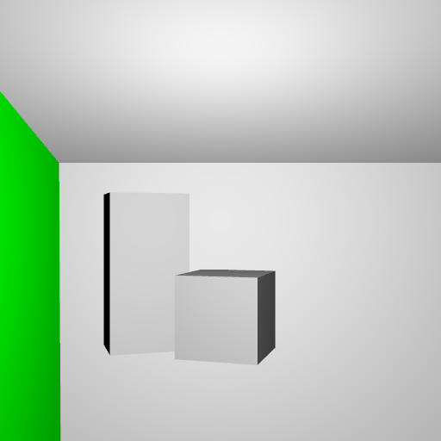
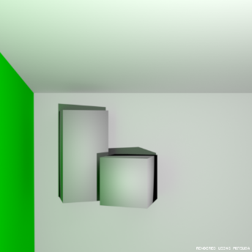
Directional occlusion by neural network
We want a direct process from ambient to DO image
  No code to refer to so we made it all by hand
Ambient image
Directional occluded image

Slide 24
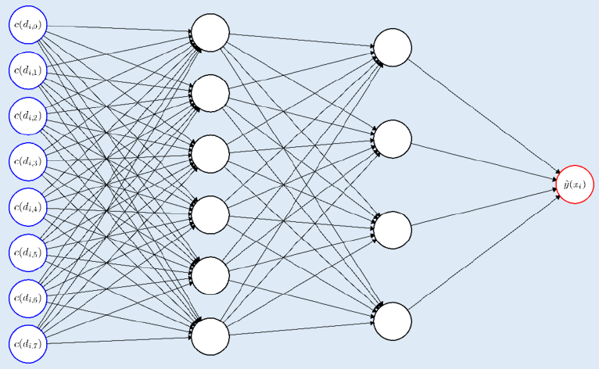
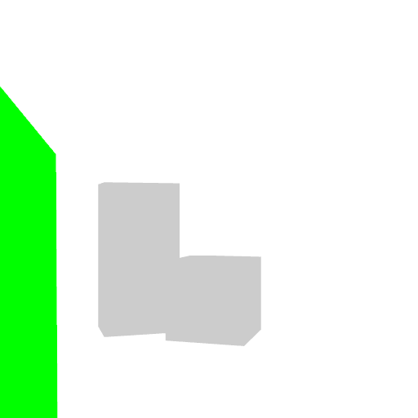
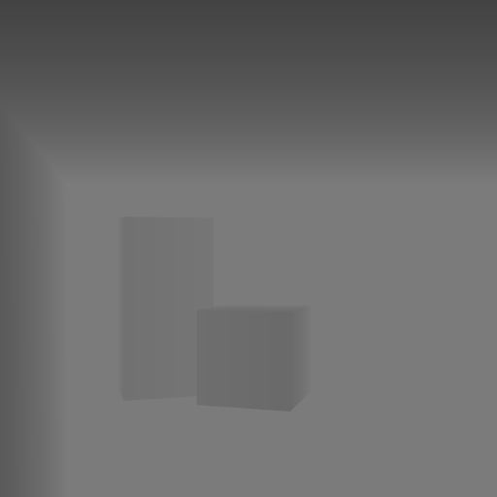
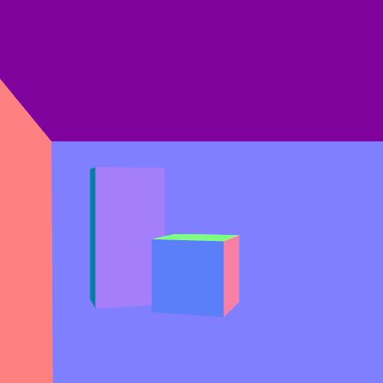
MLP (Multi Layer Perceptron)
Pixel wise computation
For each pixel (i,j)
Ambient
Has 4 informations
Get the pixel value (i,j)
Color
Depth
Normal

Slide 25
MLP (Multi Layer Perceptron)
For each pixel (i,j)
Ambient
Has 4 informations
Failed to train
One pixel does not have information of it’s neighbor (e.g Distance sample)
Get the pixel value (i,j)
Color
Depth
Normal

Slide 26
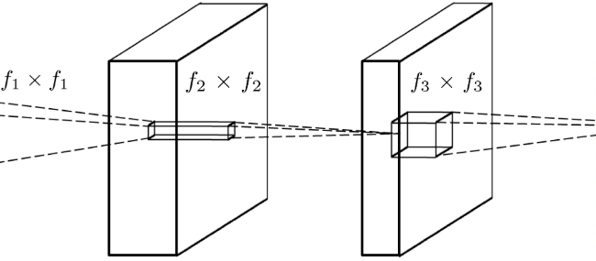
2D CNN
To provide information of local environments
We tried to use 2D CNN

Slide 27
2D CNN
Then the network can know where to shade
  Shade when there is object boundary → depth map
  What kind of shade? → Normal map
  What color? → Color map
  Preserve content → Ambient image

Slide 28
Residual learning
Learning technique that learns the residual instead of the final result
Normal CNN learning
  Hard to learn

Slide 29
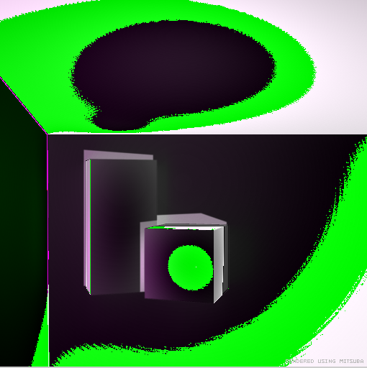
Residual learning
Residual CNN learning
  More easy to learn
  Learns what to add to make the DO image (where to shade, where to bright)
  By combining information of normal, depth, color.

Slide 30
What the network has to learn
Shade walls with greenish light to make it more photo realistic
Add shadows behind objects
Brighten box surface where the light hits
Learn!!!

Slide 31
Residual CNN architecture we found
Through many trial and errors, we managed to find the best network
20 convolutional layer with ReLu & residual learning
Adam optimizer & Xavier initializer
Input 10 channels (3 RGB ambient + 3 RGB color + 3 xyz normal + 1 depth)
Loss = 0.7*SSIM + 0.3*MSE
Clipping output value to a range of 0~255
Ambient image
DO image

Slide 32
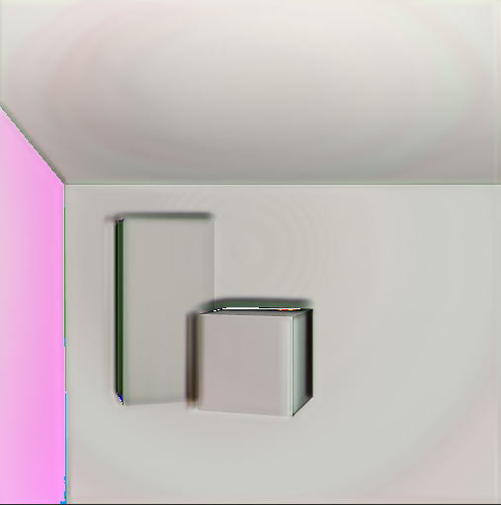
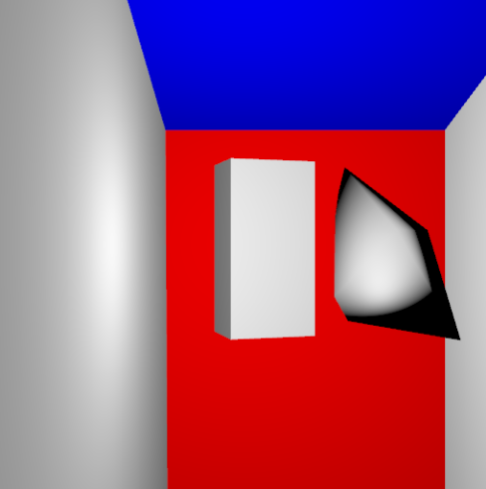
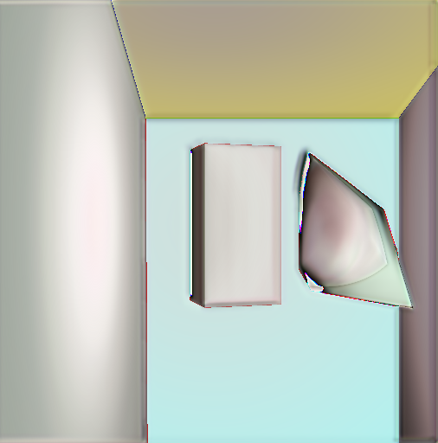
Results
Residual, 20 layers, SSIM MSE 7:3, no clipping
Ambient image
CNN result

Slide 33
Results
Residual, 20 layers, SSIM MSE 7:3, no clipping
Some output image pixel value
were over 255 or under 0

Slide 34
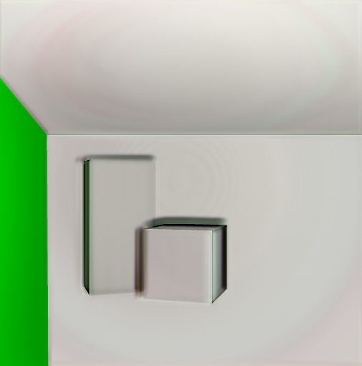
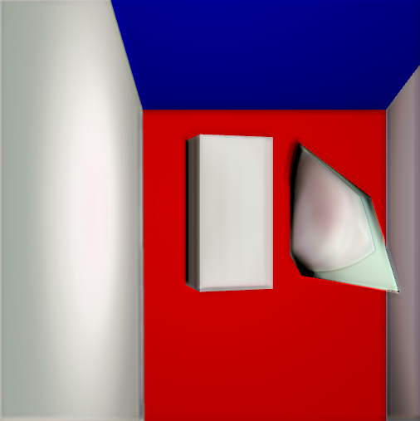
Results
Residual, 20 layers, SSIM MSE 7:3, clip by value (time: 0.754 sec)
Ambient image
CNN result

Slide 35
Results
Ambient image
CNN result

Slide 36
Results
Small Green indirect light
Ambient image
CNN result
DO image

Slide 37
Results
CNN result
DO image

Slide 38
Results
Ambient image
CNN result

Slide 39
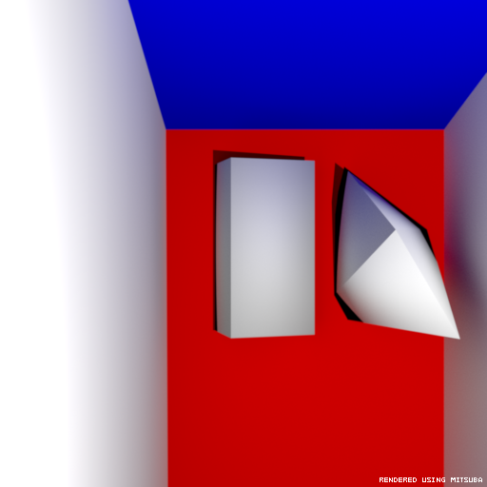
Results
CNN result
DO image

Slide 40
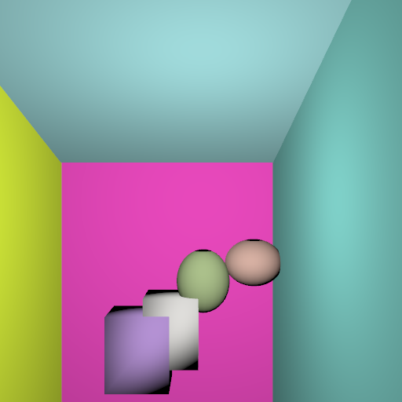
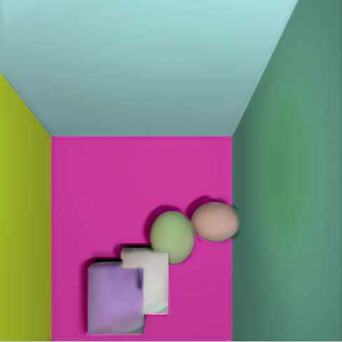
Results
Ambient image
CNN result

Slide 41
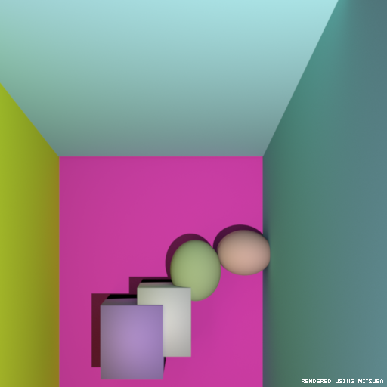
Results
Ambient image
CNN result
DO image

Slide 42
Results
CNN result
DO image

Slide 43
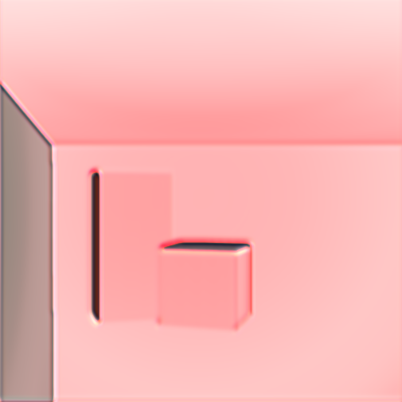
Ablation study
Power of residual learning
Without residual (direct learning)
With residual

Slide 44
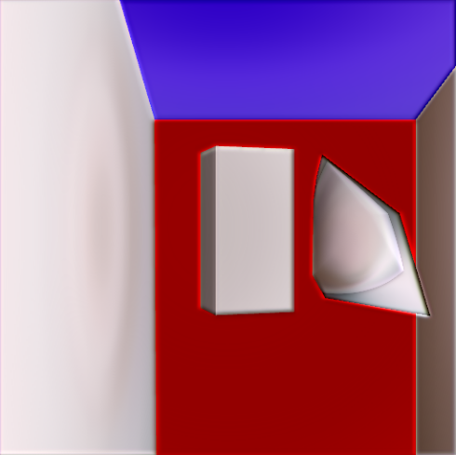
Ablation study
How many layers??
10 layers
20 layers

Slide 45
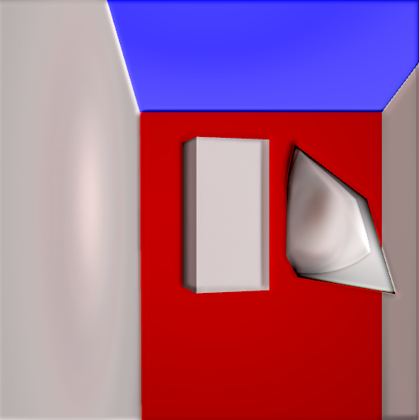
Ablation study
How helpful depth is??
Without depth map
With depth map

Slide 46
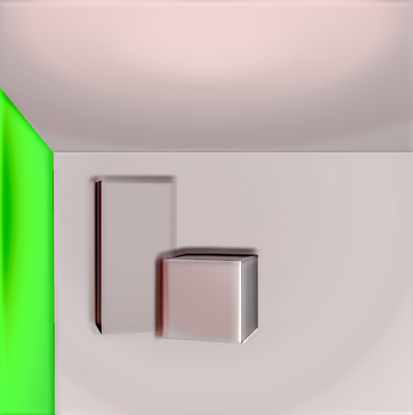
Ablation study
How helpful depth is??
Without depth map
With depth map

Slide 47
Ablation study
Other network architecture that we tried
Encode and decode spatial features
Best network was
Ambient image
DO image
Ambient image
DO image

Slide 48
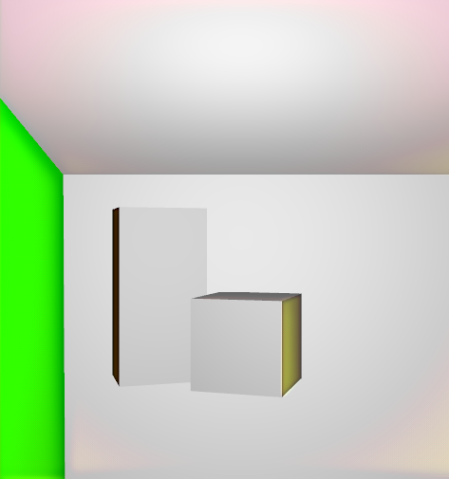
Ablation study
Ambient image
DO image
Ambient image
DO image

Slide 49
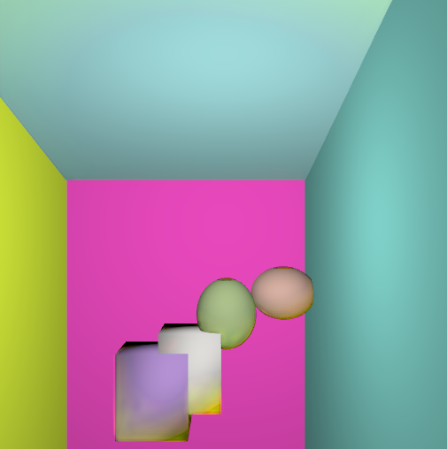
Ablation study
Ambient image
DO image
Ambient image
DO image

Slide 50
Ablation study
Ambient image
DO image
Ambient image
DO image
Shrinking spatial features lead to loss of local relation information

Slide 51
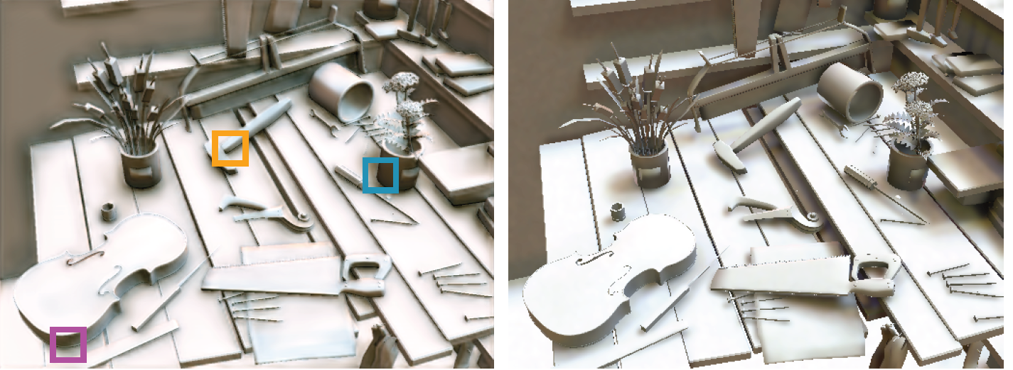
Evaluation Results
Deep Shading
SSIM = 0.589
Deep Shading
SSIM = 0.951
Ours
Ground truth

Slide 52
Role
Jaeyoon: Render data set
  Make every object & code every scene
  Calculate depth, normal, color
  Rendered ground truth DO
Saehun: Used data set from Jaeyoon to deep learning
  Code all networks by hand
  Tune hyper parameters
  Find best network architecture
  Perform ablation study

