Slide 1
Diverse Generative Perturbations on Attention Space for Transferable Adversarial Attacks
Woo Jae Kim (김 우 재)
Advisor: Prof. Sung-Eui Yoon
School of Computing, KAIST
Published at International Conference on Image Processing (ICIP) 2022, Oral paper
Notes:
Hi, I am Woo Jae Kim in Master’s program under the supervision of Professor Sung-Eui Yoon, and today I will be giving my Master’s Defense presentation.
In this presentation, we present diverse generative perturbations on attention space for transferable adversarial attacks.
This work presents a new way to improve transferability of adversarial attacks by generating diverse perturbations that disrupt image attention.

Slide 2
Contents
Introduction
Related Works & Motivations
Our Approach
Experimental Results
Conclusion
Notes:
This is the table of contents for today’s presentation.
I will first talk about the introduction, then the related works and motivations of our work.
Then, I will elaborate on our approach, show some experimental results, and end the presentation with conclusion.

Slide 3
Introduction
Notes:
First, I will talk about some introduction and backgrounds about my research.

Slide 4
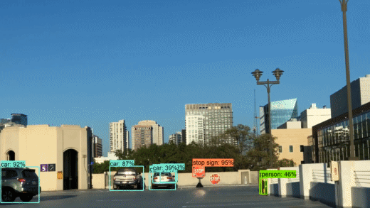
What is Adversarial Attack?
Deep learning is used in numerous computer vision tasks
Image recognition
Image retrieval
Autonomous driving
Deep learning models are vulnerable to adversarial attack
Perturbation maliciously crafted to fool machine learning models
Video: https://www.youtube.com/watch?v=pc2ssNY98LA&feature=emb_logo&ab_channel=PoloClubofDataScience
Notes:
While deep neural networks have been shown to be promising in numerous computer vision tasks such as image recognition, retrieval, and autonomous driving, recent works have shown that they are vulnerable adversarial attacks.
Let’s look at the video of a deep-learning based object detector on the right side of the screen.

Slide 5
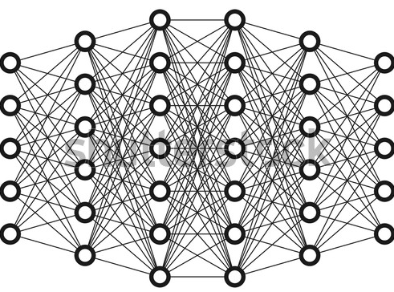
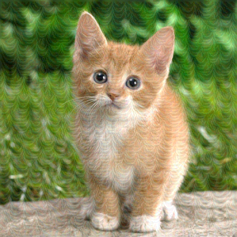
White-box Attack vs. Black-box Attack
White-box Attack
Transfer-based Black-box Attack
Requires knowledge of the model (weights, structures, etc …)
Target model is known to the attacker
Target model is unknown to the attacker
Transferability: Adversarial image crafted on a known (white-box) surrogate model can fool unknown (black-box) target models
Dog!
Dog!
Surrogate model
Dog!
Adversarial image
Target model
Adversarial image
Target model
Notes:
And such adversarial attack can be classified into a white-box attack or a black-box attack depending on the knowledge of the model revealed to the attacker.
White-box attack considers a scenario where the information of the target model including its weights, structures, and gradients are known to the attacker.
In this case, the attacker exploits such information to craft adversarial images that are specifically designed to fool the target model.

Slide 6
White-box Attack vs. Black-box Attack
White-box Attack
Transfer-based Black-box Attack
Requires knowledge of the model (weights, structures, etc …)
Target model is known to the attacker
Target model is unknown to the attacker
Transferability: Adversarial image crafted on a known (white-box) surrogate model can fool unknown (black-box) target models
Dog!
Dog!
Surrogate model
Dog!
Adversarial image
Target model
Adversarial image
Target model
Notes:
However, in real world cases, the information of the model is usually unrevealed to the attacker.
In this case, we can exploit the transferability characteristics of white-box adversarial attacks.
Transferability refers to a characteristic of adversarial attacks that adversarial images crafted on a known, white-box surrogate model can also sometimes fool unknown, black-box target models.
In this scenario, we can use any white-box attacks to generate adversarial examples that can fool both the surrogate and the target model.

Slide 7
White-box Attack vs. Black-box Attack
White-box Attack
Transfer-based Black-box Attack
Requires knowledge of the model (weights, structures, etc …)
Target model is known to the attacker
However, simple white-box attacks usually suffer from low transferability
Dog!
Dog!
Overfitting to
surrogate model
Surrogate model
Dog!
Adversarial image
Target model
Adversarial image
Target model
Notes:
However, most of the existing white-box attacks suffer from limited transferability because they are often overfitted to the surrogate model.
Due to the difference in structure and weights across different models, these attacks usually fail to transfer to other models, making them suffer from poor transferability.

Slide 8
Related Works & Motivations
Transfer-based Black-box Attacks
Notes:
Now, I will talk about some recent approaches that have tried to solve this problem and our motivations.

Slide 9
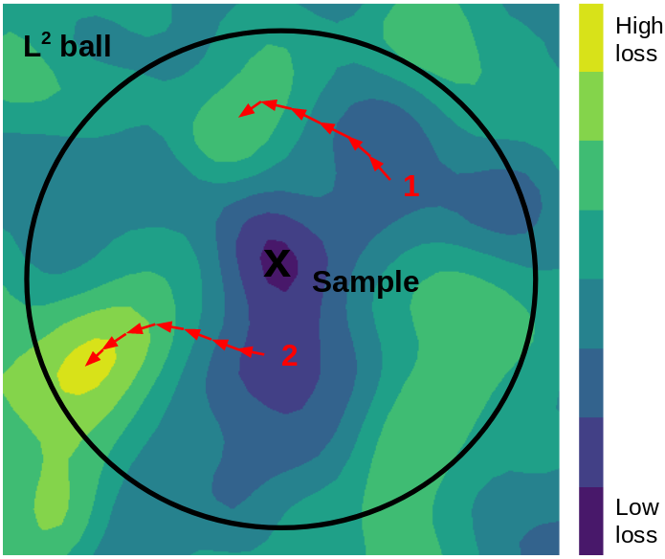
Existing Approaches | Transfer-based Black-box Attacks
Modifying attack optimization method
MI-FGSM [1] : Applies momentum to gradient update process
DI-FGSM [2] : Applies random transformations on image for different gradient update
VMI-FGSM [3]: Exploits gradient from previous iteration to tune current gradient update step
Visualization of perturbation update process of gradient-based attack
Image: https://towardsdatascience.com/know-your-enemy-7f7c5038bdf3
Notes:
To reduce such overfitting problem and to solve the overfitting problem, numerous attempts, named transfer-based black-box attacks, have been proposed.
These methods are mostly based on the gradient-based scheme of white-box attacks.
Given a natural image of low classification loss, gradient-based methods iteratively updates the adversarial perturbation to specifically maximize the loss value at each iteration, thus reaching to the final adversarial example of high loss.
One branch of transfer-based attacks have modified the attack optimize method of these gradient-based attacks to improve transferability.

Slide 10
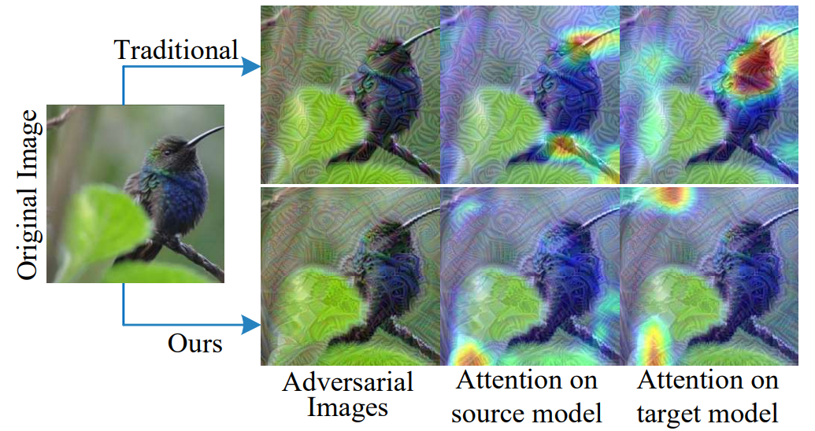
Existing Approaches | Transfer-based Black-box Attacks
Modifying objective functions
TAP [4] : Disrupts images on the feature space
ATA [5] : Disrupts images on the GradCAM attention space
FIA [6] : Disrupts importance features of images obtained through aggregated gradients
Image: [6] Wang et. al., Feature Importance-aware Transferable Adversarial Attacks, ICCV 2021
Notes:
More recently, another branch has focused on modifying the objective functions of these gradient-based attacks.
Unlike the classification loss that focuses on disrupting the final output of the model, these have disrupted the image in intermediate representations of surrogate models.
Out of those, disrupting the attention representation of the image has shown to be the most promising.
Based on the intuition that different models share similar attention representations on a same image, these approaches aim to boost the attack transferability by disrupting the attention.

Slide 11
Limitations of Existing Approaches
Gradient-based attacks craft adversarial examples in a deterministic manner
Adversarial example easily falls into a poor local optimum and overfits to the surrogate model
Notes:
However, even with these attempts, these approaches still rely on a gradient-based method and generates adversarial examples in a deterministic manner.
Adversarial examples crafted in this deterministic manner easily fall into a poor local optimum of the surrogate model.
As shown in this conceptual visualization of class decision boundary of a surrogate model and different target models, by searching for adversarial examples in a single direction at each iteration, these methods fail to fully explore the search space of different possible adversarial examples on the surrogate model.
This makes the adversarial example easily fall into a poor local optimum and thus be overfitted to the surrogate model, in which case it would fail to transfer to different target models.

Slide 12
Motivation and Idea
Thus, we guide the attack to fool the model in a diverse manner
This will prevent the adversarial example from falling into poor local optimum
Notes:
To avoid such poor local optimum and overfitting to the surrogate model, we propose to guide the attack to fool the model in a diverse manner.
As shown in the figure, this will make the attack explore the search space of adversarial examples more exhaustively and thus prevent the adversarial examples from falling into a poor local optimum.
Adversarial examples generated this way are less likely to overfit to the surrogate model, making them successfully transfer over to different target models.

Slide 13
Contributions
For the first time, we introduce stochasticity to adversarial examples in the feature level to improve transferability.
We propose Attentive-Diversity Attack (ADA), an effective generator-based adversarial attack framework that perturbs image attention in a diverse, non-deterministic manner.
Extensive experiments exhibit the superior transferability of our method as compared to existing state-of-the-art methods.
Notes:
So, our contributions are as follow:
For the first time, we introduce stochasticity to adversarial examples in the feature level to improve transferability.
Then, based on the recent findings that the image attention is likely to be transferable across different models, we propose Attentive-Diversity Attack, an effective generator-based framework that disrupts image attention in a diverse, non-deterministic manner.
We finally show that our framework exhibits superior transferability compared to existing state-of-the-art methods.

Slide 14
Our Approach
Attentive-Diversity Attack (ADA)
Notes:
Now, we will talk about how we design our method to solve this problem.

Slide 15
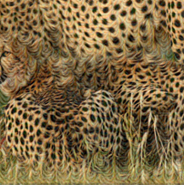
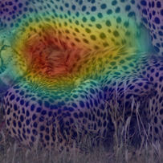
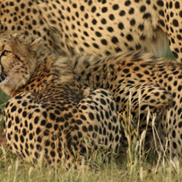
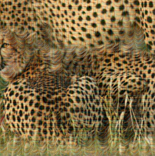
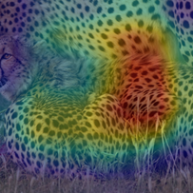
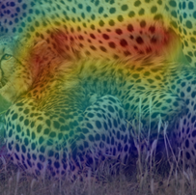
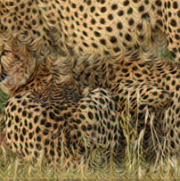
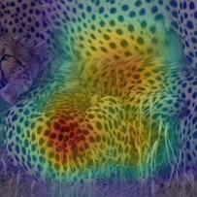
Overview
We propose Attentive-Diversity Attack (ADA)
(1) Attack generator, (2) Attention perturbation, (3) Feature diversification
Adv. image
Attention
Natural image
(3)$L_{div}$
(2)$L_{attn}$
Latent code
(1) Attack generator
Attention
Gaussian
distribution
Notes:
This is an overview of our method.
We propose Attentive-Diversity Attack, or ADA, in short.
In consists of three components: attack generator, attention perturbation, and feature diversification.
In short, we use an attack generator to generate adversarial examples, which is guided to disrupt the attention representation extracted from the model.
We also guide the model to disrupt the attention in a diverse manner.
I will elaborate on each method in more detail sequentially.

Slide 16
(1) Attack Generator
To prevent deterministic attacks, we design an attack generator
Takes natural image and latent code as input and returns perturbation as output
$$x_{z}^{adv}=Clip_{\left\{x, ε\right\}}\left\{x+ε⋅g\left(x, z\right)\right\}$$
Natural image $x$
Adv. image $x_{z}^{adv}$
Latent code $z$
(1) Attack generator
$$g$$
Gaussian
distribution
Notes:
In this framework, to prevent deterministic attacks caused by gradient-based methods, we design an attack generator to craft adversarial examples.
Given a natural image x and a latent code z sampled from a Gaussian distribution, the attack generator g generates an adversarial perturbation.
This perturbation is added to the natural image and clipped to the perturbation bound \epsilon to obtain the adversarial image.
Through latent code z, we aim to learn the attack generator to craft diverse perturbations given different latent codes, thus avoiding poor local optimum.

Slide 17
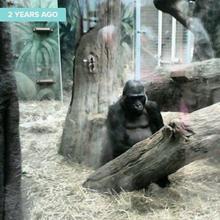
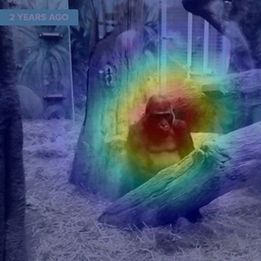
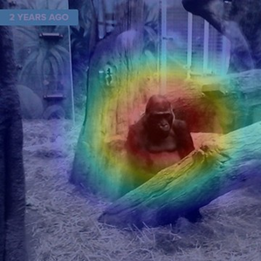
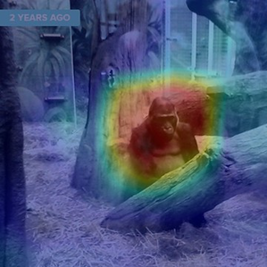
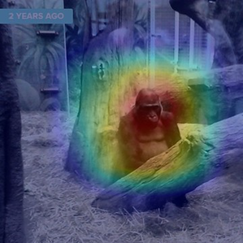
(2) Attention Perturbation
Different models focus on similar regions on the image
To further boost attack transferability, we disrupt the image attention
ResNet V2
Inception V3
Inception V4
Inception-ResNet V2
Gorilla
Gorilla
Gorilla
Gorilla
Notes:
Also, based on recent works that attention of a model is likely to be shared across different models, we propose to disrupt the image on the attention space to further boost transferability.
As shown in this figure, all four models in this figure share similar attention representations; they focus on the head of a gorilla to classify this image as a “gorilla”.

Slide 18
(2) Attention Perturbation
Disrupting attention on surrogate model will disrupt attention on target models
Calculating attention $A\left(x;t\right)$
$$A\left(x;t\right)=GAP\left(\frac{∂y_{t}}{∂F}\right)F,$$
Prediction for GT class $t$
Feature representation
Notes:
Thus, by disrupting the model attention on one model, we will be able to disrupt attention on other models.
We calculate attention A given image x and ground truth label t as follows.
We first obtain the gradient of y_t, which represents the model prediction output for ground truth class t with respect to target feature F.
Then, we take global average pooling on the gradient and take element-wise multiplication between the output and the feature representation F.
In other words, we treat the weighted feature representation as attention, where the activation of channels that are important to model prediction are boosted, while activation of channels that are less important are suppressed.

Slide 19
(2) Attention Perturbation
Disrupting attention on surrogate model will disrupt attention on target models
Calculating attention $A\left(x;t\right)$
$$A\left(x;t\right)=GAP\left(\frac{∂y_{t}}{∂F}\right)F,$$
Calculating attention loss $L_{attn}$:
$$L_{attn} = −∥A\left(x_{z}^{adv};t\right) −A\left(x;t\right)∥_{2}$$
Prediction for GT class $t$
Feature representation
Adversarial image
Natural image
Notes:
Then, we design the attention loss as the L-2 distance between the attention representation of the adversarial image crafted by the attack generator and the attention representation of the natural image.

Slide 20
(2) Attention Perturbation
Attention loss $L_{attn}$ guides the attack generator to disrupt the image attention
$$L_{attn} = − ∥A\left(x_{z}^{adv};t\right) −A\left(x;t\right)∥_{2}$$
Adversarial image
Natural image
Natural image
Adv. image
Attention
(2)$L_{attn}$
Latent code
(1) Attack generator
Attention
Gaussian
distribution
Notes:
Then, the attack generator is trained to maximize the attention loss.
As shown in this diagram, the attack generator is trained to craft perturbations that lead to different attention representation from that of the natural image, thus fooling both the surrogate and target models.

Slide 21
(3) Feature Diversification
Without any guidance, the attack generator may disrupt the attention in a deterministic manner
We explicitly guide it to disrupt attention differently given the latent code [7]
The attack generator avoids falling into poor local optimum
$$L_{div}=−\frac{∥A\left(x_{z_{1}}^{adv};t\right) −A\left(x_{z_{2}}^{adv};t\right)∥}{∥z_{1} −z_{2}∥}$$
Notes:
However, without any guidance, the attack generator may disrupt the attention in a deterministic manner.
In other words, it may simply ignore the latent code z and generate the same perturbations for different latent codes, which will then make it fall into a poor local optimum.
Thus, we explicitly guide the generator to disrupt the attention differently given different latent codes.
To achieve this goal, we propose the diversity loss, which is formulated as follows.
Given the same natural image x, we sample two different latent codes z1 and z2 and generate two different adversarial examples x^adv_z1 and x^adv_z2 using the attack generator.
Then, we obtain the attention representation for the two adversarial examples, and we design the diversity loss as the L-1 distance between the two attention representations regularized by the L-1 distance between the two latent codes.

Slide 22
(3) Feature Diversification
$L_{div}$ forces the attack generator to disrupt attention in a diverse manner
$$L_{div}=−\frac{∥A\left(x_{z_{1}}^{adv};t\right) −A\left(x_{z_{2}}^{adv};t\right)∥}{∥z_{1} −z_{2}∥}$$
Adv. image
Attention
Natural image
(3)$L_{div}$
(2)$L_{attn}$
Latent code
(1) Attack generator
Attention
Gaussian
distribution
Notes:
Then, we train the attack generator to maximize the diversity loss.
This guides the generator to produce different perturbations for different latent codes such that they lead to adversarial examples that fool the model attention differently.
In this way, the generator exhaustively explores the search space of adversarial examples and avoids falling into a poor local optimum.

Slide 23
Overall Objective
$$L=λ_{attn}⋅L_{attn}+λ_{div}⋅L_{div}$$
Weight for $L_{attn}$
Weight for $L_{div}$
Adv. image
Attention
Natural image
(3)$L_{div}$
(2)$L_{attn}$
Latent code
(1) Attack generator
Attention
Gaussian
distribution
Notes:
Given the attention loss and the diversity loss, the overall objective of the framework is to learn the generator to maximize both loss functions.
We control the weight of each loss using two hyperparameters lambda_attention and lambda_diversity.

Slide 24
Experimental Results

Slide 25
Experimental Setups
Target models
Inception V3, Inception V4, Inception-ResNet V2, ResNet V2, VGG16
Dataset
Training : 10,000 images randomly selected from ImageNet val set
Testing : 1,000 ImageNet-like images from NeurIPS 2017 adversarial competition
Structure of Attack Generator
U-Net based convolutional encoder-decoder

Slide 26
Experimental Results | Comparison with existing methods
Metric – Attack success rate (Misclassification rate %)
Ensemble – Ensemble of prediction logits from black-box models
Parentheses () = White-box setting
Notes:
Now, we would like to share some of the main experimental results.
We first report the comparison of attack transferability with existing transfer-based attacks.
The leftmost column shows the surrogate models used to craft adversarial examples, and the uppermost row shows the target models used to test the attack transferability.
We use the attack success rate, which is simply the misclassification rate of the models, to compare transferability of the attack.

Slide 27
Experimental Results | Comparison with existing methods
Metric – Attack success rate (Misclassification rate %)
Ensemble – Ensemble of prediction logits from black-box models
Parentheses () = White-box setting
Gradient-based
methods
Notes:
We make comparisons with existing methods, which all rely on a gradient-based method.

Slide 28
Experimental Results | Comparison with existing methods
Metric – Attack success rate (Misclassification rate %)
Ensemble – Ensemble of prediction logits from black-box models
Parentheses () = White-box setting
Gradient-based
methods
Notes:
While our method lags behind existing methods under white-box attacks marked in parentheses, which is when the surrogate model is the same as the target model,

Slide 29
Experimental Results | Comparison with existing methods
Metric – Attack success rate (Misclassification rate %)
Ensemble – Ensemble of prediction logits from black-box models
Parentheses () = White-box setting
Gradient-based
methods
Notes:
our method outperforms existing methods in most of the black-box settings.
This shows that our method overfits less to the surrogate model and generalizes well to unknown models.

Slide 30
Experimental Results | Comparison with existing methods
Metric – Attack success rate (Misclassification rate %)
Ensemble – Ensemble of prediction logits from black-box models
Parentheses () = White-box setting
Gradient-based
methods
Notes:
Also, one interesting observation is that our method outperforms existing methods by a larger margin when the architectures of the target models are more different from that of the surrogate model.

Slide 31
Experimental Results | Comparison with existing methods
Metric – Attack success rate (Misclassification rate %)
Ensemble – Ensemble of prediction logits from black-box models
Parentheses () = White-box setting
Gradient-based
methods
+ 4.7%p
+ 9.6%p
Notes:
For example, while our attack crafted on Inception v3 outperforms FIA by 4.7%p on a more similarly structured Inception v4, it outperforms FIA by a larger margin of 9.6%p on a more differently structured Vgg16.
This shows that while existing methods overfit to the surrogate model and show low transferability on models with more distinct structures, our method still generalizes well to these models.

Slide 32
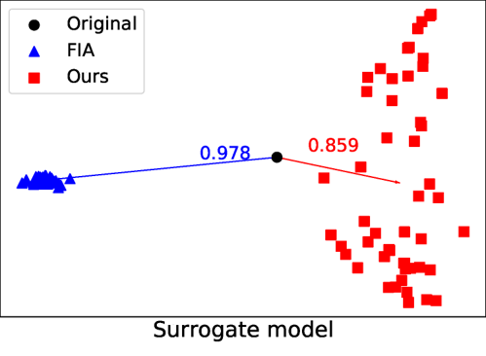
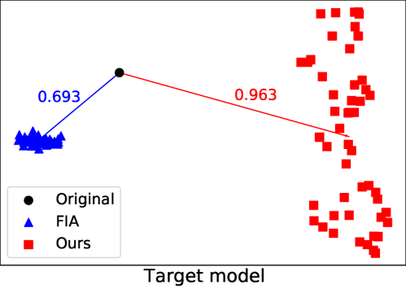
Experimental Results | Effects of diversity on transferability
PCA visualization of features of FIA (blue) and our method (red)
More widely distributed adversarial examples
Larger average distance from natural image on target model
Inception v3
ResNet-v2
Notes:
We now show that diverse adversarial examples generated using our method are indeed more transferable.
The two figures show the PCA visualization of features of adversarial examples crafted by FIA or our method on the surrogate model, which is Inception v3, and a target model, which is ResNet v2.
FIA generates deterministic adversarial examples whose feature representations form a dense cluster, while our method generates diverse adversarial examples with a wider distribution.

Slide 33
Experimental Results | Effects of diversity on transferability
PCA visualization of features of FIA (blue) and our method (red)
More widely distributed adversarial examples
Larger average distance from natural image on target model
Low diversity,
High performance on
surrogate model
Inception v3
ResNet-v2
Notes:
On the surrogate model, we can observe that FIA generates stronger adversarial examples.
The average L2 distance from the feature of the original image marked in black circle to the features of the adversarial examples crafted by FIA marked in blue triangles is larger than the distance between the feature of the original image and the features of the adversarial examples crafted by our method marked in red squares.

Slide 34
Experimental Results | Effects of diversity on transferability
PCA visualization of features of FIA (blue) and our method (red)
More widely distributed adversarial examples
Larger average distance from natural image on target model
High diversity,
High performance on
target model
Inception v3
ResNet-v2
Notes:
However, in the unknown target model, the distance to FIA adversarial examples is a lot smaller than the distance to adversarial examples by our method, showing that adversarial examples crafted by our method are stronger in the black-box setting.
This shows that our method generates highly diverse adversarial examples that also show higher transferability on black-box target models.

Slide 35
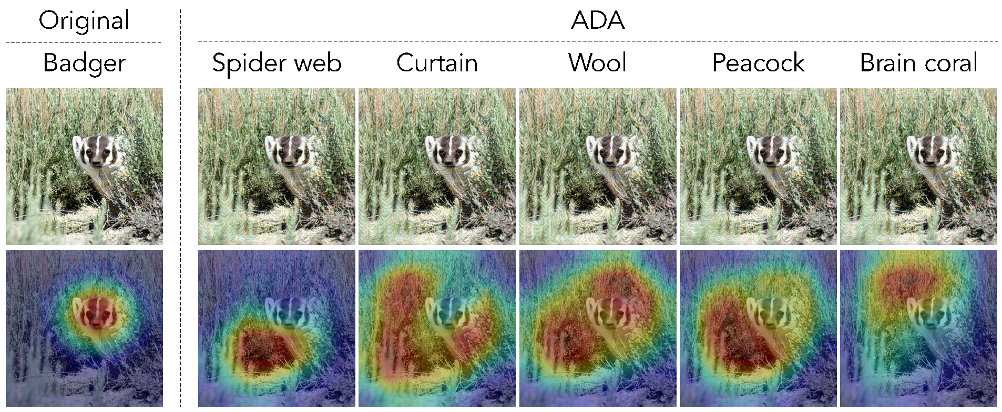
Experimental Results | Qualitative results
Visualization of diverse adversarial examples and their attention heatmaps
Each adversarial example fools model decision and attention in a diverse manner
Notes:
Finally, we visualize the semantically diverse adversarial examples crafted by our method.
We show five adversarial examples crafted using our method with different latent codes.
For all five images, the model misclassifies each of them to different classes and also infers different attention heatmaps, showing that our method indeed disrupts the model in a diverse, non-deterministic manner.

Slide 36
Conclusion

Slide 37
Conclusion
Attentive-Diversity Attack (ADA) for improved attack transferability
Attack generator to prevent deterministic attacks
Attention perturbation to disrupt features shared by different models
Feature diversification to avoid falling into poor local optimum

Slide 38
Limitations & Future Works
Most adversarial attacks assume pre-defined, noise-less environments
Thus, subtle adversarial perturbations may lose their power in real-world settings
Variability from shadows & illuminations
Camera noises & blur
During the Ph.D. program, I plan to work on devising adversarial attack/defense techniques in real-world settings

Slide 39
Publications
First-authored:
Woo Jae Kim, Yoonki Cho, Junsik Jung, Sung-Eui Yoon. Feature Separation and Recalibration for Adversarial Robustness. Submitted to CVPR 2023 (under review)
Woo Jae Kim, Seunghoon Hong, Sung-Eui Yoon. Diverse Generative Perturbations on Attention Space for Transferable Adversarial Attacks. ICIP 2022 (Oral)
Woo Jae Kim, Sung-Eui Yoon. 적대적 공격에 견고한 피처 신뢰도 기반 다운샘플링. IPIU 2022 (우수논문상)
Co-authored:
Guoyuan An, Woo Jae Kim, Saelyne Yang, Yuchi Huo, Rong Li, Sung-Eui Yoon. Towards Content-based Pixel Retrieval in Revisited Oxford and Paris. Submitted to CVPR 2023 (under review)
Yoonki Cho, Woo Jae Kim, Seunghoon Hong, Sung-Eui Yoon. Part-based Pseudo Label Refinement for Unsupervised Person Re-identification. CVPR 2022
Kyuyeon Kim, Junsik Jung, Woo Jae Kim, Sung-Eui Yoon. Deep Video Inpainting Guided by Audio-Visual Self-Supervision. ICASSP 2022

Slide 40
References
[1] Dong et. al., Boosting Adversarial Attacks with Momentum, CVPR 2018
[2] Xie et. al., Improving Transferability of Adversarial Examples with Input Diversity, CVPR 2019
[3] Wang et. al., Enhancing the Transferability of Adversarial Attacks through Variance Tuning, CVPR 2021
[4] Zhou et. al., Transferable Adversarial Perturbations, ECCV 2018
[5] Wu et. al., Boosting the Transferability of Adversarial Samples via Attention, CVPR 2020
[6] Wang et. al., Feature Importance-aware Transferable Adversarial Attacks, ICCV 2021
[7] Yang et. al., Diversity-Sensitive Conditional Generative Adversarial Networks, ICLR 2019

Slide 41
Thank you for your attention. Any questions or feedback?

Slide 42
Appendix

Slide 43
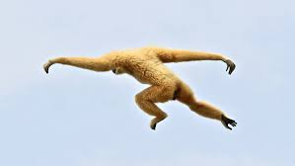
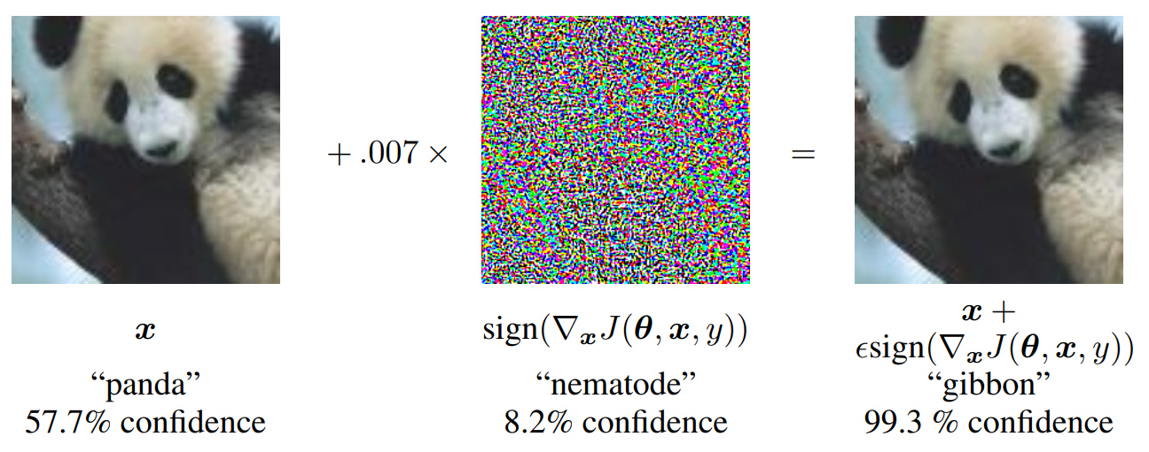
What is Adversarial Attack?
Imperceptible perturbation maliciously crafted to fool machine learning models
gibbon
Notes:
So then, what is adversarial attack?
It is a perturbation maliciously designed to fool the deep learning models.
As shown in the figure, a deep learning model can classify an image of a panda as “panda”.
We can perform adversarial attack on this image to craft an adversarial image.
This adversarial image still looks like a panda to human eyes, but a model misclassifies this image as a “gibbon”.
This is what a gibbon looks like, which is vastly different from panda.

Slide 44
Existing Approaches | White-box Attacks
$$x$$ | Clean image
$$x^{adv}$$ | Adversarial image
$$y$$ | GT label
$$θ$$ | Parameters of target model
$$J()$$ | Classification loss
$$ε$$ | Perturbation scale
Gradient-based white-box attacks
Explicitly exploits the loss gradient to generate perturbations
FGSM [8] : First gradient-based attack with single iteration
I-FGSM [9] : Repeats FGSM for multiple iterations
$$x^{adv}=x+ε ∗sign\left(∇_{x}J\left(θ, x, y\right)\right)$$
[8] Goodfellow et. al., Explaining and Harnessing Adversarial Examples, ICLR 2015
[9] Kurakin et. al., Adversarial Examples in the Physical World, ICLR Workshop 2017
Notes:
First, before we talk about recent approaches to solve the overfitting problem, I will first talk about the white-box gradient-based attacks, which serve as a baseline of those methods.
First introduced by FGSM in 2015, gradient-based attacks exploit the loss gradient of a model to generate perturbations.
Specifically, blah blah
I-FGSM, which was introduced in 2017, repeats this process for multiple iterations to generate stronger attacks.

Slide 45
Experimental Results | Generation of diverse perturbations
Adversarial training against different attack methods
Model adversarially trained on diverse perturbations is more robust [10]
Metric – classification accuracy (%)
$L_{div}$ in our method leads to highest robustness
[10] Yunseok Jang, Tianchen Zhao, Seunghoon Hong, and Honglak Lee, “Adversarial defense via learning to generate diverse attacks,” in ICCV, 2019.
Notes:
Now, we show that our method can indeed generate diverse adversarial examples.
Recent findings have shown that the robustness of adversarial training model improves when trained against a diverse set of adversarial examples.
Based on this finding, we adversarially train a model against different gradient-based methods including FGSM, BIM, and PGD, and our method with or without diversity loss.
As shown in the table, our method with the diversity loss shows the highest robustness against all adversarial attacks.
While existing gradient-based methods and our method without diversity loss train the models only against a limited set of deterministic attacks, our method with the diversity loss trains the model against diverse adversarial examples and makes it more robust.

Slide 46
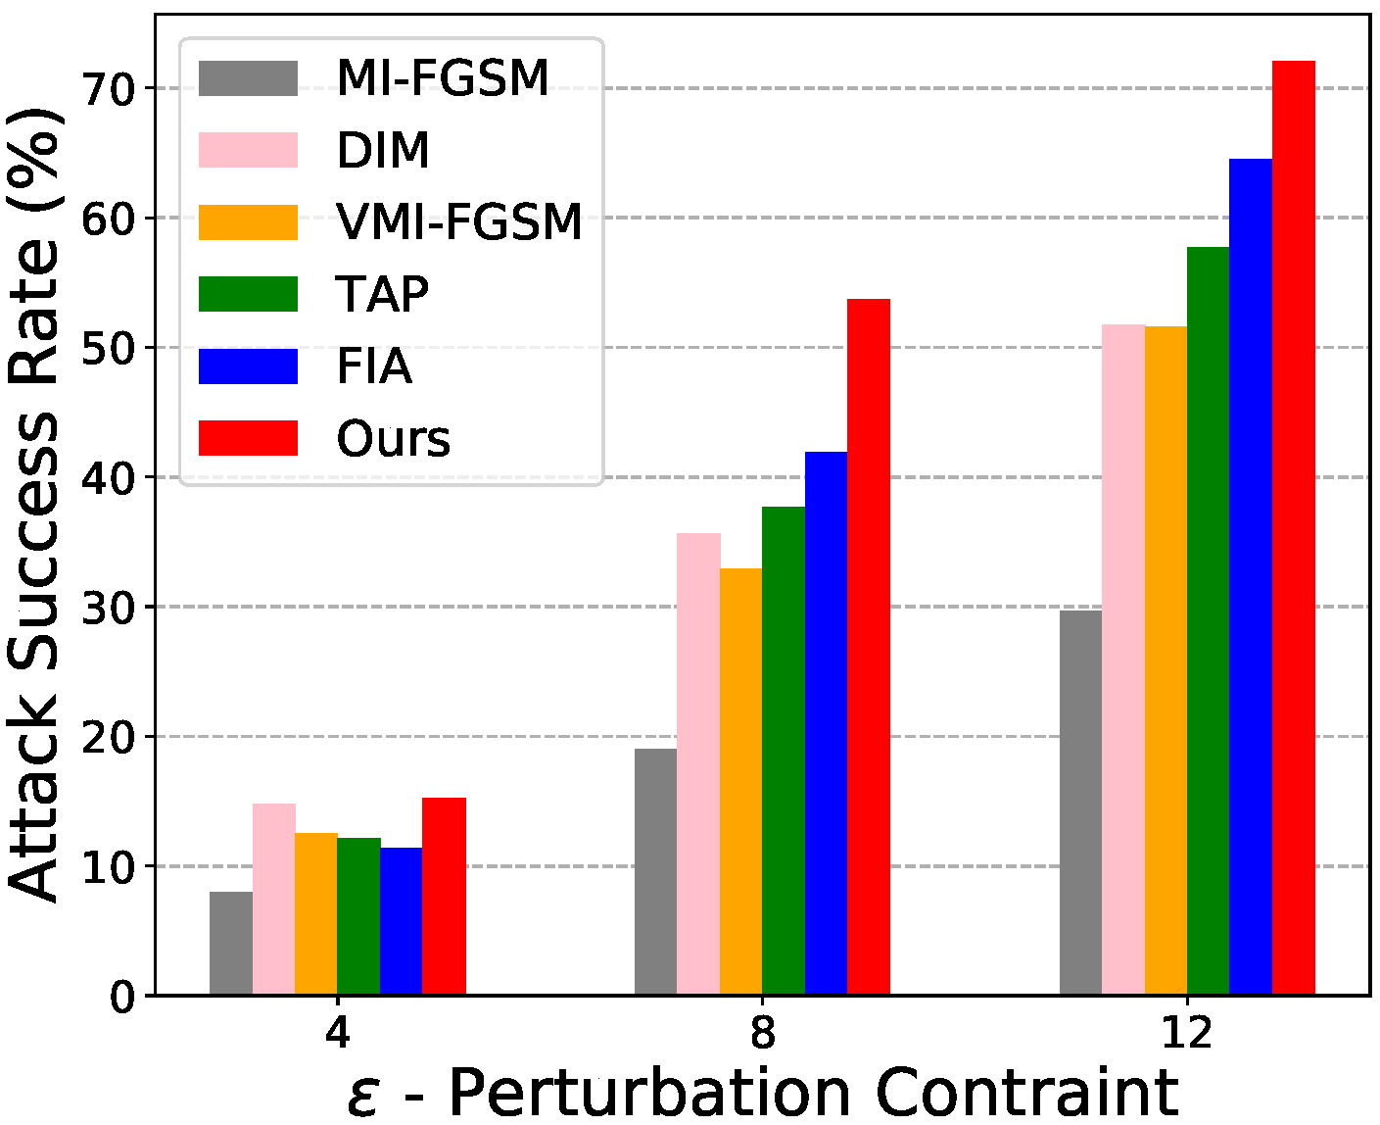
Experimental Results | Effects of perturbation bound $ε$
Vary the perturbation bound $ε$ on adversarial perturbations
Our method shows highest robustness throughout different $ε$
Notes:
This chart shows that our method can outperform existing approaches under various perturbation constraints \epsilon, which controls the magnitude of the adversarial perturbations.
Even at lower \epsilon values of 4, 8, and 12, our method outperforms existing approaches with a significant margin.

Slide 47
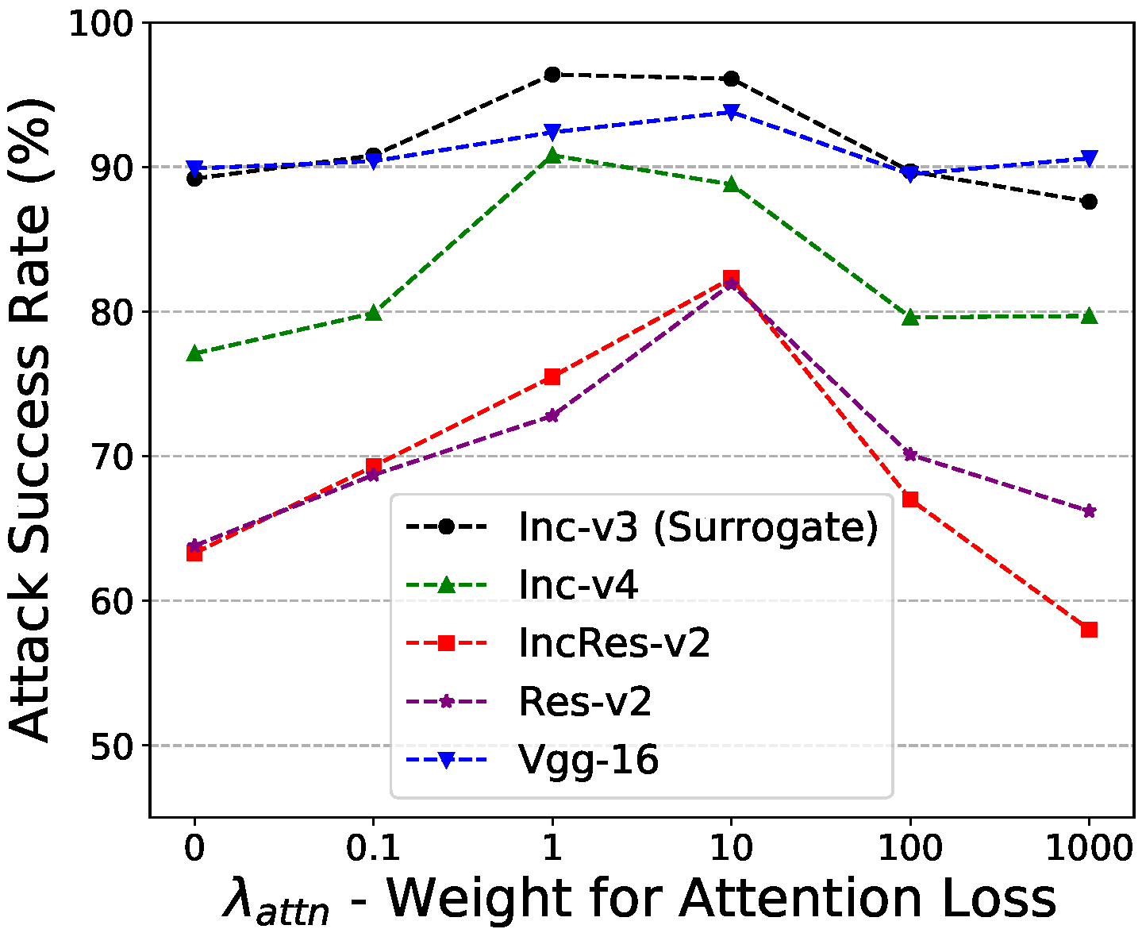
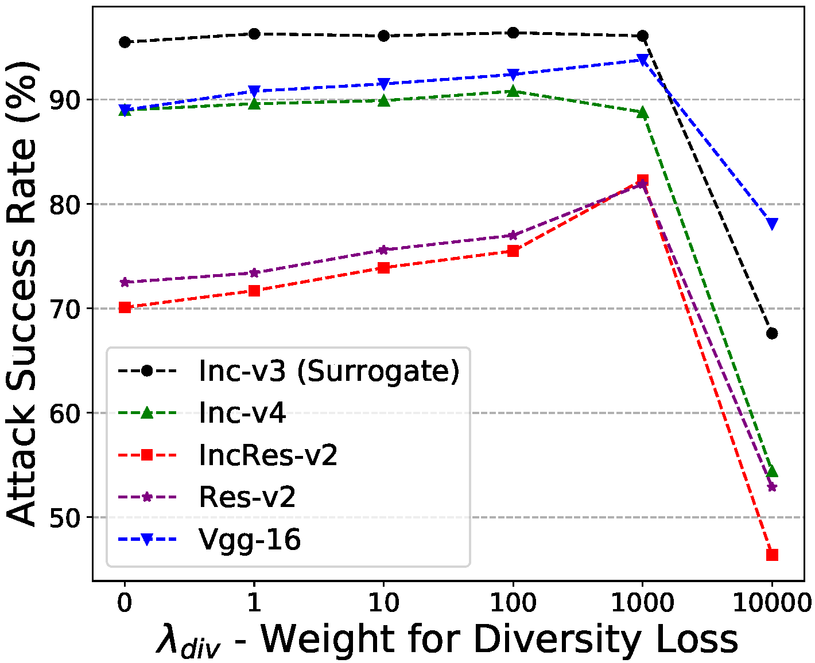
Experimental Results | Effects of $L_{attn}$ and $L_{div}$
Vary the weights $λ_{attn}$ and $λ_{div}$ on proposed loss $L_{attn}$ and $L_{div}$
Both loss play important role improving attack transferability
Notes:
We also verify the effectiveness of our two proposed objectives, or the attention loss and the diversity loss, by controlling the weights on each term.
We use Inception v3 as the surrogate model.
In general, both objectives play an important role at boosting the transferability.
We achieve the best performance when lambda_attention is 10, and lambda_diversity is 1000.
Interestingly, the attack success rate against Inception v4 is higher when lambda_attention is smaller at value of 1, and lambda_div is smaller at value of 100.
This is because insufficient weights on the two objectives overfit the attacks to the surrogate model and lead to higher transferability on a more similarly structured Inception v4 but reduces transferability on more differently structured black-box models.

