Slide 1
Semi-Supervised Learning of Optical Flow by Flow Supervisor
October 23-27, 2022
Woobin Im Sebin Lee Sung-Eui Yoon
sgvr.kaist.ac.kr

Slide 2
What is optical flow?
Pixel-level motion in consecutive frames

Slide 3
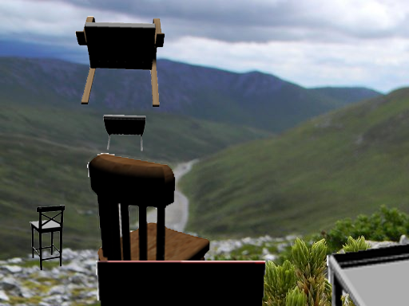
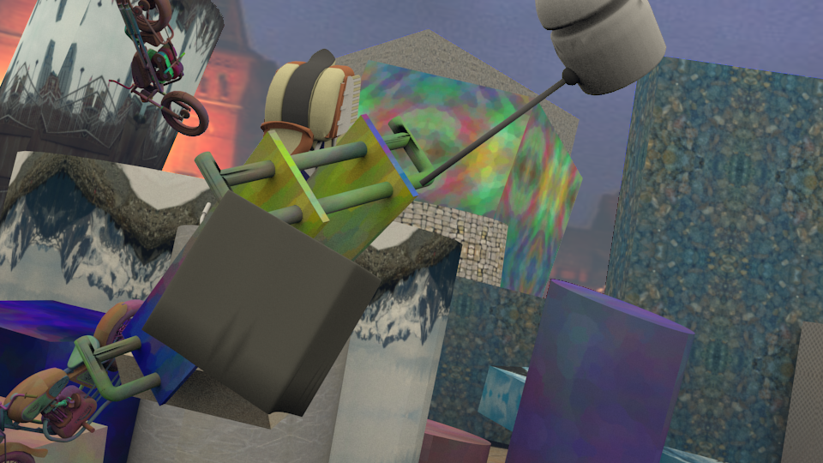
Deep Learning
Optical Flow Networks
Chairs
Things
Sintel Trainset
Sintel
22k pairs
25k pairs
1k pairs
Large-scale synthetic datasets
Labeled target dataset
Target dataset
Pretraining → Fine tuning
Deep Network

Slide 4
Deep Learning
Optical Flow Networks
Chairs
Things
Sintel Trainset
Sintel
22k pairs
25k pairs
1k pairs
Large-scale synthetic datasets
Labeled target dataset
Target dataset
Deep Network

Slide 5
Deep Learning
Optical Flow Networks
Chairs
Things
Sintel Trainset
Sintel
22k pairs
25k pairs
1k pairs
Large-scale synthetic datasets
Labeled target dataset
Target dataset
Pretraining
Deep Network

Slide 6
Deep Learning
Optical Flow Networks
Chairs
Things
Sintel Trainset
Sintel
22k pairs
25k pairs
1k pairs
Large-scale synthetic datasets
Labeled target dataset
Target dataset
Deep Network

Slide 7
Deep Learning
Optical Flow Networks
Chairs
Things
Sintel Trainset
Sintel
22k pairs
25k pairs
1k pairs
Large-scale synthetic datasets
Labeled target dataset
Target dataset
Fine tuning
Deep Network

Slide 8
Deep Learning
Optical Flow Networks
Chairs
Things
Sintel
Sintel
Missing label?
22k pairs
25k pairs
1k pairs
Large-scale synthetic datasets
Target dataset
Target dataset
Fine tuning
Deep Network

Slide 9
Supervised Pretraining
Chairs
Things
Sintel
Missing label
Large-scale synthetic datasets
Unlabeled Target dataset
Pretraining
EPE on target dataset (Sintel Final)

Slide 10
Unsupervised Fine Tuning
Chairs
Things
Sintel
Missing label
Large-scale synthetic datasets
Unlabeled Target dataset
Fine tuning with conventional unsupervised loss
Pretraining
EPE on target dataset (Sintel Final)

Slide 11
FlowSupervisor (Ours)
Chairs
Things
Sintel
Missing label
Large-scale synthetic datasets
Unlabeled Target dataset
Fine tuning with conventional unsupervised loss
Pretraining
Fine tuning with our FlowSupervisor
EPE on target dataset (Sintel Final)

Slide 12
Self-Supervision for Optical Flow
Input Frame
Input Frame
Student Network
$$f_{θ}$$
Supervision with Pseudo-Label (pixel-wise loss)
$$f_{t}$$
Teacher Network
stop_grad
Prediction
$$L_{self}$$
Pseudo-label
Pixel-wise loss (e.g., L1 loss)

Slide 13
Design Strategy of FlowSupervisor

Slide 14
Design Strategy of FlowSupervisor
Feature Encoder
Student Network
Predicted Flow
Input
$$x$$
enc
$${ f}_{φ}$$
$$\hat{y}$$
$${ f}_{θ}$$
Supervise
$$x$$
enc
$${ f}_{t}$$
Teacher Network
Baseline strategies
Self: $t=θ$
Fixed Teacher: $t$ is fixed
EMA teacher: update $t$with EMA

Slide 15
Design Strategy of FlowSupervisor
Feature Encoder
Student Network
Predicted Flow
Input
$$x$$
enc
$${ f}_{φ}$$
$$\hat{y}$$
$${ f}_{θ}$$
Separated Parameter
Supervise
$$x$$
enc
$${ f}_{φ}$$
Flow Supervisor

Slide 16
Design Strategy of FlowSupervisor
Feature Encoder
Student Network
Predicted Flow
Input
$$x$$
enc
$${ f}_{φ}$$
$$\hat{y}$$
$${ f}_{θ}$$
Separated Parameter
Student output connection
$$x$$
enc
$${ f}_{φ}$$
FlowSupervisor learns conditional knowledge
$$P\left(y | \hat{y}\right)$$
Flow Supervisor

Slide 17
Design Strategy of FlowSupervisor
Feature Encoder
Student Network
Predicted Flow
Input
$$x$$
enc
$${ f}_{φ}$$
$$\hat{y}$$
$${ f}_{θ}$$
Separated Parameter
Student output connection
Residual Prediction
$$x$$
enc
$${ f}_{φ}$$
$$Δ\hat{y}$$
$${\hat{y}}_{FS}$$
+
Flow Supervisor
Residual Flow
Teacher Output

Slide 18
Design Strategy of FlowSupervisor
Feature Encoder
Student Network
Predicted Flow
Input
$$x$$
enc
$${ f}_{φ}$$
$$\hat{y}$$
$${ f}_{θ}$$
Separated Parameter
Student output connection
Residual Prediction
$$x$$
enc
$${ f}_{φ}$$
$$Δ\hat{y}$$
$${\hat{y}}_{FS}$$
+
Flow Supervisor
Residual Flow
Teacher Output
Student Parameter Update
$$θ^{t}←θ^{t−1}−\left(lr⋅2{\frac{∂\hat{y}}{∂θ^{t}}}^{T}\right)⋅Δ\hat{y}$$
Student parameter: (at $t$ step)
Update student

Slide 19
FlowSupervisor (Ours)
Input Frame
Input Frame
Encoder
Encoder
Student Network
$$f_{θ}$$
$$f_{t}$$
Teacher Network
Prediction
stop_grad
Pseudo-label
$$L_{self}$$

Slide 20
FlowSupervisor (Ours)
Input Frame
Input Frame
Encoder
Encoder
Separated Parameter
Student Network
Student Output Connection
Flow Supervisor
$$f_{θ}$$
$$f_{φ}$$
+
Residual Prediction
Prediction
stop_grad
Pseudo-label
$$L_{self}$$

Slide 21
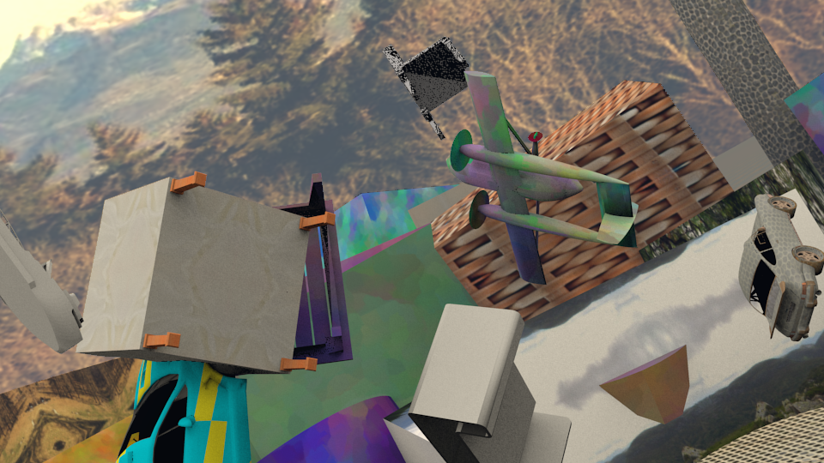
Things (Labeled)
Sintel (Unlabeled)
25,000 pairs labeled
1,000 frames unlabeled
$$Loss=ℓ_{sup}+λℓ_{self}$$
Pixel-wise loss e.g. L1 loss
Pixel-wise loss w/ pseudo-label

Slide 22
Validation Accuracy on Sintel Final
Supervised
Baseline Self-Supervision
Ours: FlowSupervisor

Slide 23
Experimental Results

Slide 24
Supervised (baseline) vs. Semi-supervised (ours)
Labeled data: Synthetic (Chairs + Things)
Target data: Sintel or KITTI
w/o label on target
Chairs
Things
Sintel Final
KITTI

Slide 25
Supervised (baseline) vs. Semi-supervised (ours)
Labeled data: C+T+S+K+H (Chairs + Things + Sintel + KITTI + HD1k)
Target data: Sintel or KITTI
w/ label on target
Sintel Final
KITTI

Slide 26
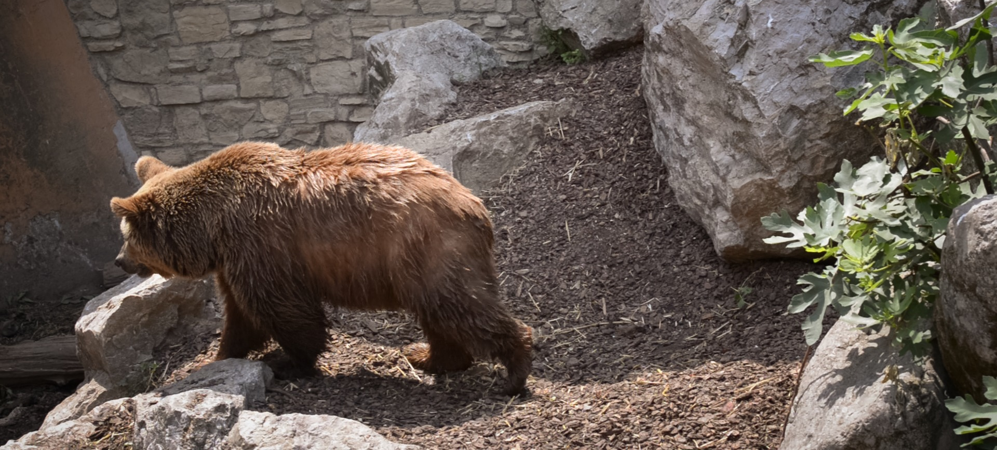
Application to Real-World Dataset (DAVIS)
Labeled datasets
Target dataset
(unlabeled)
+ others
Labeled Datasets (C+T+S+K+H)
DAVIS Dataset (3.5K)

Slide 27
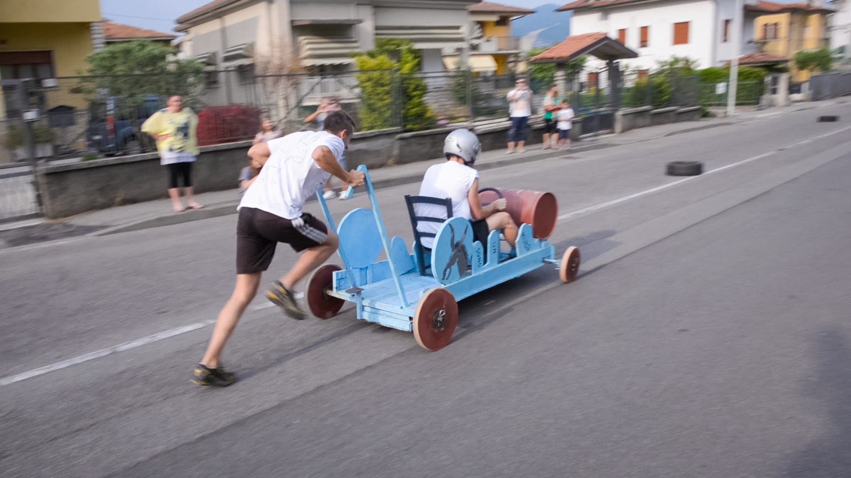
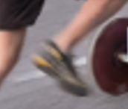
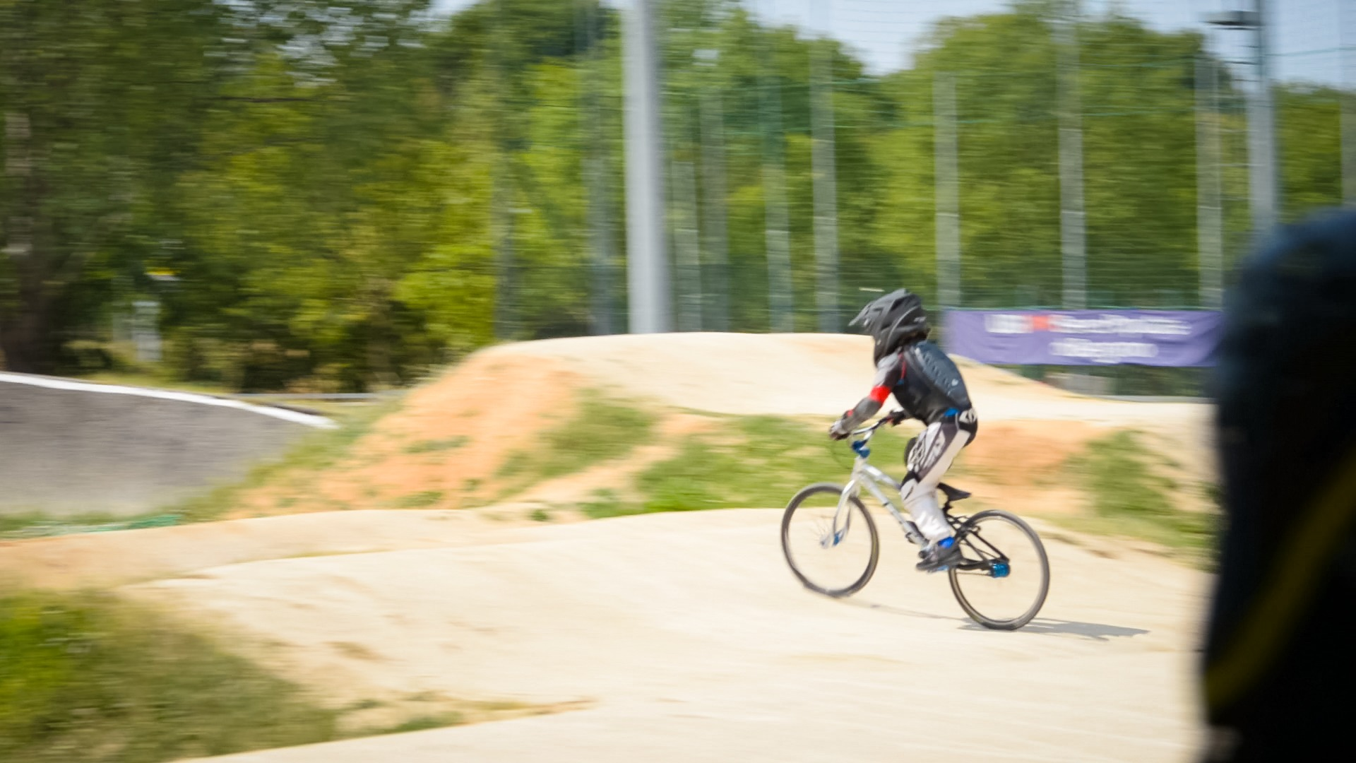
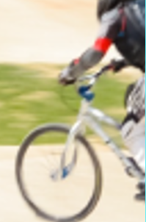
DAVIS dataset (real-world, 1080p)
Input
Supervised-only
(C+T+S+K+H)
Semi-supervised (ours)
(C+T+S+K+H)

Slide 28
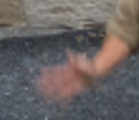
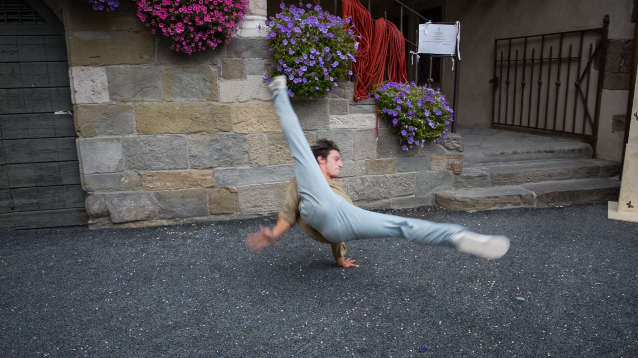
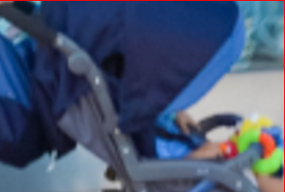
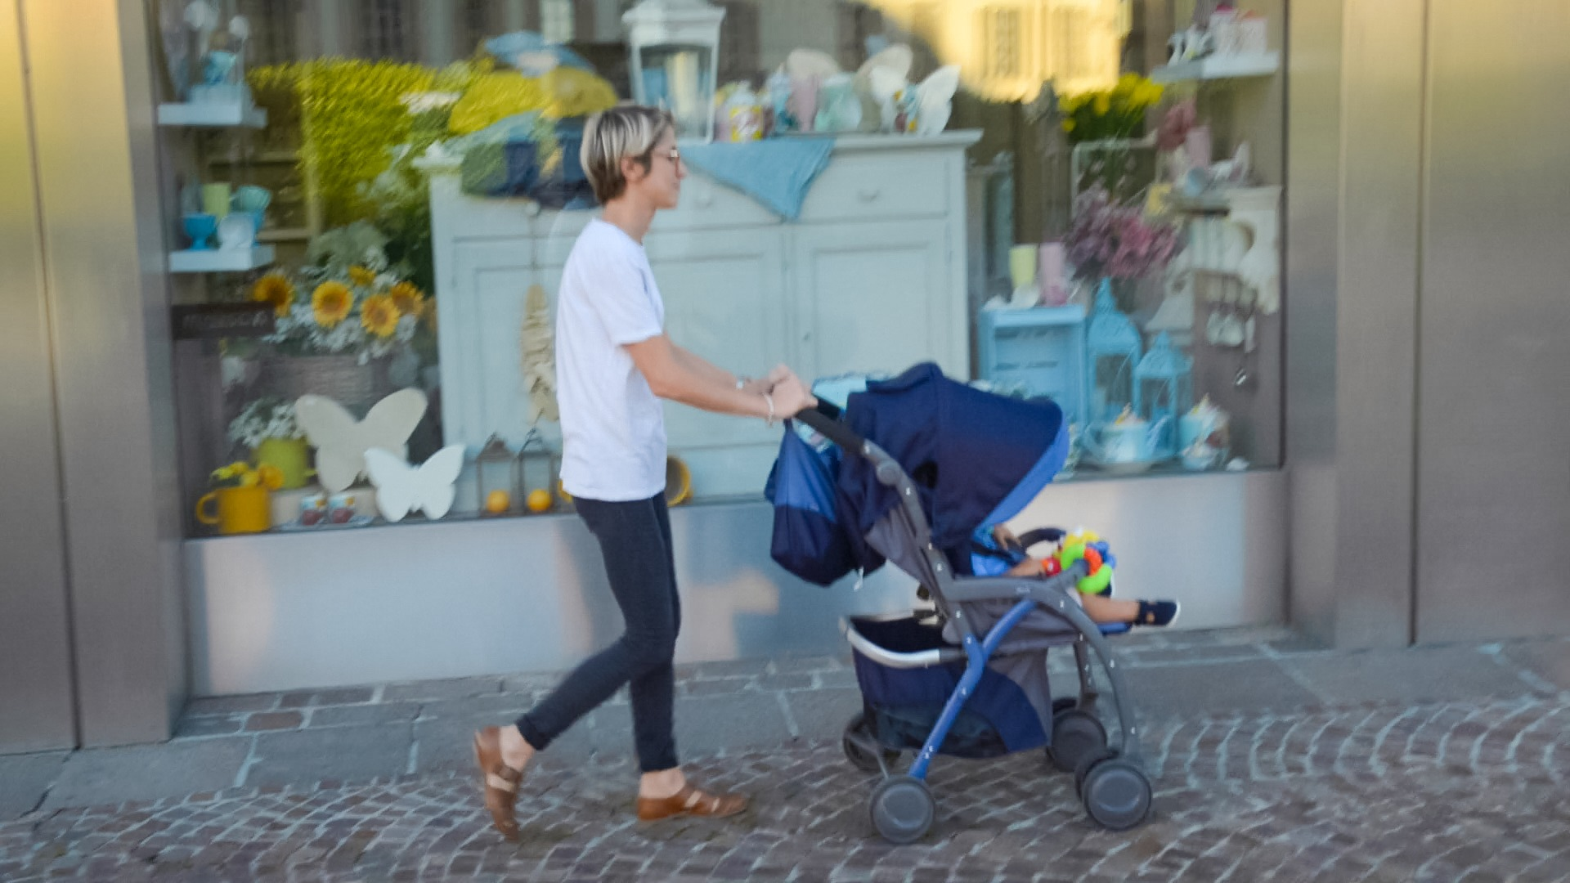
DAVIS dataset (real-world, 1080p)
Input
Supervised-only
(C+T+S+K+H)
Semi-supervised (ours)
(C+T+S+K+H)

Slide 29
Semi-Supervised Learning of Optical Flow by Flow Supervisor
Woobin Im Sebin Lee Sung-Eui Yoon
Project page sgvr.kaist.ac.kr/publication/ Flow-Supervisor
sgvr.kaist.ac.kr

