Slide 1
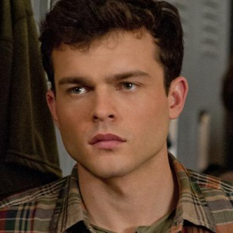
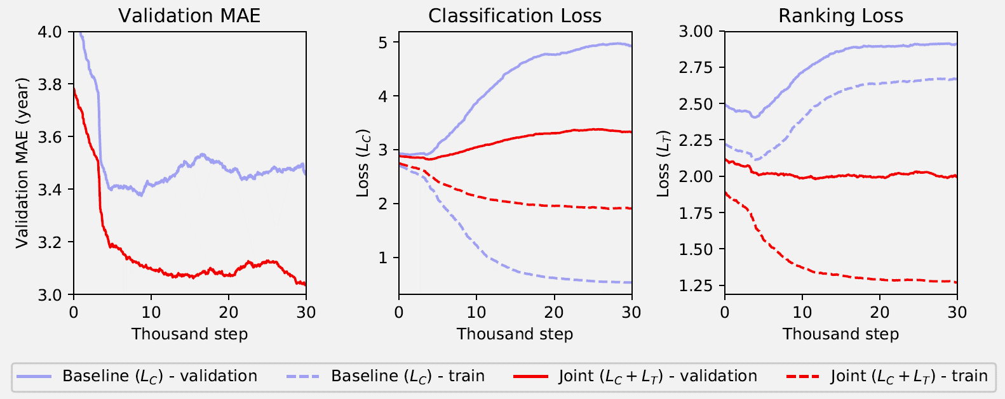
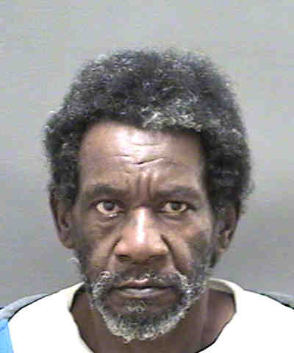
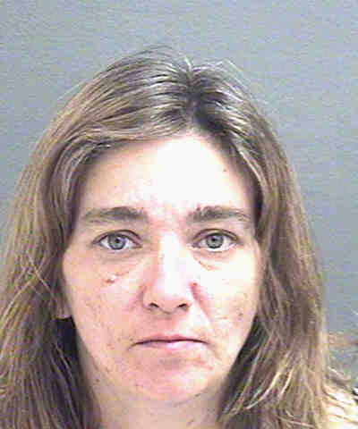
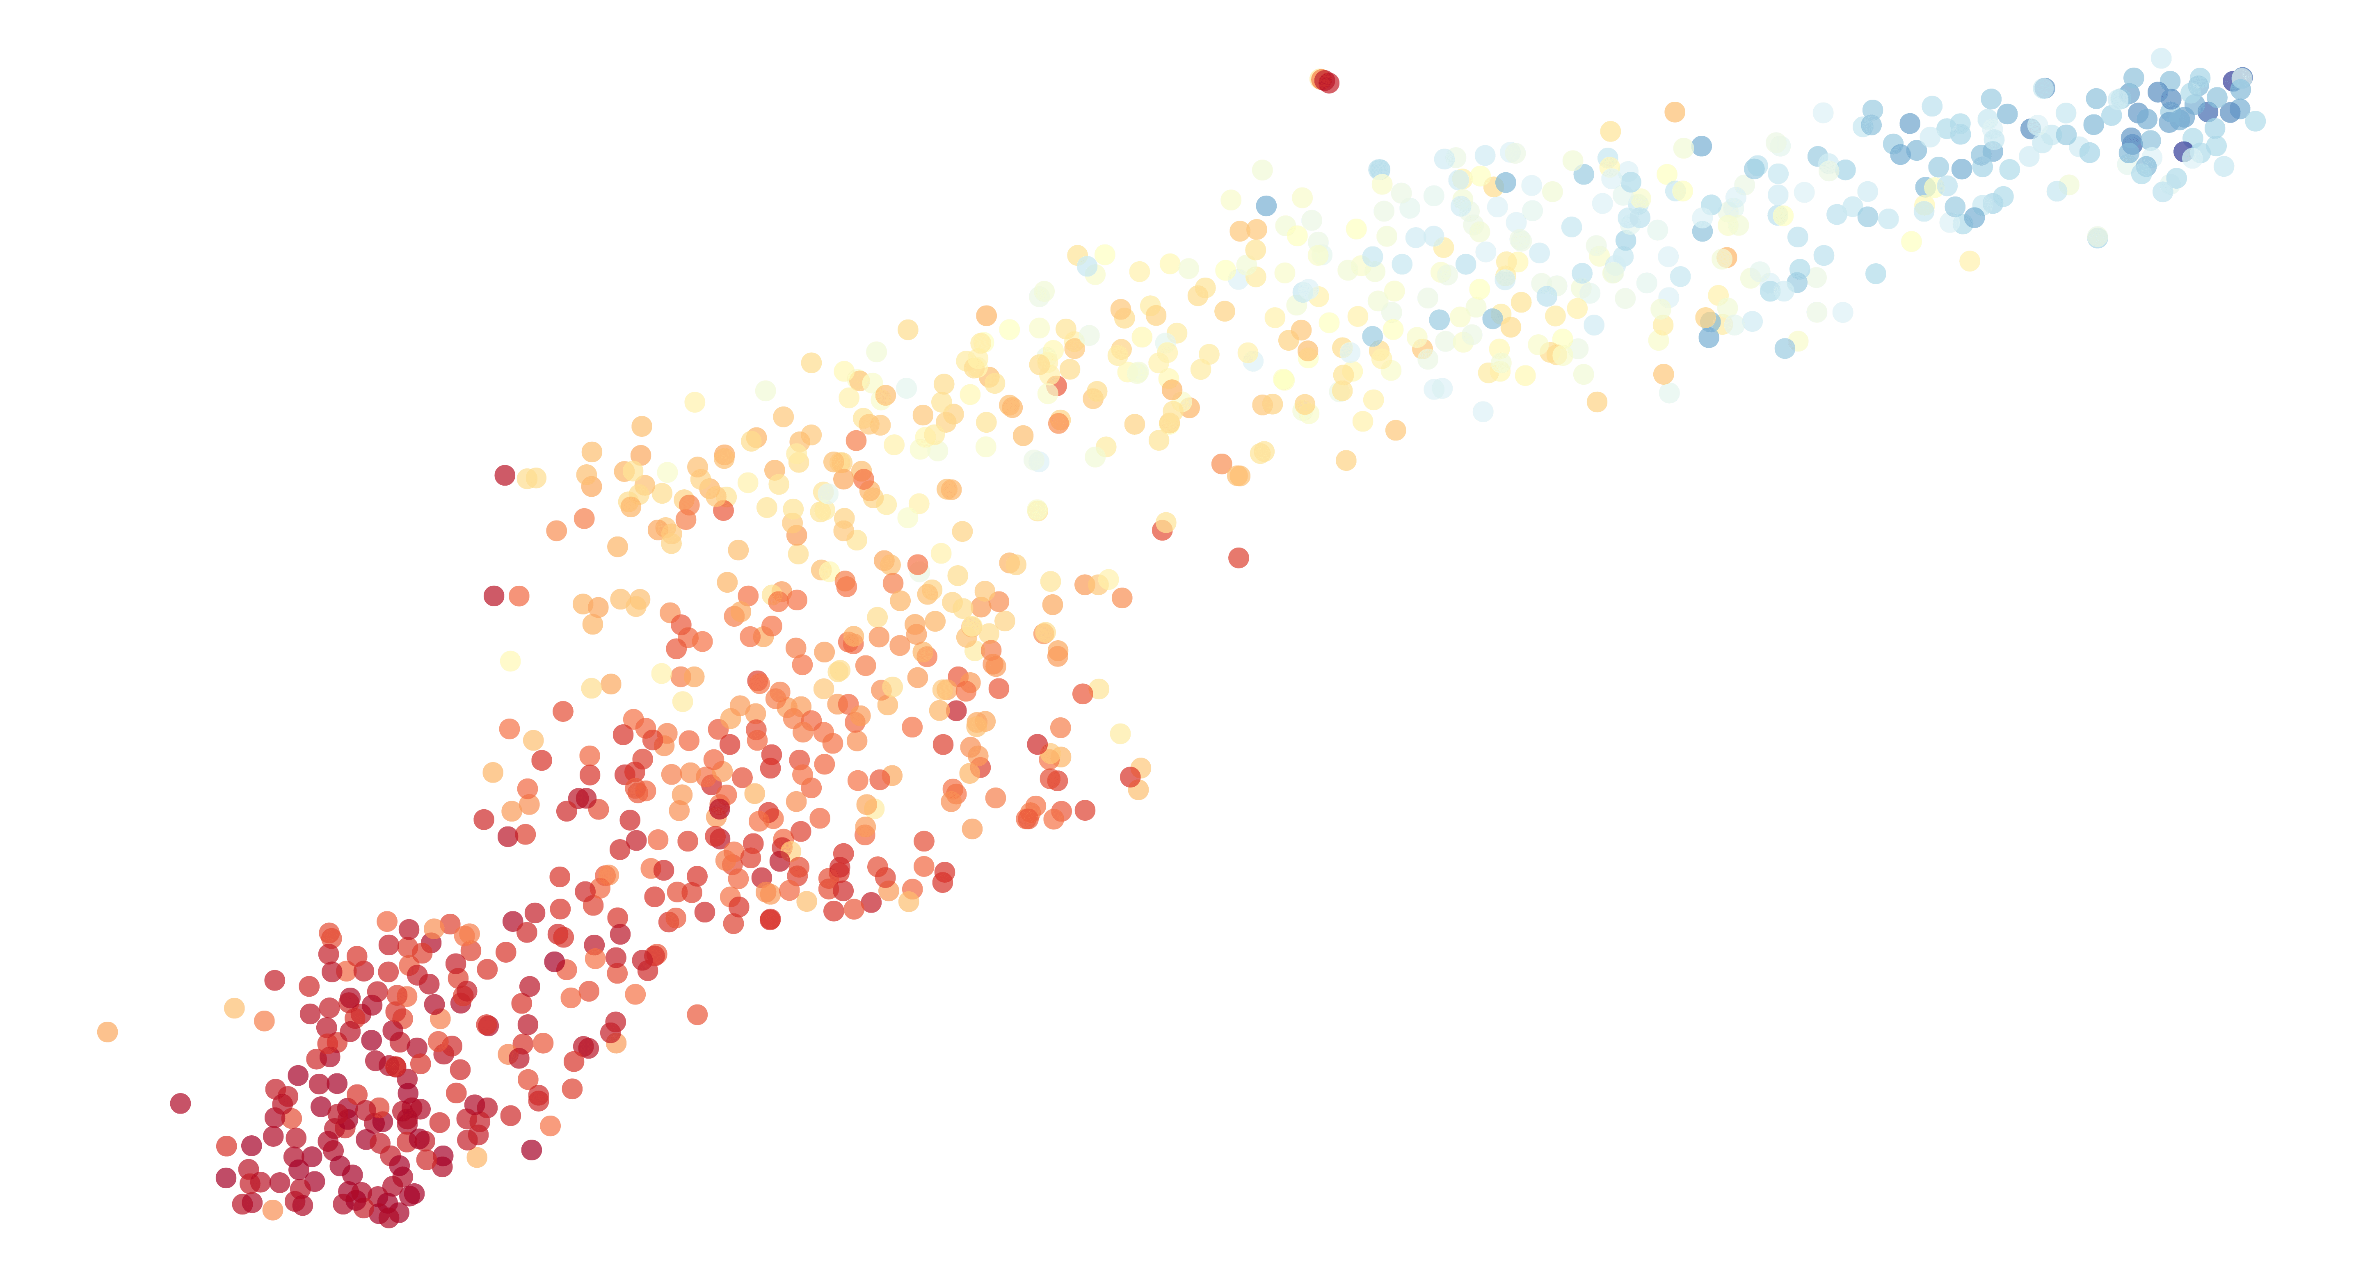
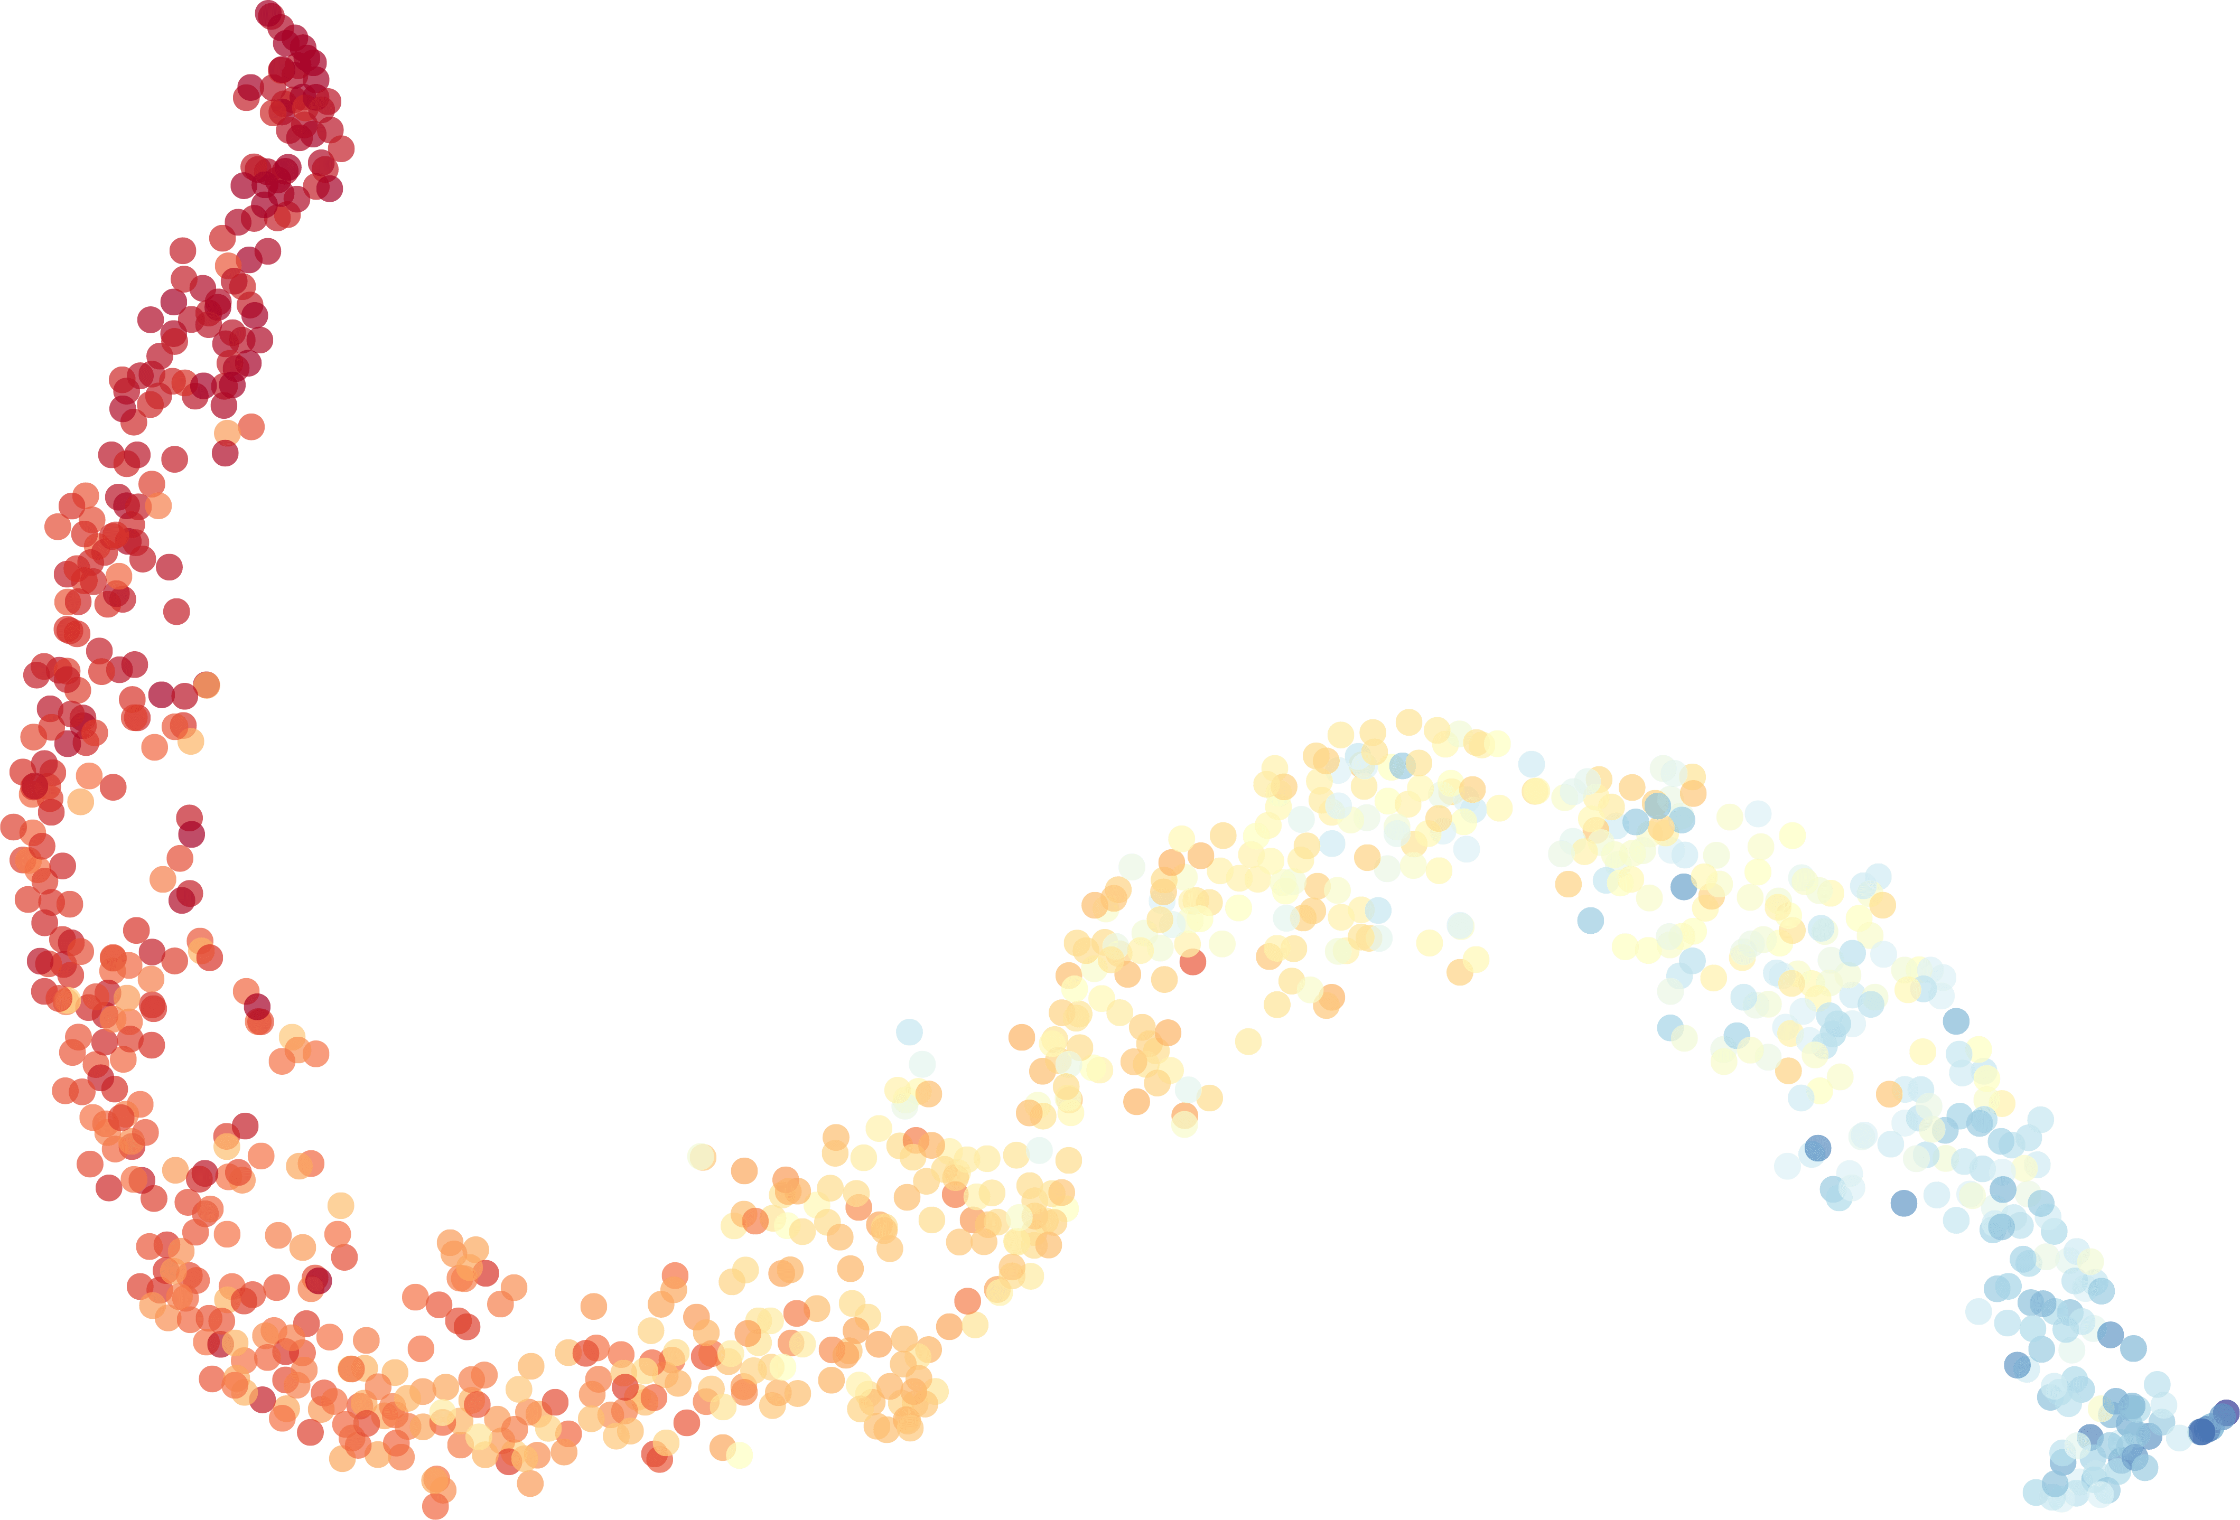
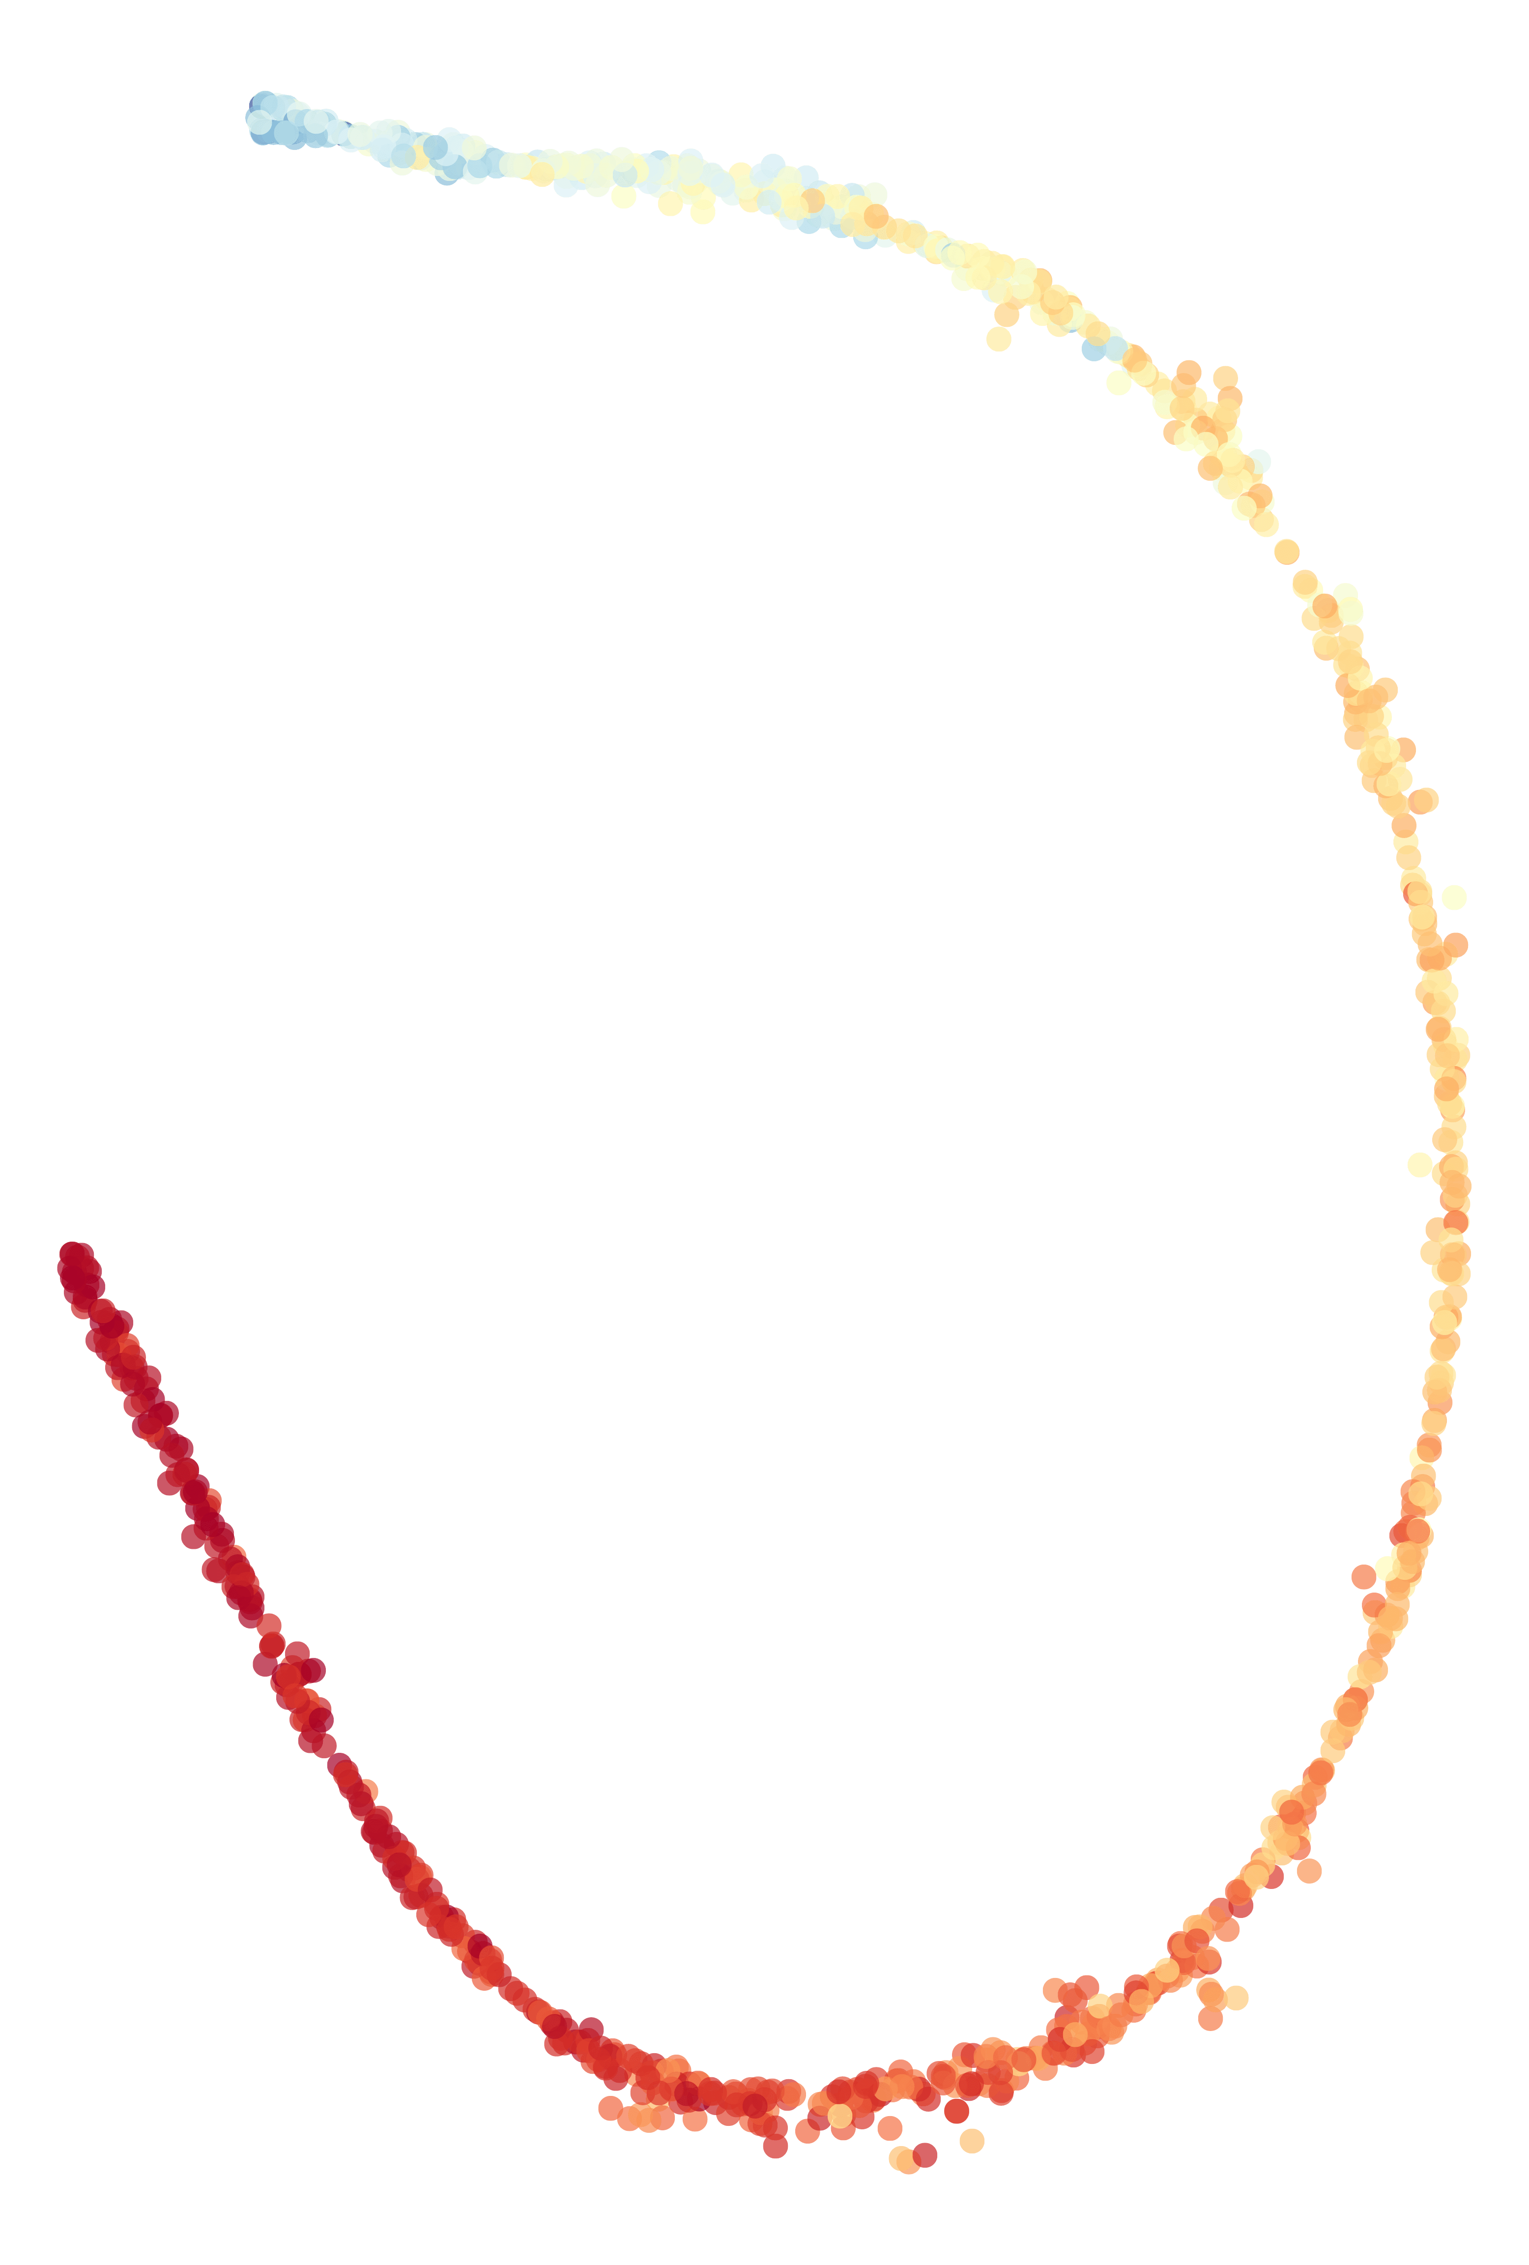
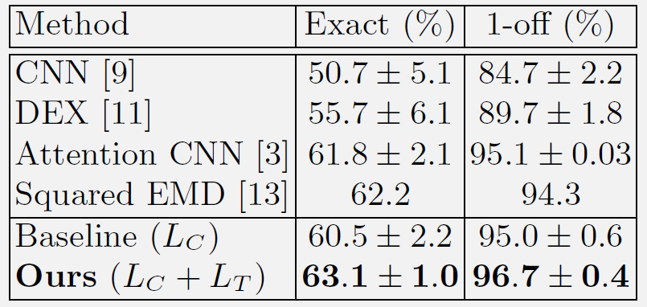
Scale-Varying Triplet Ranking with Classification Loss
for Facial Age Estimation
Project page
Code available at
You can find link at
Woobin Im, Sungeun Hong, Sung-Eui Yoon, Hyun S. Yang
1
4
Age Estimation
Estimating age group or age value from face images
Our Method - Overview
Softmax layer: age output from an input image
Scale-Varying Ranking: aids network learning by our suggested method
Goal: Joint Learning → classification + ranking = better age estimation
MODEL
23 years
2
Conventional CNN Approach (baseline)
Simple classification CNN performs quite well [1,2,3]
23!
5
Scale-Varying Ranking
3
Formulation
Distance normalization
Loss:
Weighting function:
Applying weight: $L_{T}=∑ω\left(f_{a},f_{p},f_{n}\right)⋅l_{T}(d_{+}, d_{−})$
Why good? (gradient analysis)
Conventional:
Ours:
With , two losses have the same direction, but only scale will be adjusted by the weighting function
Key-Idea:
Using Ordinal Property by Our Triplet Ranking
Classification
Affinity of labels
Ranking Loss [4]
Difference of labels
Scale-Varing Ranking Loss
Ordinal property of labels
Conventional triplet loss [4]:
$L=∑max(0, {\left\|a−p\right\|}_{2}^{2}−{\left\|a−n\right\|}_{2}^{2}+m$)
$m$: fixed margin constraint
→ every triplet has the same amount of loss
Scale-varying triplet loss:
$$L_{T}=∑ω\left(a,p,n\right)⋅l_{T}(d_{+}, d_{−})$$
$d_{+}, d_{−}$: normalized positive, negative distance
$ω\left(⋅\right)$: weighting function
→ triplets are not equally treated (see figure):
Triplet Selection
Conventional triplet samples contain 3 samples from dataset: $(a, p,n)$ where $a, p$ are in the same class, and $a, n$ are not.
Our relative triplet samples contain 3 samples from dataset: $(a, p,n)$ where $a, p$ are in closer age than the age difference between $a, n$.
$O(num_classes)$times more diverse samples than the conventional one
6
Experimental Results
Loss graph
Reference
[1] Rothe, R., Timofte, R., & van Gool, L.: Deep Expectation of Real and Apparent Age from a Single Image Without Facial Landmarks. IJCV (2016)
[2] Levi, G., Hassner, T.: Age and gender classification using convolutional neural
networks. In: CVPR Workshop (2015)
[3] Rodriguez, P., Cucurull, G., Gonfaus, J.M., Roca, F.X., Gonzalez, J.:Age and gender recognition in the wild with deep attention. Pattern Recognition (2017)
[4] Schroff, F., Kalenichenko, D., Philbin, J.: Facenet: A unified embedding for face
recognition and clustering. In: CVPR (2015)
Dataset
Experimental Settings
Base network: InceptionResnetV1
Pretrained on ILSVRC2012 or MS Celeb 1M
Adam optimizer with learning rate ($5×{10}^{−4}$)
Max steps: when validation accuracy converges
Results
Morph Album 2
Adience
MORPH Album 2
Adience
55k facial images of 13k people
25k facial unconstrained images
Feature visualization
Age
Only Classification
Conventional Triplet loss
Ours
Qualitative results
Acknowledgements
This work was supported by Institute for Information & Communications Technology Promotion(IITP) grant funded by the Korea government(MSIT) [2016-0-00562(R0124-16-0002), Emotional Intelligence Technology to Infer Human Emotion and Carry on Dialogue Accordingly], and NRF [NRF-2017M3C4A7066317].

