Slide 1
Unsupervised Learning of Optical Flow with Deep Feature Similarity
Woobin Im¹ Tae-Kyun Kim^{2,1} Sung-eui Yoon¹
¹
²

Slide 2
Background

Slide 3
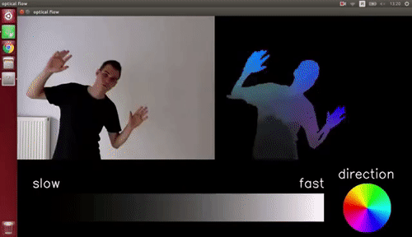
Optical Flow
Describes motion in a sequence of images
Image from: https://gfycat.com/wetcreepygecko

Slide 4
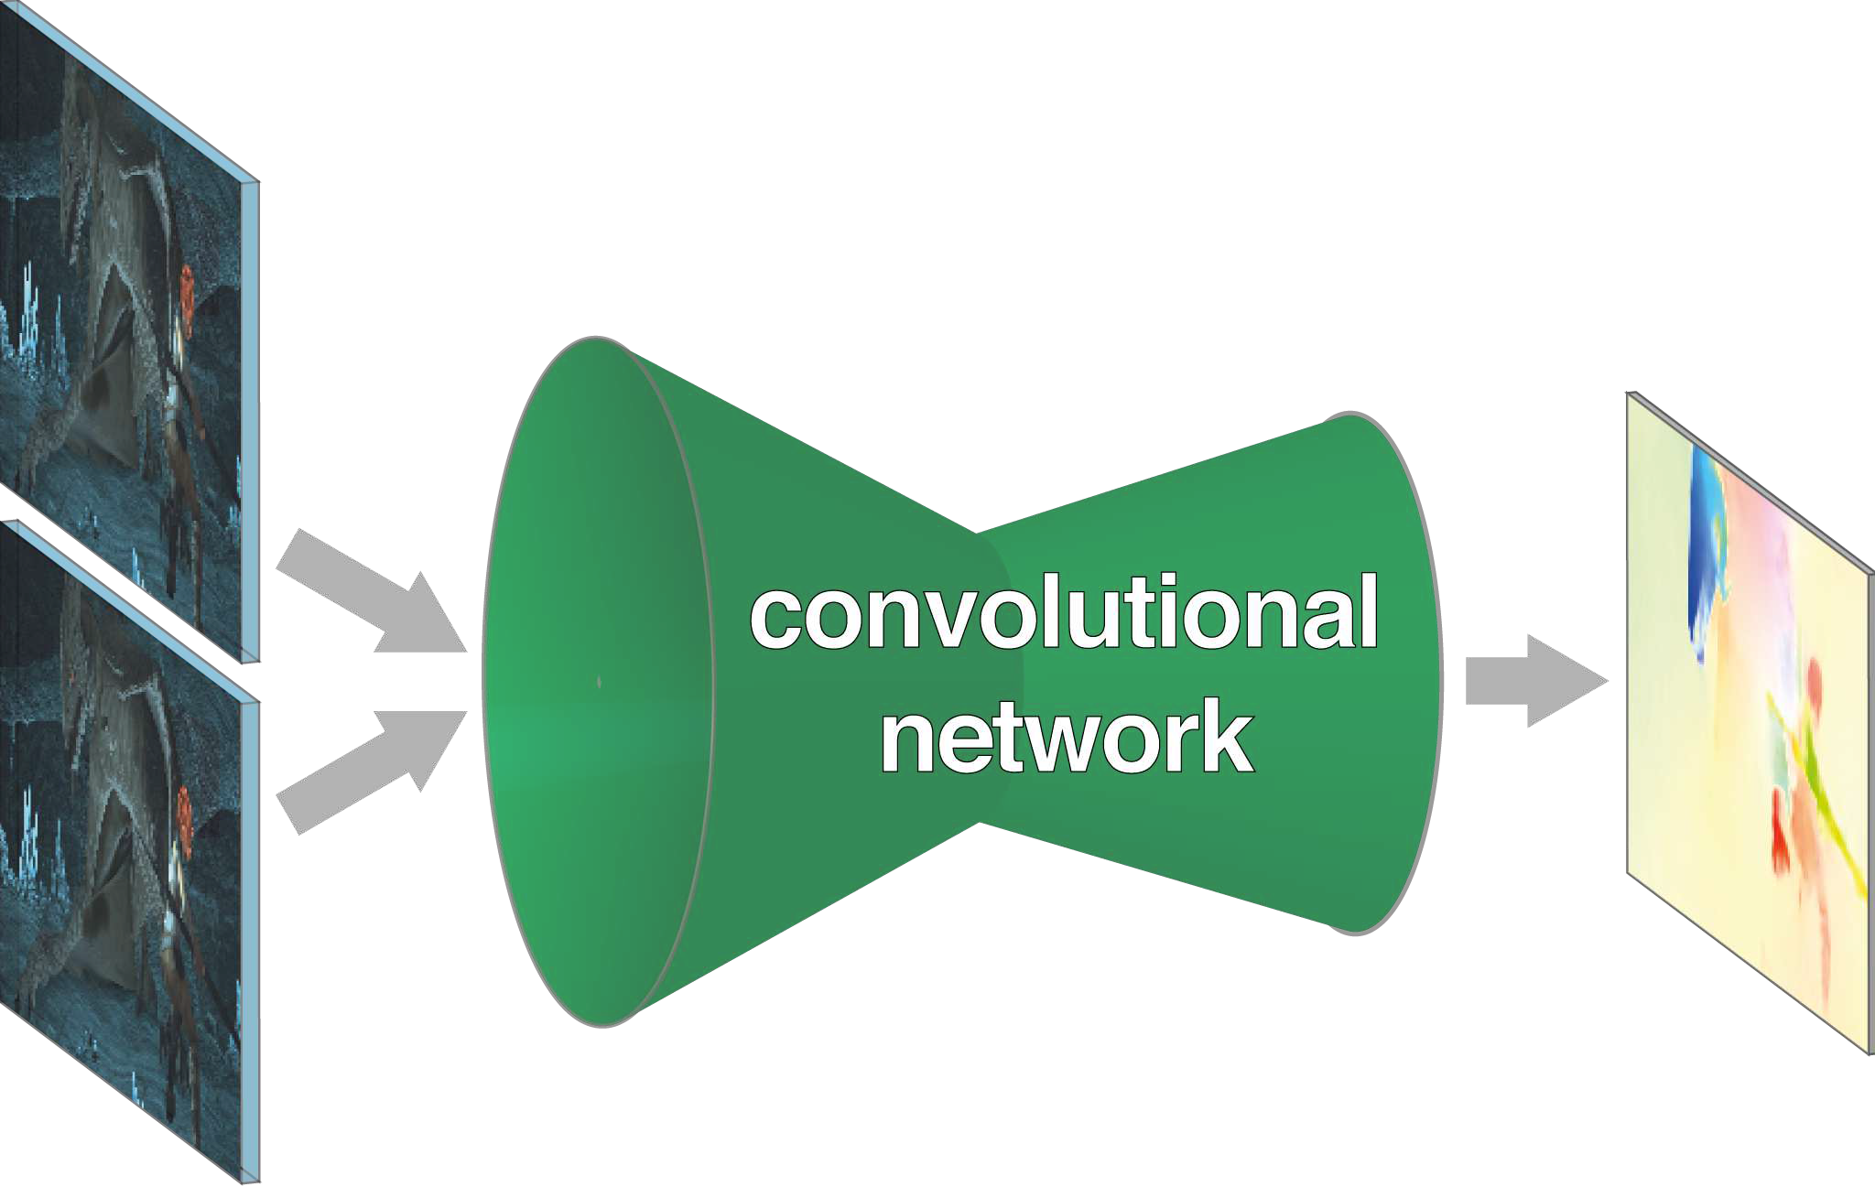
Deep end-to-end optical flow
FlowNet (ICCV 2015)
FlowNet 2.0 (CVPR 2017)
PWC-Net (CVPR 2018)
…
Figure from: FlowNet: Learning Optical Flow with Convolutional Networks, ICCV 2015

Slide 5
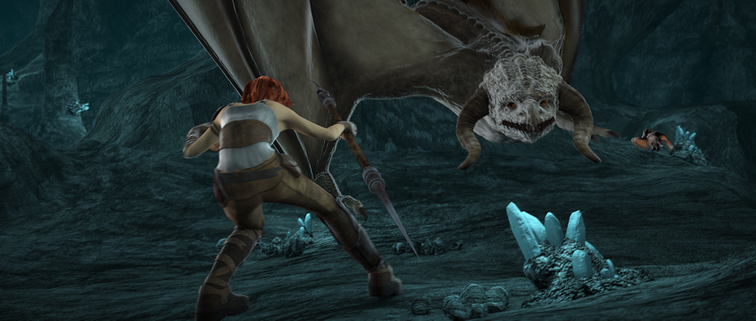
Video
Dense Optical Flow
Deep CNN
Key

Slide 6
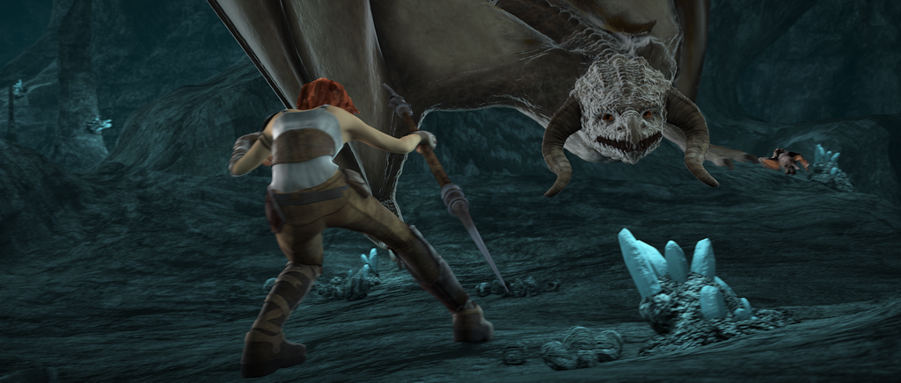
Photometric Loss (RGB consistency)
t
Guide w/o GT
Deep CNN
t+1

Slide 7
Photometric loss
Image 1
Image 2
Images from Occlusion Aware Unsupervised Learning of Optical Flow, CVPR 2018

Slide 8
Photometric loss
Image 1
Prediction
Ground-truth
Image 2
Images from Occlusion Aware Unsupervised Learning of Optical Flow, CVPR 2018

Slide 9
Photometric loss
Image 1
Prediction
Ground-truth
Image 2
Warped (b) by (e)
Warped (b) by (c)
Images from Occlusion Aware Unsupervised Learning of Optical Flow, CVPR 2018

Slide 10
Photometric loss
Image 1
Prediction
Ground-truth
Image 2
Warped (b) by (e)
Warped (b) by (c)
Images from Occlusion Aware Unsupervised Learning of Optical Flow, CVPR 2018

Slide 11
Photometric loss
Image1
Image 1
Flow (a) → (b)
Pixel loss (e.g. l2 loss)
Prediction
W
Image 2
Differentiable
Warped (b) by (e)
Images from Occlusion Aware Unsupervised Learning of Optical Flow, CVPR 2018

Slide 12
Photometric loss
(e) gets better, (f) will be close to (a)
Image1
Image 1
Flow (a) → (b)
Pixel loss (e.g. l2 loss)
Prediction
W
Image 2
Differentiable
Warped (b) by (e)
Images from Occlusion Aware Unsupervised Learning of Optical Flow, CVPR 2018

Slide 13
Motivation

Slide 14
RGB is not sufficient!
Prediction flow gets better, (f) will be close to (a)
Image1
Pixel loss (e.g. l2 loss)
Warped (b) by (e)

Slide 15
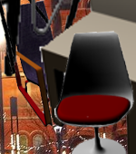
Similarity
$$t$$
$$t+1$$

Slide 16
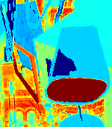
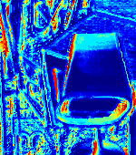
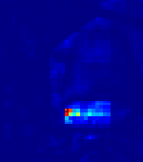
Similarity
$$t$$
$$t+1$$
Most discriminative!
RGB
Census
(handcraft feature)
Deep feature (self-supervised)

Slide 17
t
Deep CNN (PWC-Net)
t+1
Estimated flow

Slide 18
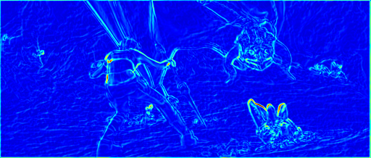
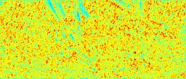
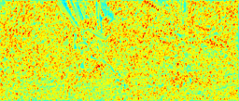
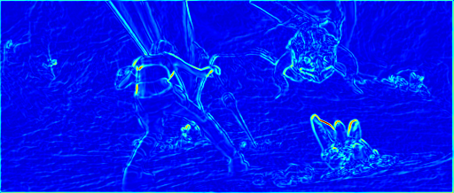
t
Deep CNN (PWC-Net)
t+1
Estimated flow
t
t+1
Multi-layer features

Slide 19
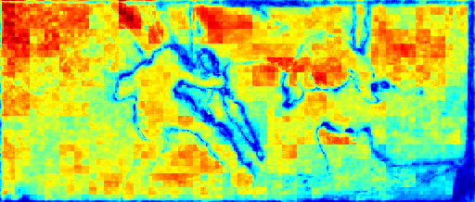
Unsupervised update
Unsupervised update
This evaluates the matching quality
t
Deep CNN (PWC-Net)
Estimated flow
Build similarity map (fused similarity)
t+1
t
Calculate loss
t+1
Fused similarity
Multi-layer features

Slide 20
Our method 1. Similarity map

Slide 21
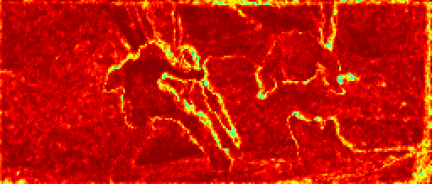
Estimated flow
t
t+1
Input
DNN
DNN
Resize
Conv feature at layer $l$
Normailize
Normailize
Inner product
Warp
Normailize
Similarity at layer $l$ ($sim_{l}$)

Slide 22
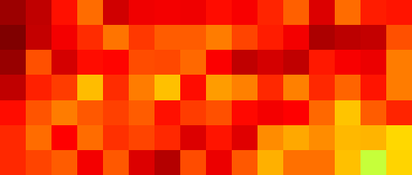
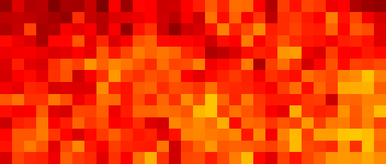
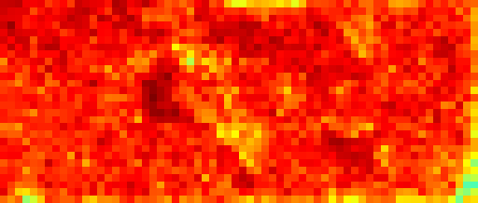
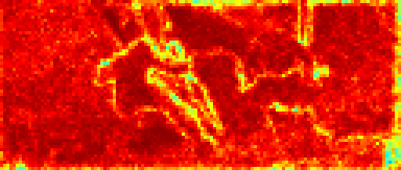
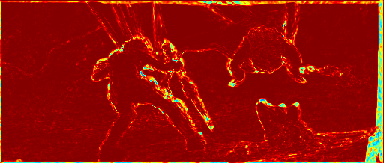
Estimated flow
Product fusion
DNN
$$sim_{1}$$
$$sim_{2}$$
DNN
$$sim_{3}$$
$$sim_{4}$$
Fusion
$$sim_{5}$$
$$sim_{6}$$
Multi-layer similarity maps
Fused similarity
Conv features
Input Images

Slide 23
Our method 2. Loss functions

Slide 24
More details are available in the paper! (sec 3.3)
Feature separation loss
Regulated census loss
+ Conditional smoothness loss
+ Data distllation loss (AAAI 2019)

Slide 25
More details are available in the paper! (sec 3.3)
Feature separation loss
Learn feature and flow jointly
Reduce ambiguity in feature & flow

Slide 26
Feature separation loss (ours)
Naïve approach

Slide 27
Estimated flow
Build similarity map (fused similarity)
t
t+1
Fused similarity
Multi-layer features

Slide 28
Naïve approach
Similarity center (k)

Slide 29
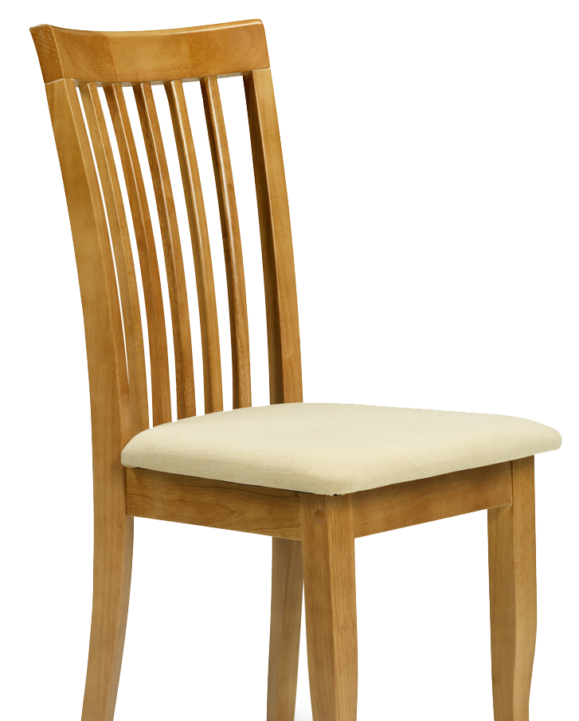
Naïve approach
Similarity center (k)

Slide 30
Naïve approach
Similarity center (k)
We should avoid matching ‘ambiguous’ pixels!
Notes:
Here we visualize the distribution of the similarity.
The x axis displays the distance of similarity values from the similarity center k.
Which means, the similarity values are condensed into the middle area.

Slide 31
Feature similarity distribution of matched spatial points on Sintel train dataset (Fig. 5)
Similarity center (k)
Fused similarity (est.)
Unsupervised baseline
from similarity center
Similarity center
Far from center = confident estimation

Slide 32
Feature similarity distribution of matched spatial points on Sintel train dataset (Fig. 5)
Similarity center (k)
Fused similarity (est.)
Unsupervised baseline
Ambiguous matching
from similarity center
Similarity center
Far from center = confident estimation

Slide 33
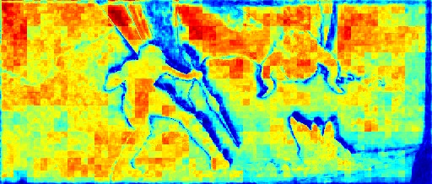
Feature similarity distribution of matched spatial points (Fig. 5)
Similarity center
Unsupervised baseline
Ground-truth
from similarity center
from similarity center
Fused similarity (est.)
Fused similarity (GT)

Slide 34
Feature separation loss
Similarity threshold
$$L_{f}$$
$$k$$
$$sim_{f}$$
Separates feature
similarty

Slide 35
Feature similarity distribution of matched spatial points (Fig. 5)
Unsupervised baseline
w/ feature separation loss
Ground-truth
from similarity center
from similarity center
from similarity center

Slide 36
More details are available in the paper! (sec 3.3)
Feature separation loss
Regulated census loss
+ Conditional smoothness loss
+ Data distllation loss (AAAI 2019)

Slide 37
More details are available in the paper! (sec 3.3)
Regulated census loss
our similarity map as a mask
Census photometric loss
Helps to generate precise flow results
Compensate for low-resolution of deep features

Slide 38
More details are available in the paper! (sec 3.3)
Final loss term
DD loss (DDFlow; AAAI19)
Smoothness loss
Feature separation loss
Regulated census loss

Slide 39
Unsupervised update
Unsupervised update
t
Deep CNN (PWC-Net)
Estimated flow
Build similarity map (fused similarity)
t+1
t
Calculate loss
t+1
Fused similarity
Multi-layer features

Slide 40
Results

Slide 41
Ablation study (average end-point-error) Lower is better
More results are available in the paper! (table 1)
 | Feature separation | Regulated census | FlyingChairs | Sintel Clean | Sintel Final
Baseline (DDFlow) | ❌ | ❌ | 2.93 | 3.15 | 3.86
 | ❌ | ✔️ | 2.81 | 2.91 | 3.62
 | ✔️ | ❌ | 2.87 | 3.25 | 4.15
Ours | ✔️ | ✔️ | 2.69 | 2.86 | 3.57

Slide 42
Ablation study (average end-point-error) Lower is better
More results are available in the paper! (table 1)
 | Feature separation | Regulated census | FlyingChairs | Sintel Clean | Sintel Final
Baseline (DDFlow) | ❌ | ❌ | 2.93 | 3.15 | 3.86
 | ❌ | ✔️ | 2.81 | 2.91 | 3.62
 | ✔️ | ❌ | 2.87 | 3.25 | 4.15
Ours | ✔️ | ✔️ | 2.69 | 2.86 | 3.57

Slide 43
Ablation study (average end-point-error) Lower is better
More results are available in the paper! (table 1)
 | Feature separation | Regulated census | FlyingChairs | Sintel Clean | Sintel Final
Baseline (DDFlow) | ❌ | ❌ | 2.93 | 3.15 | 3.86
 | ❌ | ✔️ | 2.81 | 2.91 | 3.62
 | ✔️ | ❌ | 2.87 | 3.25 | 4.15
Ours | ✔️ | ✔️ | 2.69 | 2.86 | 3.57
Suffers from low-resolution problem

Slide 44
Ablation study (average end-point-error) Lower is better
More results are available in the paper! (table 1)
 | Feature separation | Regulated census | FlyingChairs | Sintel Clean | Sintel Final
Baseline (DDFlow) | ❌ | ❌ | 2.93 | 3.15 | 3.86
 | ❌ | ✔️ | 2.81 | 2.91 | 3.62
 | ✔️ | ❌ | 2.87 | 3.25 | 4.15
Ours | ✔️ | ✔️ | 2.69 | 2.86 | 3.57
Best

Slide 45
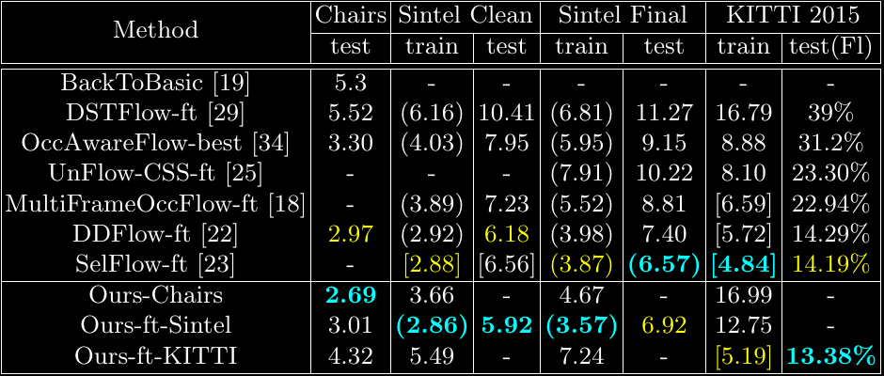
Comparison to other methods
2nd-best
Best
( ): unsupervised training on the evaluation set
[ ]: unsupervised training on ‘related’ set

Slide 46
Qualitative results

Slide 47
Input image
Ground-truth
Estimated flow
DDFlow
Ours
Feature Separation
Fused Similarity

Slide 48
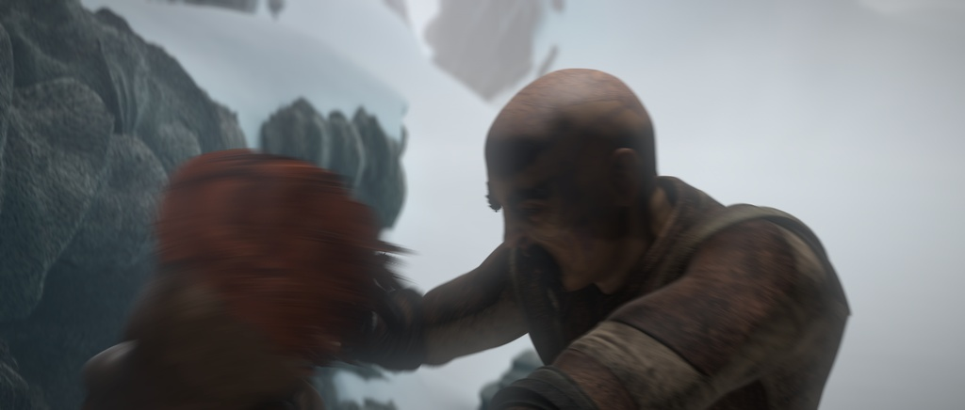
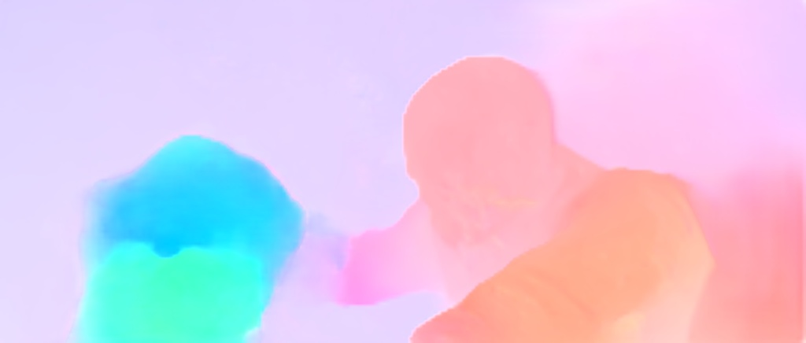
Input image
Ground-truth
Estimated flow
DDFlow
Ours
Feature Separation
Fused Similarity

Slide 49
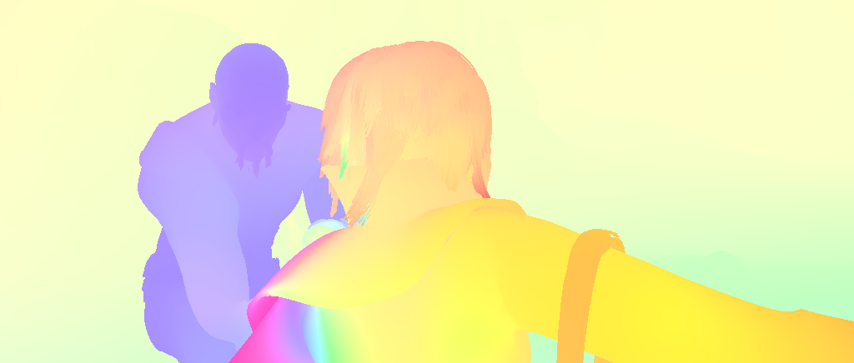
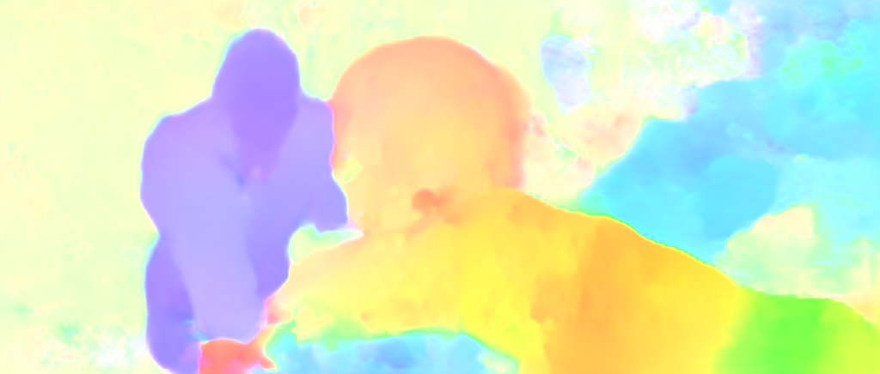
Dataset: Sintel Test
Input
Ground-truth
Previous work (SelFlow; CVPR 2020)

Slide 50
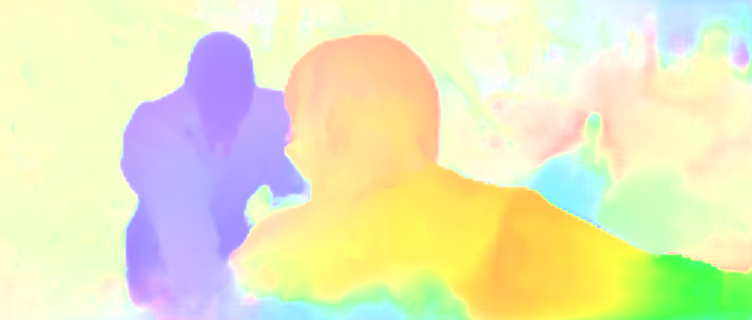
Dataset: Sintel Test
Input
Ground-truth
Ours

Slide 51
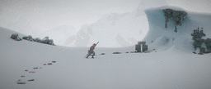
Dataset: Sintel Test
Input
Ground-truth
Previous work (SelFlow; CVPR 2020)

Slide 52
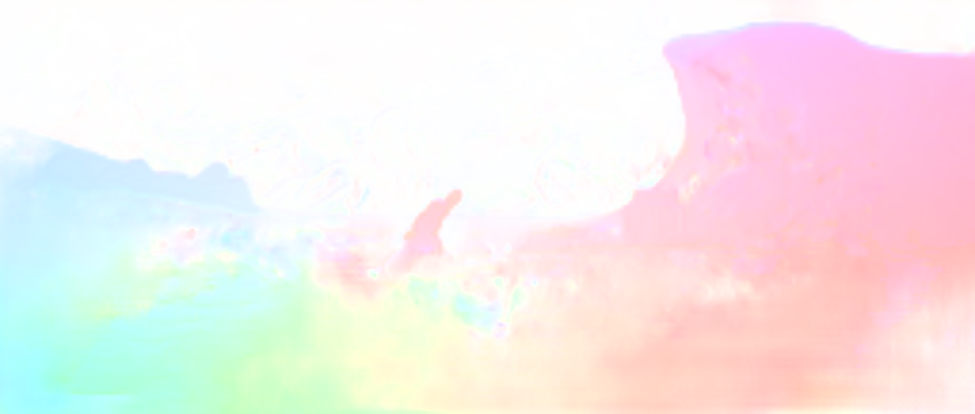
Dataset: Sintel Test
Input
Ground-truth
Ours

Slide 53
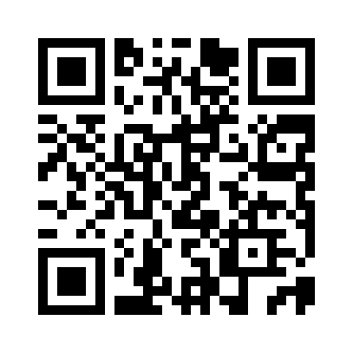
Project page: https://sgvr.kaist.ac.kr/publication/unsupsimflow/

